Slide 1
Resources for Our Families of the SDS Community

Slide 2
Categories of Resources
SDS Google Drive
Government Agencies - DMH, DHSS, Federal agencies
Nonprofit Groups
ARC, Easter seals, UCP, etc.
St Louis Advocate – Larry Opinsky
School Districts (home districts and SSD) & Universities
Subscriptions (magazines and online) – Documentaries
Internet Groups
Facebook, twitter, Instagram, etc.
Recreation

Slide 3
https://mosds.org/

Slide 5
Click on Knowledgebase at top to access Google Drive

Slide 6
SSD Google Drive

Slide 7
Government Agencies
Federal – Various
State – DMH & DHSS
UMKC Institute for Human Development
Charting the Lifecourse

Slide 9
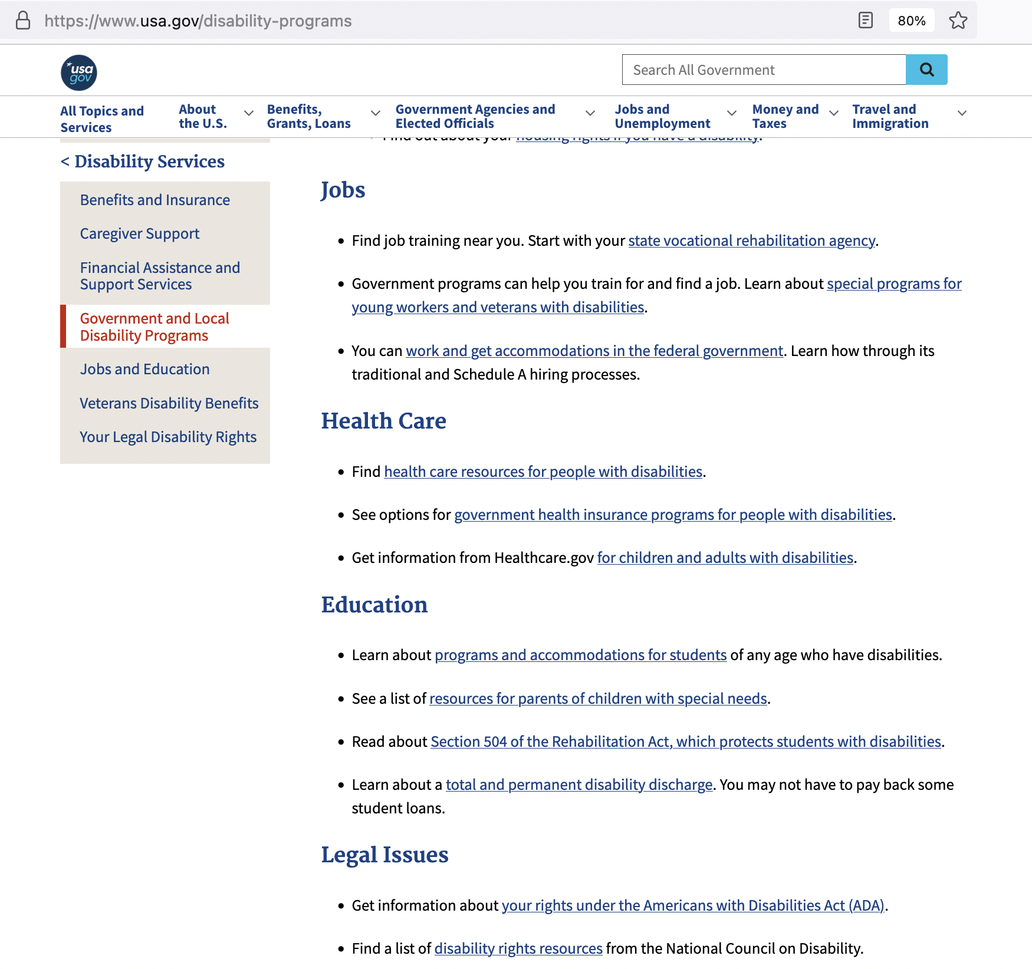

Slide 10
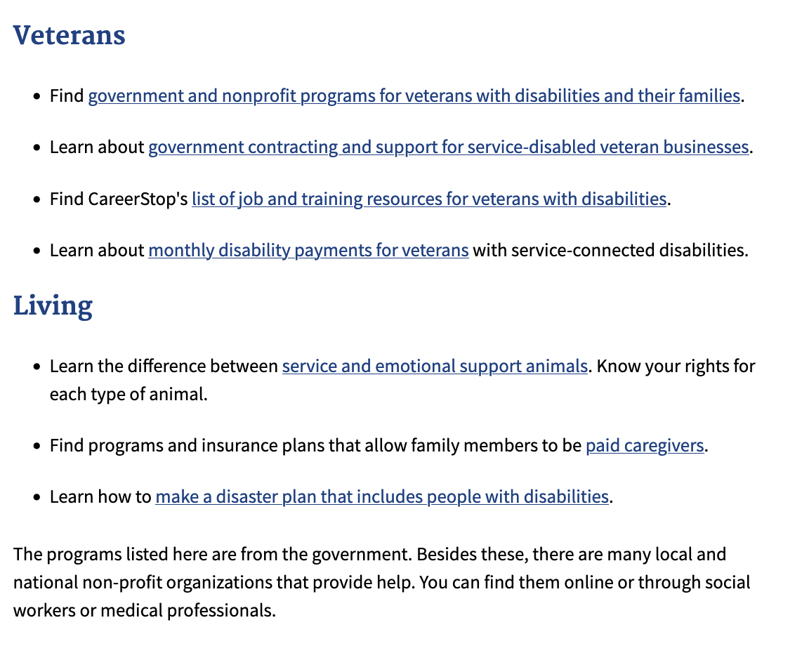

Slide 11
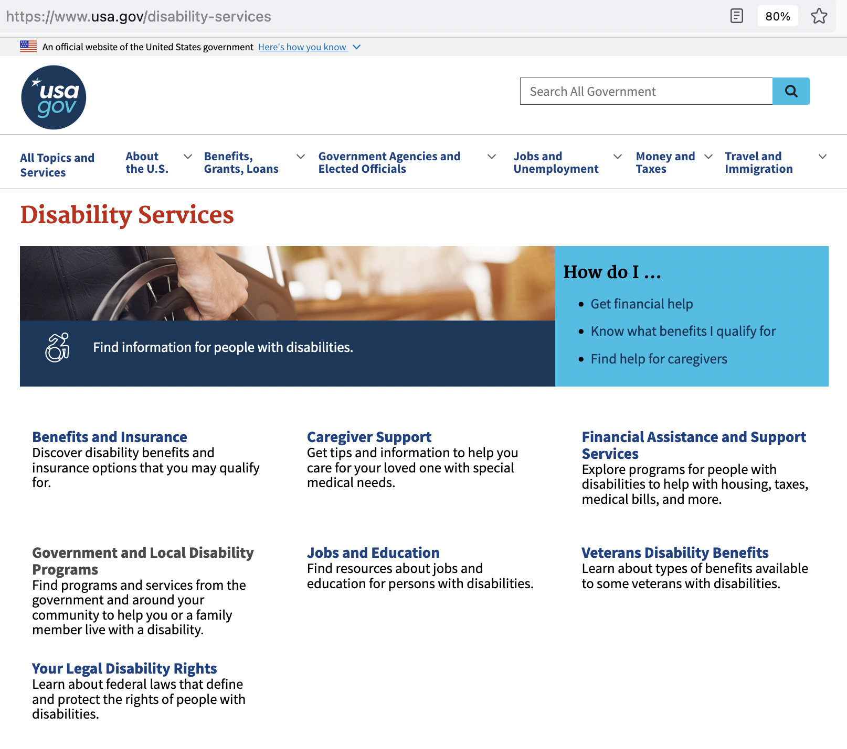

Slide 12
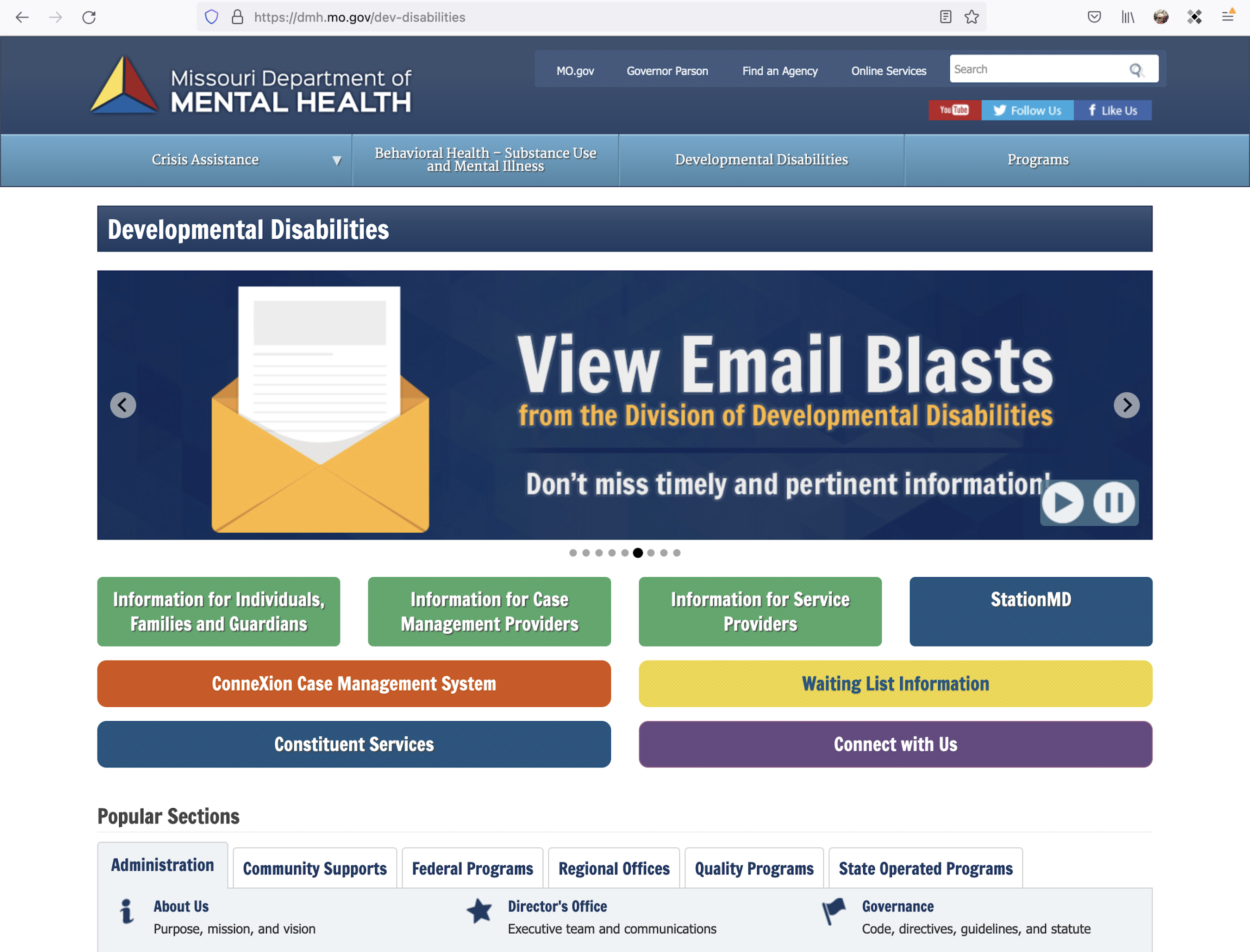

Slide 13
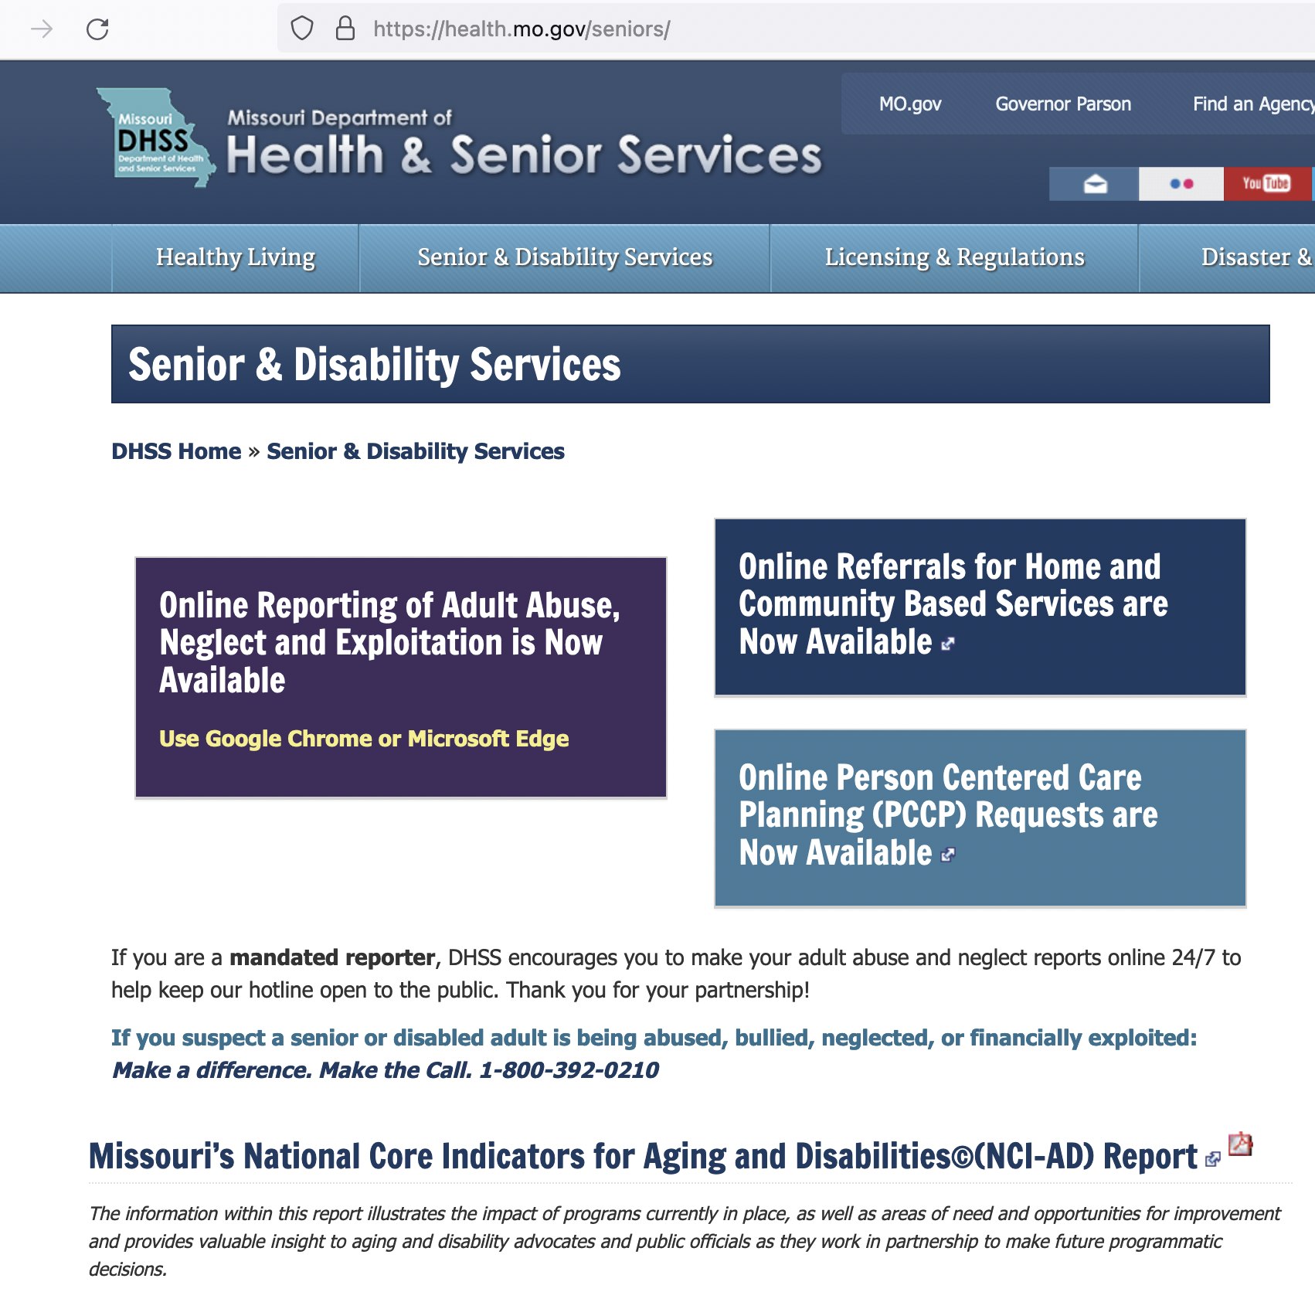

Slide 14
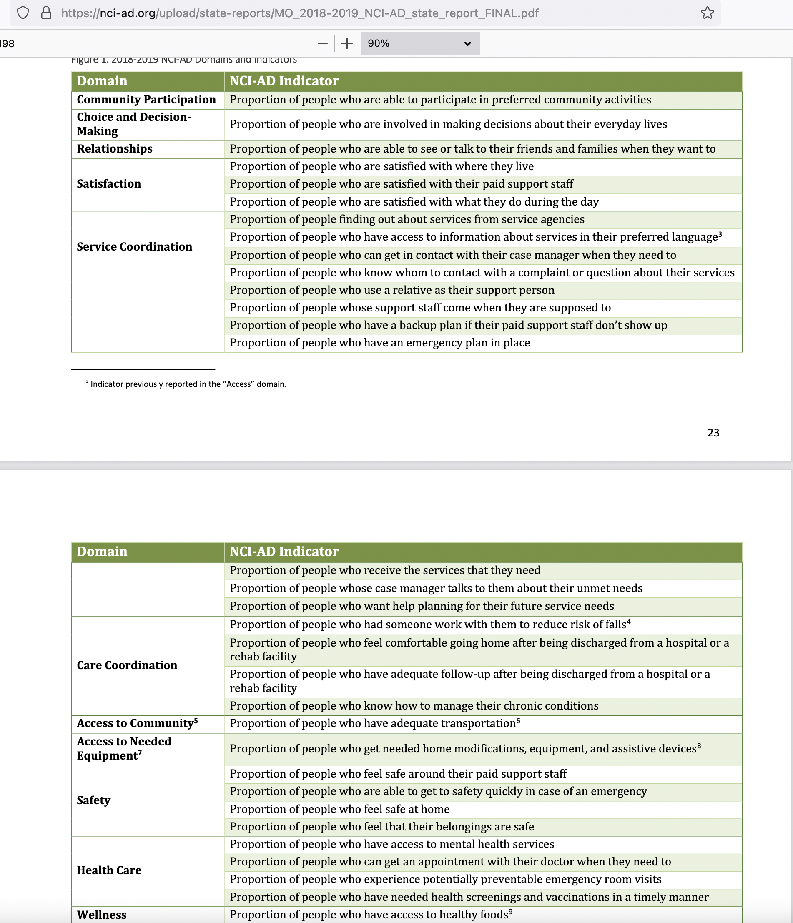

Slide 15
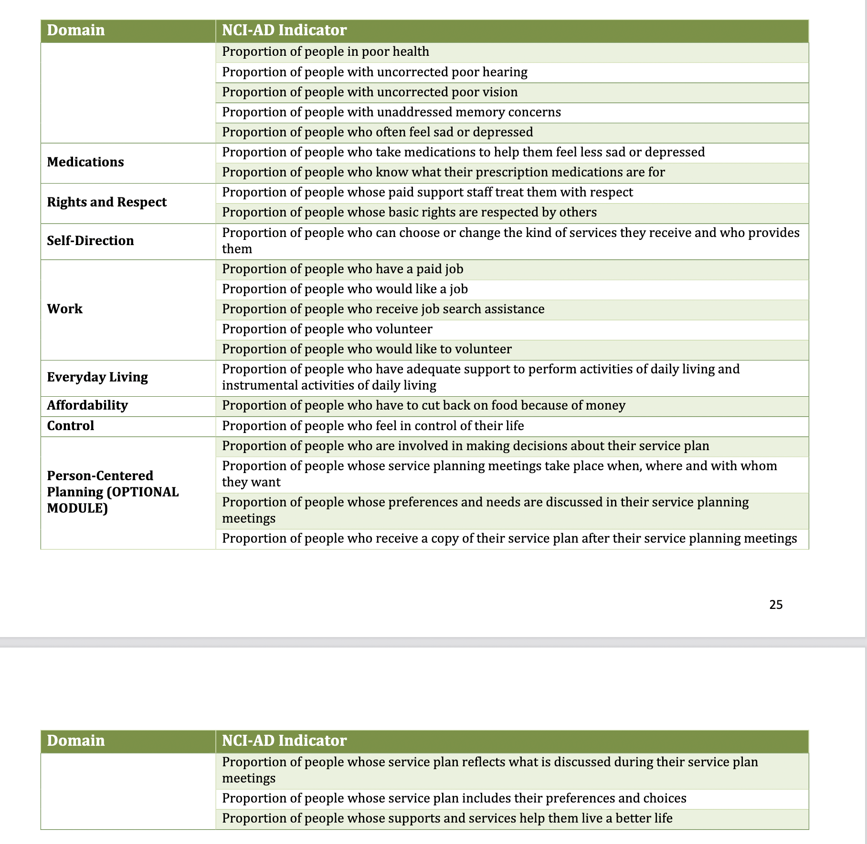

Slide 16
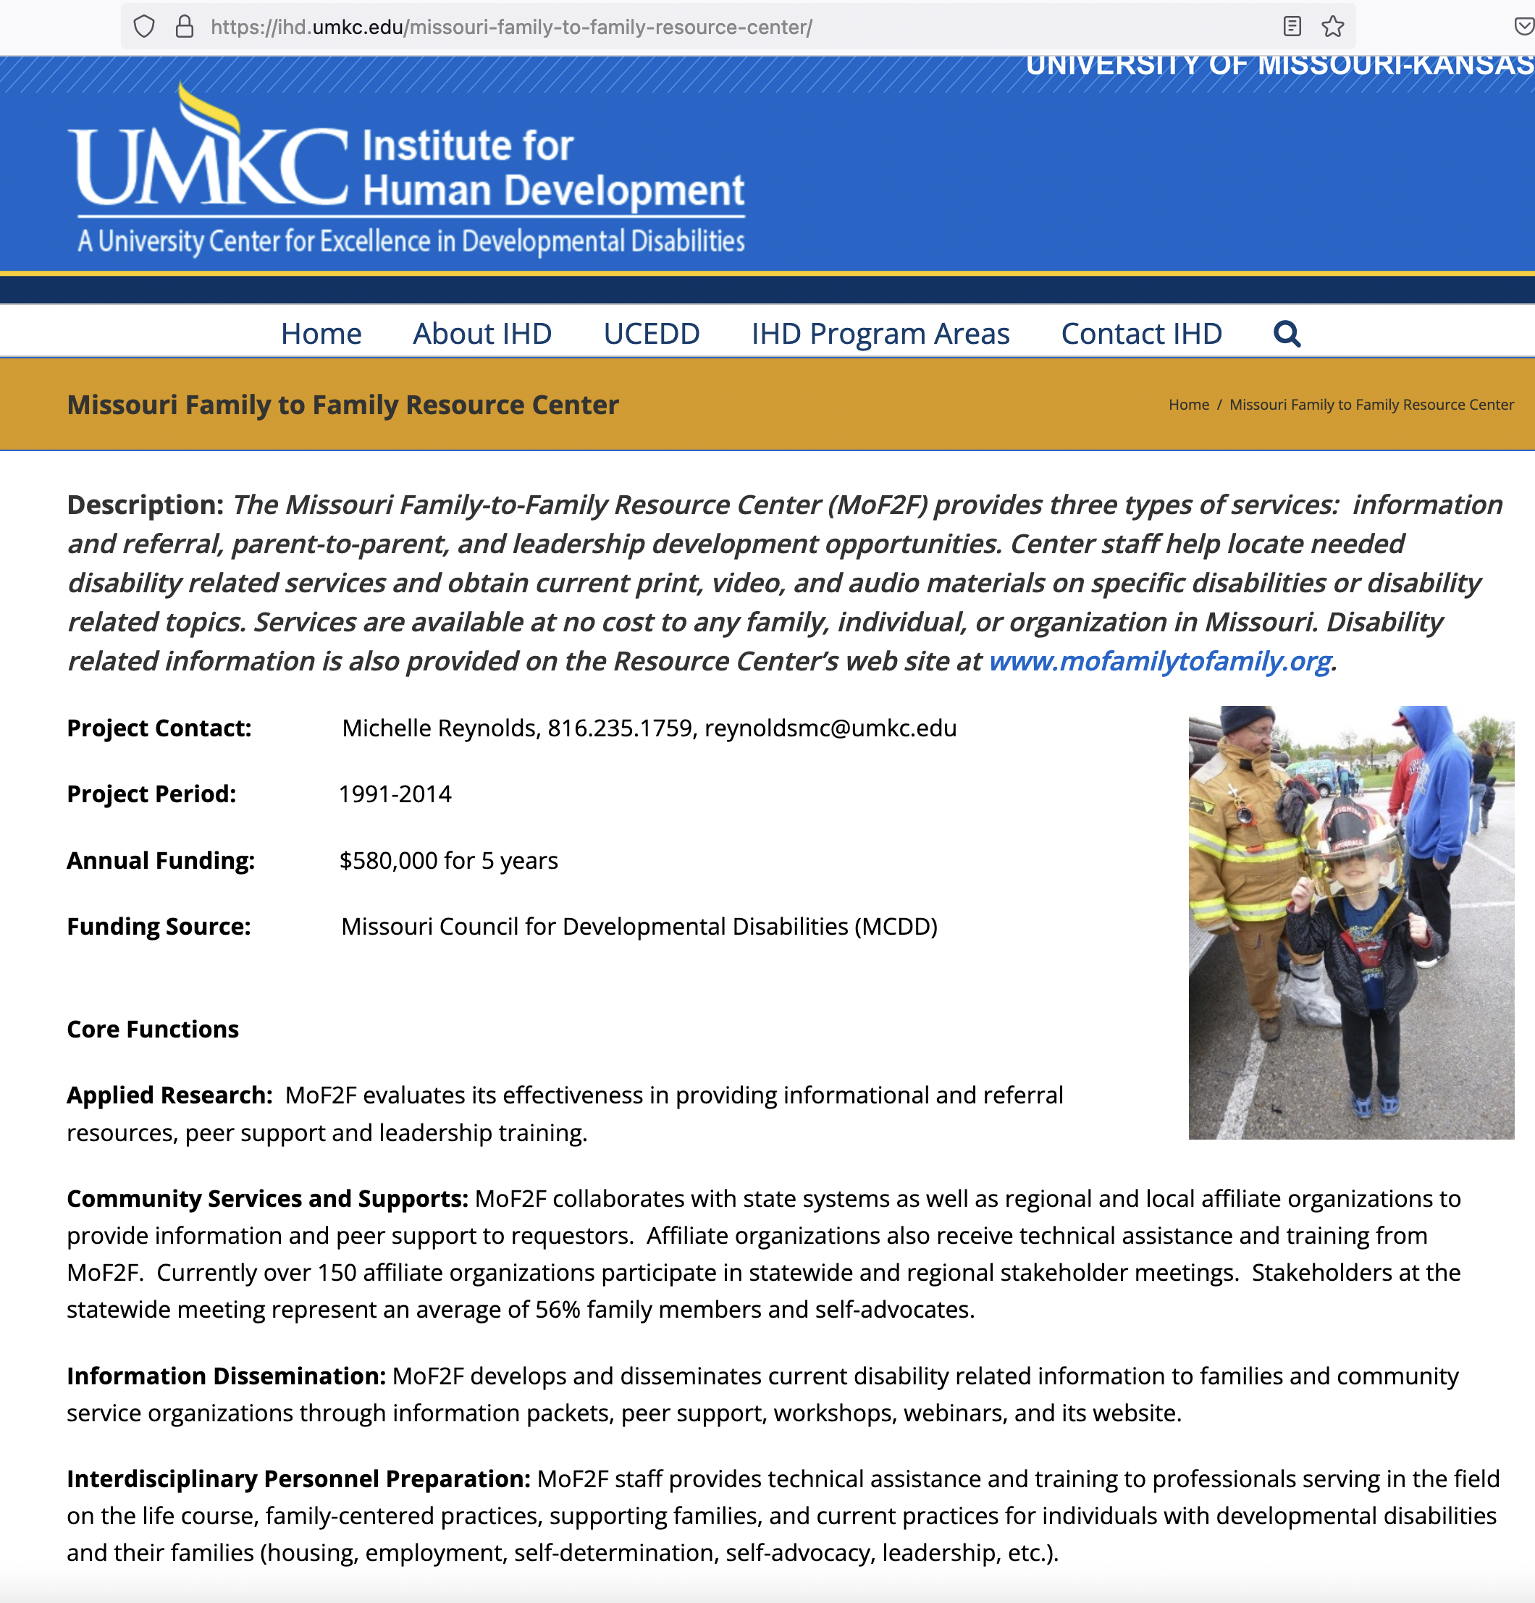

Slide 17
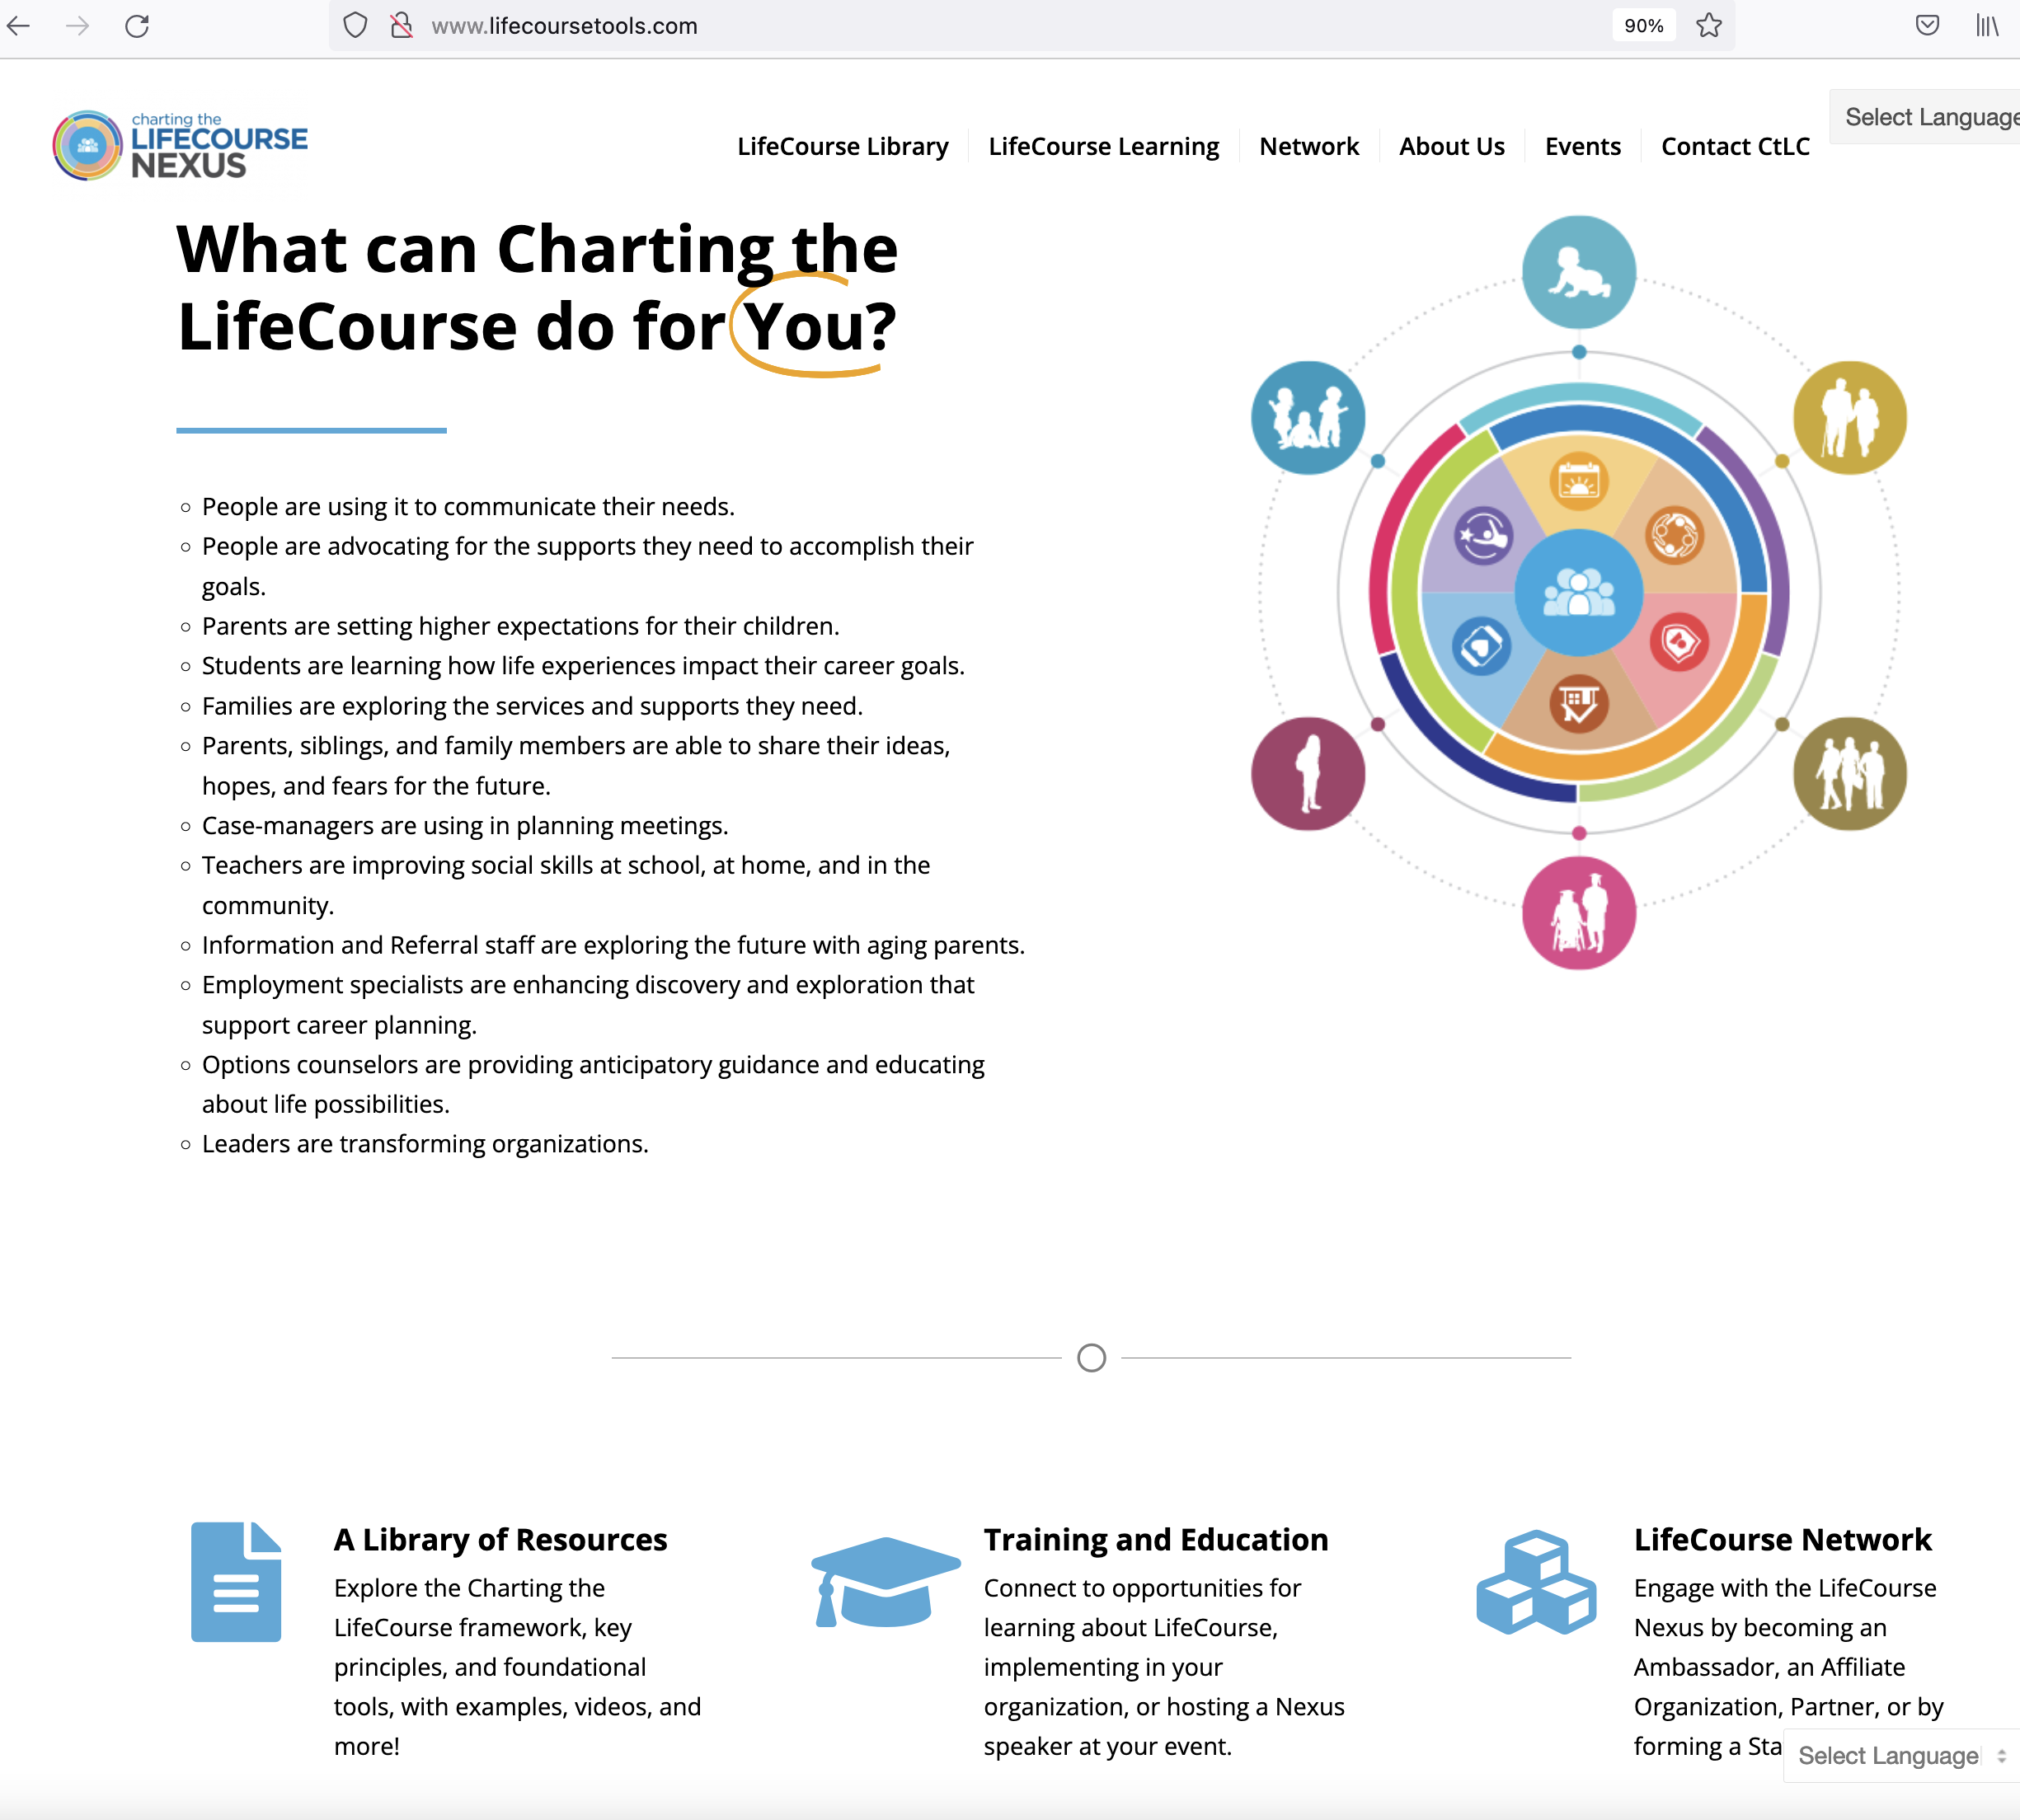

Slide 18
Nonprofit Groups St Louis Office for Developmental Disability Resources
To ensure individuals with developmental disabilities in the City of St. Louis have quality services, choices, and full inclusion.
https://www.stldd.org/funded-services/service-definitions/#isla START HERE: St Louis Area Disability Resource Directory
https://www.startherestl.org/disability.html
Lists Nonprofit Groups and description of services in St Louis area

Slide 19
St Louis Office for Developmental Disability Resources
AADD (Association on Aging w Developmental Disabilities),
SLARC,
Artist First,
Best Buddies (16-24),
Bridges Community Support Services,
Center for Head Injury Services,
Chapel for the Exceptional (Social Club),
Delta Gamma Center (Visual impairments),
Down Syndrome Association of Greater St Louis,
Easterseals Midwest,
Epilepsy Foundation,
Epworth Children and Family Services,

Slide 20
Family Advocacy and Community Support Training (FACT),
Gateway Regional YMCA,
Judevine Center for Autism,
Lifebridge,
MERS/MO Goodwill Industry,
Paraquad,
Pathways to Independence,
Recreation Council of Greater St Louis,
Sunnyhill,
Variety the Children’s Charity

Slide 21
Other Resources
L’ARCH
Oak Tree Respite Home
Transportation services are available through different community transportation groups
Employment Services – Many nonprofits support working individuals to develop and maintain the sills necessary for employment and/or advancement
St Louis Advocate – Larry Opinsky

Slide 22
School Districts (home districts and SSD) & Universities
Home School District Resources (still in School) up to 21 years old
SSD – The Resource Library – Transition into Adulthood
Other Schools?
Fontbonne – Special Education
UMSL – Education Department & SUCCEED Program
Webster University
Physical, Occupational and Speech Therapy Programs & Nursing
Maryville, SLU, WUSTL, UMSL (Nursing)

Slide 23
Subscriptions (magazines and online) Documentaries
Many Exist – What have you found of Value?
DIVERSability, Ability Magazine, Compassion and Choices (nonprofit magazine)
https://www.new-horizons.org/libmag.html
https://blog.feedspot.com/disability_magazines/
Crip Camp, Take A Look At This Heart, The Artisans, Unseen, Intelligent Lives(Documentaries)
https://mediadisability.wordpress.com/films-tv-documentaries/

Slide 24
Internet Groups
Facebook
Instagram
Listservs
Private Groups
Tic Toc
Twitter

Slide 25
Recreation
Recreation Council of Greater St Louis
Weekly email of events (Great for Community Events and Outdoor Concerts)
Summer, Fall and Spring Opportunity Guides
Vouchers
Susan Fleming doing a session for September 24 Conference
???
Local Recreation Centers and Parks
Play St Louis – 2 moms upload photographs of equipment at over 50 playgrounds in St Louis Region. You can search for accessible playgrounds and view what equipment is available at each playground. It is regularly updated.
Others???

Slide 26
Play St Louis

