Slide 1
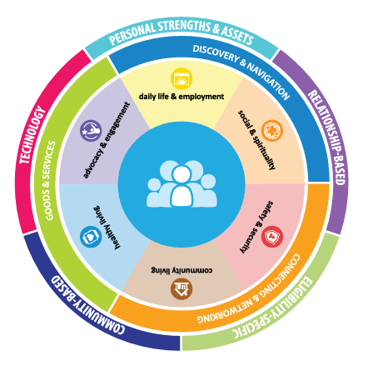
Charting the LifeCourse
Helping Families Get to the Good Life
Notes:
Charting the LifeCourse: Helping Families Get to the Good Life
This session will give people a chance to practice using Charting the LifeCourse principles and tools to build meaningful community connections and opportunities as well as a quick tour of the new LifeCourse online platform that families can use to plan and problem solve. We'll dig into strategies to maximize community engagement and available supports & resources.

Slide 2
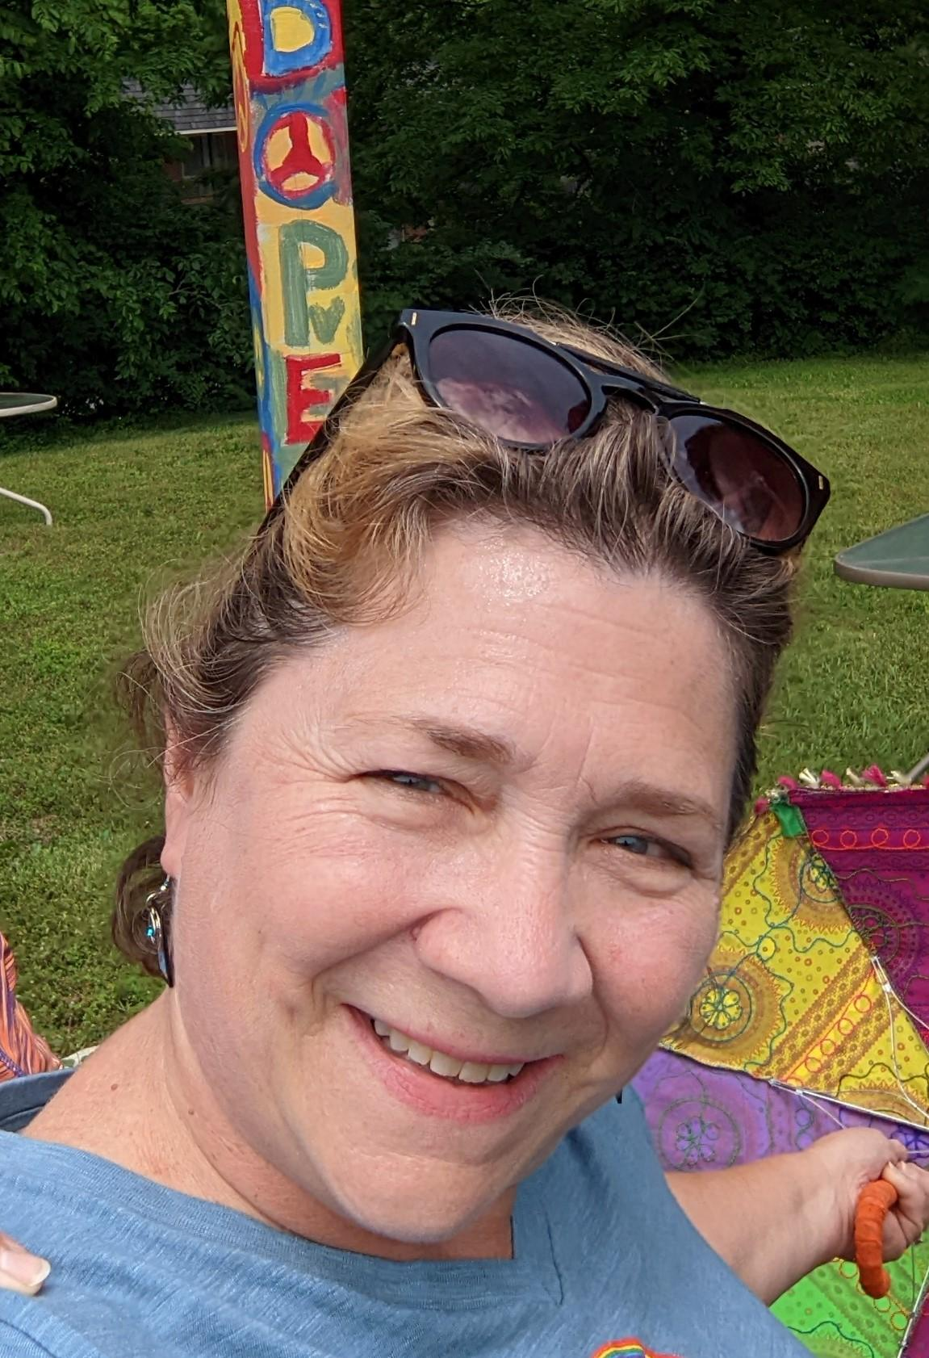
Getting to Know You
Senior Director of Family Support - St. Louis Arc
33 years at the Arc in direct support, program supervision & quality/training
Charting the LifeCourse Ambassador & Ambassador Coach
Committed to Innovation, Equity and Inclusion

Slide 3
A Quick
Review

Slide 4
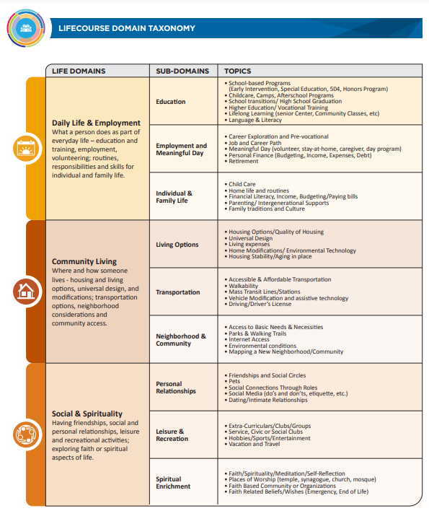
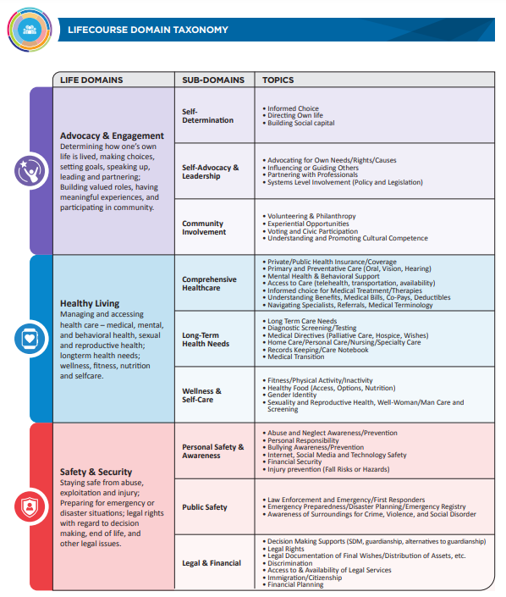
Your Vision - Digging into the Life Domains

Slide 5
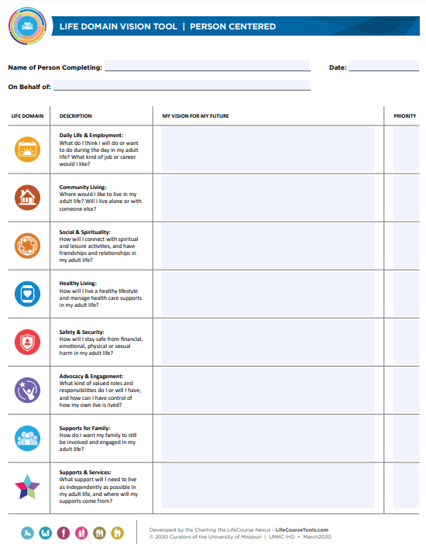
Define Your Vision

Slide 6
Focus on Priorities - Goal Setting & Identifying Supports

Slide 7
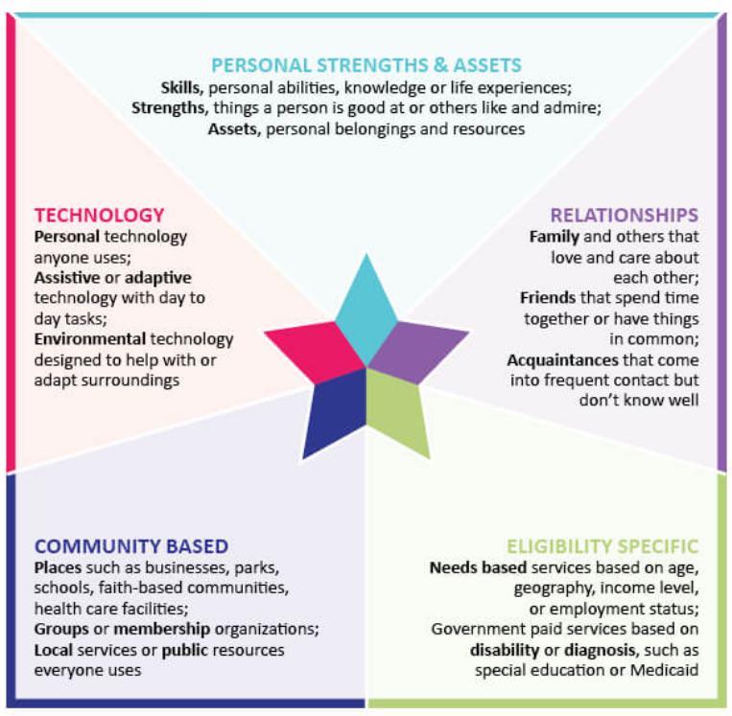
Taking Action
Choose one priority goal that you want to work on and use the star to identify
20 possible actions/solutions

Slide 8
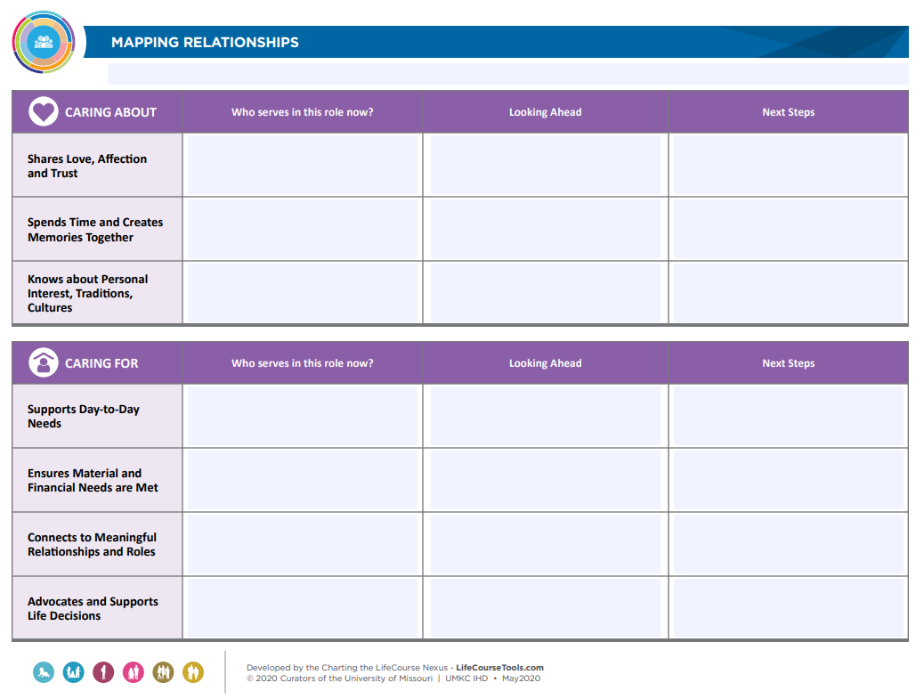
Leaning Into
Relationships

Slide 9
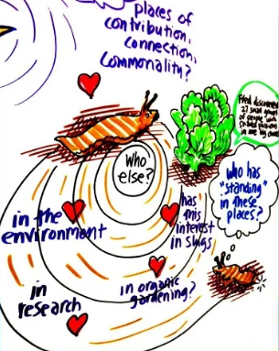
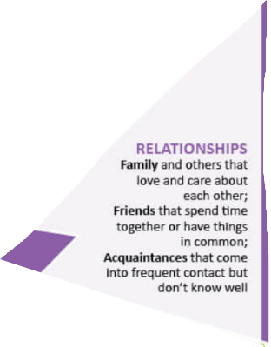
Building your Team

Slide 10
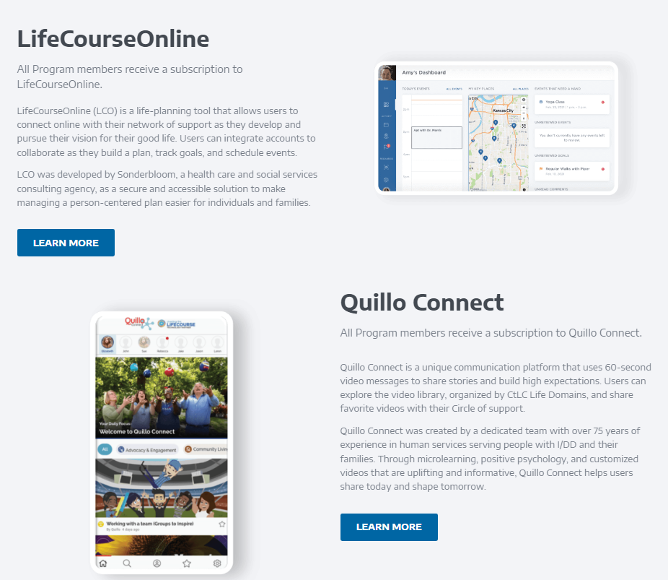
Introduction to LifeCourse Connect

Slide 11
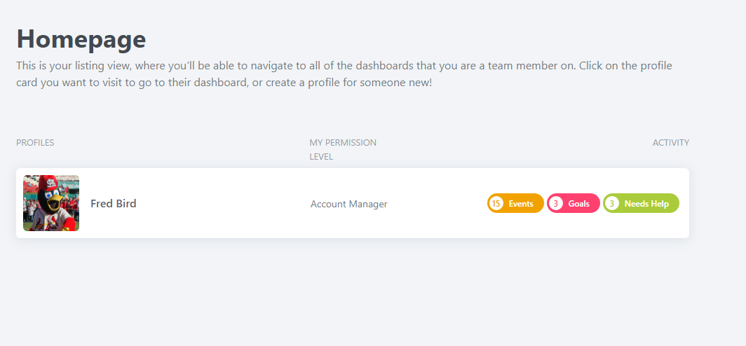
Fred's Dashboard
Notes:
Fr3dtheM@n23

Slide 12
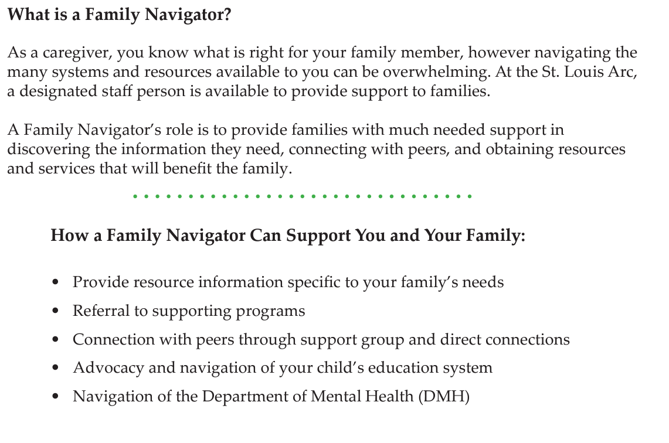
Next Steps - Family Navigation

Slide 13
Questions?
Sharon Spurlock
314-817-2222
sspurlock@slarc.org

