Slide 1
Found Money Mapping Your Financial Opportunities through the Integrated Supports Star
Georgia Mueller, MOM, MS, CWIC, CRS
Family Resource Benefits/Specialist
Missouri Family to Family at the UMKC Institute for Human Development, UCEDD

Slide 2
Georgia Mueller
MS, CWIC, CRS
MOM to Caleb
SDS user
Family Educator 16 years
PPP - Parent Policy Partner
PPM – Partners in Policymaking
MPACT –Missouri Parents LEND –KU- Leadership and Ed. in Neurodevelopmental Disabilities
Private navigator/advocate
Missouri Family to Family
Family Resource Specialist
CRS – Cert. Resource Spec.
SSI-CWIC – Certified Work Incentive Counselor
Notes:
Why should you be trusted as an expert on this subject?

Slide 3
Objectives for Today
By the end of this session you will:
Understand the definitions of assets verses resources
Have additional perspectives about using a variety of mainstream financial tools as well as disability specific tools.
Become aware of unique services available in Missouri designed to maximize you and your family’s assets and resources
CHIP Medicaid – for higher earners, combined with EPSDT- Early and Periodic Screening Diagnosis and Treatment.
Health Insurance Premium Payment Program (HIPPP)
ABLE Accounts and Special Needs Trusts
SSI/SSDI Work Incentives

Slide 4
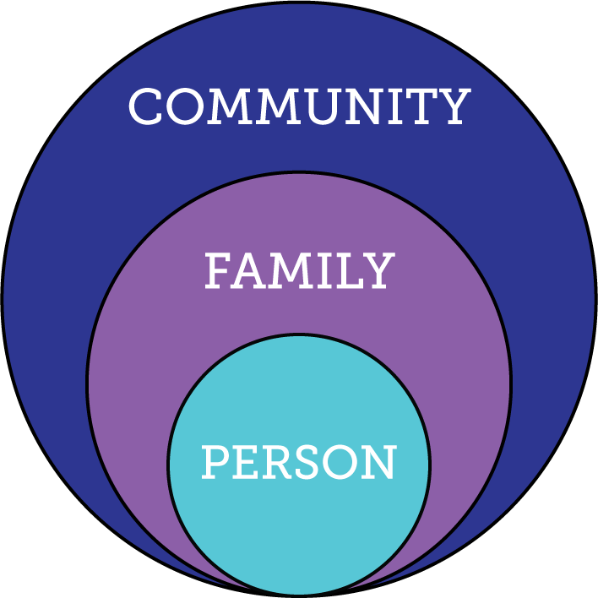
In the beginning…..
Notes:
If you think about an everyday life, (the circle on the left), you have the person, who is part of their family, and they are part of their communities.
With the best of intentions, the disability field created a system that completely wrapped around the person with a disability, and ultimately, ended up cutting them off from their families and communities.
What we want to see is the circle on the right. All people, who are part of their families, and part of their communities, all receiving supports when and where they need them.

Slide 5
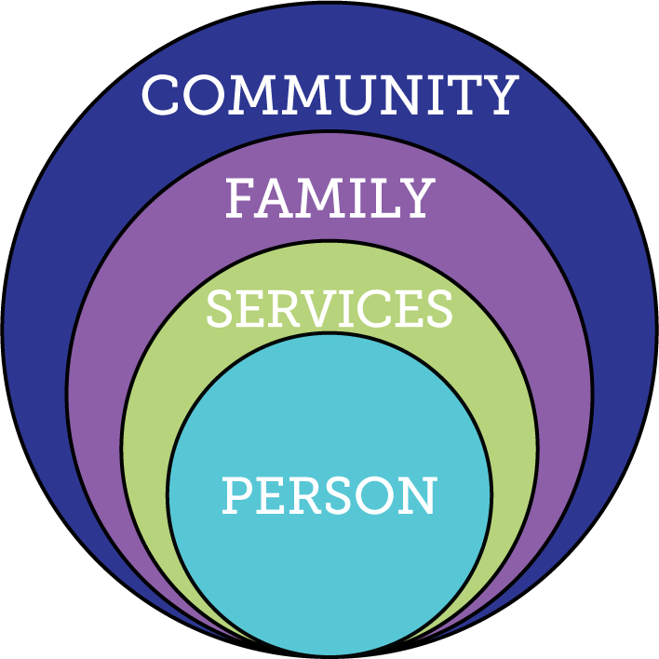
Then….
Notes:
If you think about an everyday life, (the circle on the left), you have the person, who is part of their family, and they are part of their communities.
With the best of intentions, the disability field created a system that completely wrapped around the person with a disability, and ultimately, ended up cutting them off from their families and communities.
What we want to see is the circle on the right. All people, who are part of their families, and part of their communities, all receiving supports when and where they need them.

Slide 6
What We Want to See…
Notes:
If you think about an everyday life, (the circle on the left), you have the person, who is part of their family, and they are part of their communities.
With the best of intentions, the disability field created a system that completely wrapped around the person with a disability, and ultimately, ended up cutting them off from their families and communities.
What we want to see is the circle on the right. All people, who are part of their families, and part of their communities, all receiving supports when and where they need them.

Slide 7
Consider your entire family’s quality of life…
Notes:
What do we think quality of life really means?

Slide 8
Notes:
A lot of times we think only about the person with a disability who needs support…

Slide 9
Notes:
But we know that all people are part of a family. We have to consider the needs of the entire family unit. Supports that are directed to the family will ultimately benefit the individual and vice versa if well designed.

Slide 10
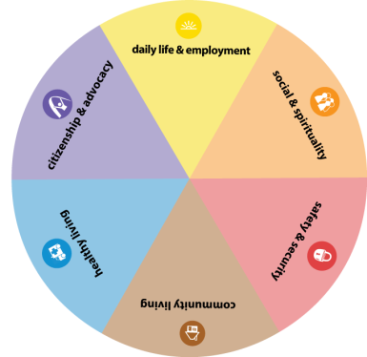
Notes:
A lot of times, when we think about our loved ones with disabilities, we tend to gravitate toward focusing on health and safety.
We know that there is more to having a good life than just health and safety. And all of the different pieces of our live are connected. Where you work will affect where you choose to live and how you get around. Where you choose to live might have an impact you’re your safety and security and even health. Everything is connected.

Slide 11
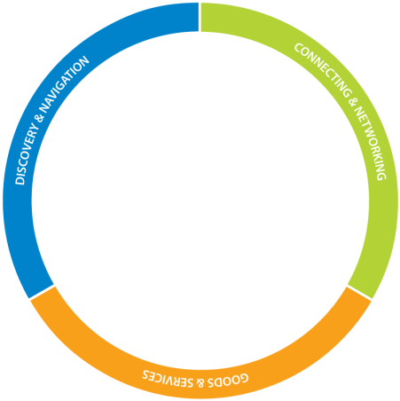
Notes:
WE KNOW that families need more than goods and services. We aren’t saying that goods and services aren’t important. We are saying that families have additional needs that need to be met.
The first bucket is Discovery and Navigation. This includes information and referral about options and training like workshops and webinars that families can watch to build their knowledge and skills. Like what we are doing in this session, and what I do every day in my job, providing information to families
The second bucket is Connecting and Networking. We have learned that families benefit from talking to another person who has walked in their shoes and networking with other families that know what’s going on. Connecting and networking with others provides not only another layer of information, but it also provides critical emotional support. Kind of like what we’re doing today and tomorrow at this conference!
Finally, Goods and Services are those things that we connect with to make our daily lives possible. They can be as simple as your alarm clock or as complex as applying for formal services.
We always want to make sure we are helping families fill all of their buckets, not just dropping everything into the goods and services bucket. So today, we’re going to work on filling your information bucket.

Slide 12
Notes:
Everyone uses a variety of resources and supports to get through their day-to-day routines and everyday lives. This ring shows integrated supports… also known as………

Slide 13
Notes:
The Integrated Supports Star.
We are trying to help families AND organizations and policymakers understand that we ALL access a variety of supports to make it through our daily lives. We can’t be reliant on only one source of support if we want to have a good life for all of our family members.

Slide 14
Notes:
This line represents the trajectory. We have borrowed this idea from the public health field. A trajectory is the path your life takes toward the future.
When we talk with families, we tell them to think about a shooting arrow. We want individuals to have a positive trajectory that points them to all the things that they want so they can have a good life.
It is actually really important to think about what you don’t want so that you can avoid it. And most of the time, it helps you better articulate what you do want.

Slide 15
Notes:
Finally, we want a good life for people no matter which life stage they might find themselves in, and we believe that the life experiences are key to setting them on a a positive trajectory so they can have a good life.

Slide 16
Down and dirty overall trajectory for your family
What Quality of Life looks like for Caleb and the Mueller family
Vision for a Good Life
Live in my own home
Go to church and get out in the community
Spend time with family
Music
Gardening TOMATOES
Own our own business
Freedom!
What We DON’T Want
Live in a nursing home
Be alone
Sick, go to hospital
Financial problems
Personal drama & stress
No choices
Notes:
For the parents – now for the person we’re supporting.

Slide 17
Integrated Supports
Notes:
We are going to spend the rest of the presentation thinking about integrated supports for financial management. We’re going to learn about each part of the star, I will share examples of our own family’s star, and then provide resources in each area for you to consider for your own family.

Slide 18
Personal Strengths and Assets What can your family bring to the table?
Your Personality!
Education/training/skills
Work-like experiences
Personal property

Slide 19
Mueller Family’s Personal Strengths and Assets
Family business
Parent’s Training
Natural lifestyle
Education
Thriftiness
Notes:
As a parent of a child with a disability I have to admit that our life pretty much stalled out. We stopped dreaming. We stopped planning financially. We were overwhelmed. I am not going back and learning the financial info needed to move forward with our life. Just refinanced the house. Digging deeper into understanding retirement. I actually have friends who are retiring.
As a result of SDS I have more peace of mind which gives me a little wiggle room to think about these things. While I feel behind the 8 ball I am not out of the game for getting on with things.

Slide 20
The Family Business KC Tomato
Notes:
As a parent of a child with a disability I have to admit that our life pretty much stalled out. We stopped dreaming. We stopped planning financially. We were overwhelmed. I am not going back and learning the financial info needed to move forward with our life. Just refinanced the house. Digging deeper into understanding retirement. I actually have friends who are retiring.
This is also the time to get really serious about our business and what that means for each family member.
As a result of SDS I have more peace of mind which gives me a little wiggle room to think about these things. While I feel behind the 8 ball I am not out of the game for getting on with things.

Slide 21
Relationship Based Financial Supports Things that family, friends, neighbors, co-workers and other people can help with
Family/Friend owned businesses
Social Connections
Family reputation
Social Capital
Inheritance
Shared Decision Making
Faith Community
Neighbors
Notes:
Shared Decision Making Conference – DMH=DD, MO

Slide 22
Mueller Family’s Relationship Based Financial Supports
Social Capital
Inheritance????
Family owned business
Shared Decision Making
Faith Community
Social Connections
Family reputation
Notes:
**************Shared Decision Making Conference – DMH=DD, MO

Slide 23
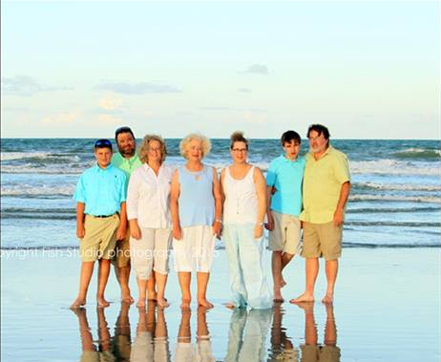
Funderburke-Mueller-Swingle Family

Slide 24
Technology Based Financial Supports From calculators to online banking... We are all using technology in some form to help us manage our money!
MO DB 101
Internet based jobs
Online Money Management
Shared banking
Financial literacy
Notes:
MO.db101.org
https://realeconomicimpact.org/pages/ndi-10-years

Slide 25
Mueller Family’s Technology Based Financial Supports
Tax apps
MO DB 101
Shared banking
Business Planning Tools
Online Money Management
Financial literacy-whole family
Notes:
MO.db101.org
https://realeconomicimpact.org/pages/ndi-10-years

Slide 26
Missouri Disability Benefits 101
Benefits Calculator
Working With a Disability
Disability Benefits 101 gives you tools and information on health coverage, benefits, and employment. You can plan ahead and learn how work and benefits go together.
Myth #1: I can’t work because of my disability.
Myth #2: I will lose my SSI/SSDI benefits when I start to work.
SSA – WIPA- Work Incentive Planning and Assistance
Myth #3: If I work, I will lose my health care benefits.
Continued Medicaid Eligibility - 1619(b)
Myth #4: If I start working, Social Security will decide I’m not disabled anymore.
Myth #5: There are no resources that can help me find and keep a job.
Myth #6: I can’t afford the extra costs of starting to work.
Myth #7: I don’t need my benefits as long as I have a job, but if I have to stop working because of my disability, I won’t be able to get my benefits back.
See Financial Resource Lists at MO Family to Family table.

Slide 27
LIVE Technology Based Financial Resources Taxes MyFreeTaxes Free Tax Preparation by Volunteers Financial Education Better Money Habits Consumer Financial Protection Bureau Employment LEAD Center Workforce3One Benefits Planning Social Security Administration – Choose Work Web Site Social Security WIPA Plan to Achieve Self-Support (PASS) Online Asset Development Assets for Independence Resource Center MyMoney.gov ABLE National Resource Center

Slide 28
Community Based Financial Supports Things that any community member can access
Private Insurance
Private Savings/Investments
Tax benefits – EITC, Property Tax exemptions/credits
Self-employment
Section 105

Slide 29
Mueller Family’s Community Based Financial Supports
Credit Union
Private Insurance-w/HIPP
Investments-401K, etc.
Tax benefits
Self-employment w/Sec.105
SBA – Small Business Association
MO Extension

Slide 30
Private Health Insurance
Read your policy, not just the overview.
Seek an Insurance Company Case manager through your private insurance policy to help you maximize your policy.
Make sure you know the format of your insurance: public, private, self-insured, government, military, retirement Medicare. This determines their legal obligations.
Employment based pre-tax options -MSA’s/HAS’s/ Dependent Care Account/ FMLA Leave- Medical expenses can’t begin to be deducted from tax obligation if not OVER 10% of AGI.
Private policies are required to offer 10 Essential Health Benefits. Currently being threatened!
Missouri State Insurance Commission – confirm your state’s laws that might not be reflected in your policy yet would be in effect for your situation, ie:
Speech Parity Law
Mental Health Parity Law
Child age out rules/exceptions
Definitions of various services COMBINE WITH HIPP. See later…
Notes:
Every health plan must cover the following services:
Ambulatory patient services (outpatient care you get without being admitted to a hospital)
Emergency services
Hospitalization (like surgery and overnight stays)
Pregnancy, maternity, and newborn care (both before and after birth)
Mental health and substance use disorder services, including behavioral health treatment (this includes counseling and psychotherapy)
Prescription drugs
Rehabilitative and habilitative services and devices (services and devices to help people with injuries, disabilities, or chronic conditions gain or recover mental and physical skills)
Laboratory services
Preventive and wellness services and chronic disease management
Pediatric services, including oral and vision care (but adult dental and vision coverage aren’t essential health benefits)

Slide 31
Entrepreneurship- Support for Small Businesses
Entrepreneurship is alive and well in America! Private business is a great idea for families and for their individuals who need long time work and support combined. Flexibility, creativity, niche work. Everyone can win!
Business Incubators in Missouri
1 Million Cups
Ewing Marion Kauffman Foundation
BuzzGate
Department of Development Missouri
Small Business Administration
SCORE Counselors to America's Small Business
Entrepreneur

Slide 32
Eligibility-Specific Financial Supports services or things that someone is eligible to access based on disability, age, income or other specific criteria.
Eligibility Dependent
Financial Opportunities
Public Insurance/Benefits
Government Based Systems

Slide 33
Mueller Family’s Eligibility-Specific Financial Supports
Eligibility Dependent
Financial Opportunities
Public Insurance/Benefits
Government Based Systems
Notes:
TWEEK

Slide 34
Safe Savings Options
Notes:
Include contacts on resource flyer
Special (Supplemental) Needs Trusts (SNT)
Safe savings option
Put aside assets for the person
Accessible by the conservator
Usable for specific purposes only
“supplement the funds and services available through government programs”
http://www.specialneedsalliance.org/frequently-asked-questions/#specialneedstrust
The A.B.L.E. Account Act of 2013 (S. 313/H.R.647)
Tax free savings
Use for qualified expenses
Supplement to other benefits
Flexible savings like other people have
Medicaid payback provision
Protects assets from consideration by federal benefit programs
Reduces financial stress to people/families
MO ABLE Account Info
https://treasurer.mo.gov/content/achieving-a-better-life-experience/able-faq#faq3

Slide 35
Special (Supplemental) Needs Trusts (SNT)
Safe savings option
Put aside assets for the person
No contribution limit
Usable for specific purposes only
ABLE Accounts
Achieving a Better Life Experience (ABLE) Act
Exclusion from means-tested federal programs
Contribution limit of $14K annually
MO ABLE Account https://www.moable.com/
See Comparison Chart

Slide 36
More formal supports for finances

Slide 37
MO HealthNet for Kids (SCHIP)
Children with monthly family MAGI above the limits referenced above may be eligible under the State Children’s Health Insurance Program if the following criteria are met: …
Uninsured children whose family MAGI is….up to 300% FPL may be eligible for coverage with a small premium;
Children in families with gross income over 150% FPL cannot have access to affordable health insurance (from $75 to $189 per month, based on family size and income). The premium is based on family size and income to insure that no family pays more than 5% of their income for coverage.
http://dss.mo.gov/mhk/
*SSI’s maximum income for a family is ~ 200% of FPL so if your income is between 200% of FPL and 300% you can’t get regular MO HealthNet for People with Disabilities but SCHIP is a possibility for your child, through which, waivered services/EPSDT can be obtained.

Slide 38
Early and Periodic Screening Diagnosis and Treatment (EPSDT)
Provides access to flexible Medicaid benefits and services for Medicaid enrolled children and youth under 21; designed to assure preventive treatment and to promote early diagnosis and treatment of identified health needs. Such services may include things like:
Equipment/ Diapers
Specialized diet
Therapy
Medical transportation
Home nursing
Personal Care assistance
ABA – Applied Behavior Analysis
Medically necessary support

Slide 39
Medicaid Health Insurance Premium Payment Program (HIPPP)
Requirements:
Someone in the home must be a MO HealthNet Medicaid recipient
The family must be willing to purchase private health coverage through employment or directly from an insurer.
Result:
Medicaid may help pay your private health insurance premiums giving you more coverage, more cash flow and more provider choices.
Contact the Missouri Medicaid HIPP program to ask detailed questions and to apply. If you have any questions about the HIPP Program, contact the MO HealthNet Division, Cost Recovery Unit at (573) 751-2005.
Notes:
Make app and other info available – include contact info in the resource list.
Kansas application:
http://content.dcf.ks.gov/ees/KEESM/Miscform/MS-2504HEALTH_INSURANCE_PREMIUM_PAYMENT_INFORMATION_FORM1-05.pdf
Missouri Contact:

Slide 40
SSI/SSDI Work Incentives
Red Book SSA https://www.ssa.gov/redbook/documents/TheRedBook2016.pdf
Ticket To Work www.choosework.net
CWIC – Certified Work Incentive Coordinators www.moadvocacy.org
Also see presenter Rich Grawer at 1:30 – 3:30 Saturday.
Notes:
Why is it important to know about the various education programs?
The services that are mandated under these programs would be very expensive out of pocket. Some times parents don’t realize what the school system should be doing and they end up paying for them separately or going without, resulting in significant financial impact on the family.

Slide 41
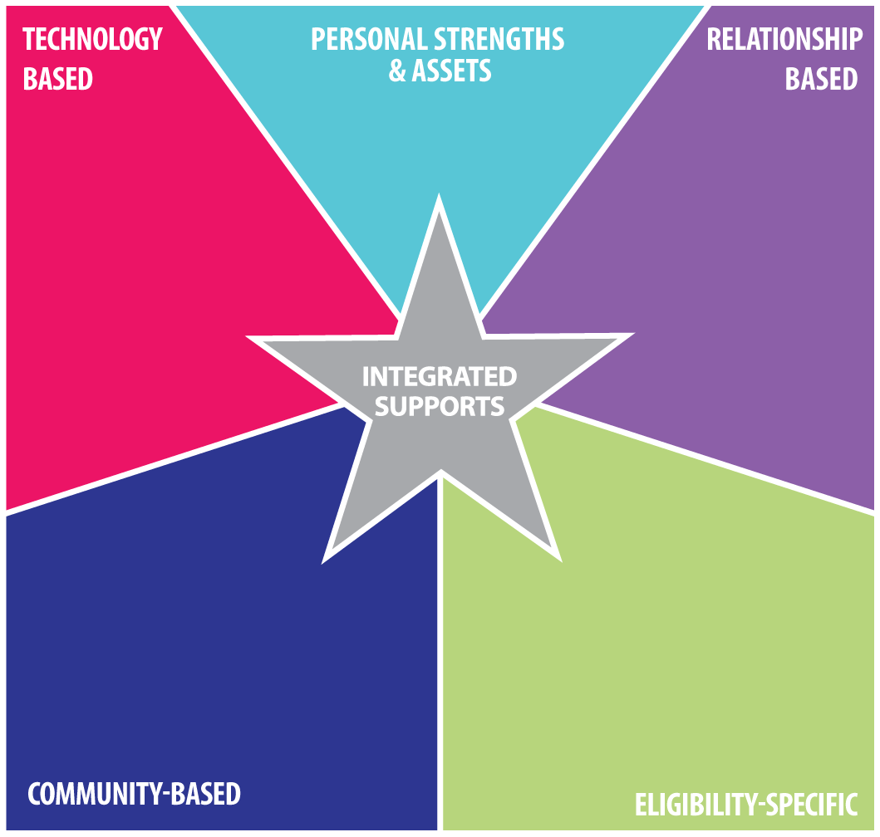
Integrated Financial Supports
Grants/Scholarships
Fundraising/Crowdfunding
Local charity volunteering
Micro-business
Self-employment
Sell goods or services online
Contract work online
Craft sales
Farming – small or large scale
Home ownership
Maintain Employment
Business ownership
Individual Development Accounts (IDA’s)
FSS – Family Self-Sufficiency
General investing
Tax opportunities
Know the rules
Micro-business or Self-employment
Craft sales
Farming – small or large scale
Home ownership
Maintain Employment
Business ownership
Know the rules
Sell goods or services online
Contract work online
Skills exchange, barter and trade with friends and neighbors
Grants/Scholarships
Fundraising/Crowdfunding
General investing
Tax opportunities
Eligibility Based Financial Opportunities
Public Insurance/Benefits
Government Based Systems

Slide 42
Mueller family’s Integrated Financial Supports Plan
Dad-Plant Geneticist
Mom -DD Work experience
Entrepreneur Spirit!
Good Credit
MO DB 101
On line banking
Shared banking
Financial literacy
Marketing the business
Family owned business
Social Connections
Family Social Capital
Inheritance
Shared Decision Making
Private Insurance
Private Savings/ Investments
Tax benefits – EITC
Small Business Classes
Self-employment
Grants and Scholarships
Self Directed Supports-PCA
Maximize Benefits Integration

Slide 43
Grants/Scholarships Fundraising/Crowdfunding Local charity volunteering Micro-business Self-employment Sell goods or services on line Contract work on line Craft sales Farming – small or large scale Home ownership Maintain Employment Business ownership Individual Development Accounts (IDA’s) FSS – Family Self-Sufficiency Special Needs Trusts ABLE Act Accounts General investing Tax opportunities Know the rules CWIC/Benefits Specialist
Creative Cash Flow List of ideas

Slide 44
Creative Cash Flow Shown in the Integrated Financial Supports
Micro-business/ Self-employment
Home ownership Maintain Employment
On line ‘re-selling”
Contract computer work
On line sales home business
Tax programs – learn,
use & work
Family Business Ownership- Micro Farming
Sharing Living
Shared Decision Making
Drive for Uber
Fundraising/Crowdfunding
SBA-Small Bus. Assoc.
Community classes
Grants & Scholarships
SELF DIRECT YOUR SUPPORT
Know how your benefits interact
Ask for Help –WIPA/CWIC
FSS-Family Self Sufficiency Program

Slide 45
Contact: Disclaimer:
Georgia Mueller, MOM, MS, CWIC, CRS
muellergl@umkc.edu
816-235-6380 or 800-444-0821
The presentation is intended as general information only and does not carry the force of legal opinion. Missouri Family to Family is providing this information as a public service. This information and related materials are presented to give the public access to information. You should be aware that while we try to keep the information timely and accurate, there may be a delay between official publications of the materials and the modification of these pages. Therefore, we make no express or implied guarantees. We have made every effort to ensure that the information you received today is current.

