Slide 1
Community Specialist
SDS MO
Today’s presentation by Georgia Mueller and
Jesse Callaway

Slide 2
Do I need a community specialist?
“A Community Specialist is used when specialized supports are needed to assist the individual in achieving outcomes as identified in the ISP. The services of the Community Specialist assist the individual and the individual’s caregivers to design and implement specialized programs to enhance self direction, independent living skills, community integration, social, leisure and recreational skills.“

Slide 3
How to Access a Community Specialist
Request funding from your case manager.
Complete and submit the community specialist assessment.
Find qualified candidates (bachelor’s degree + 1 year of relevant experience).

Slide 4
Think about who would be a good Community Specialist for your situation.
What people/professionals help you to support your individual with a developmental disability?
What unique attributes does that person bring to your situation?
What type of work needs to be done that you don’t feel qualified or equipped to do?

Slide 5
Who can be a Community Specialist?
This service shall not duplicate other waiver services, including, but not limited to ABA or PA services.
Providers of CS services must have a bachelor's degree from an accredited university or college plus one (1) year of experience, be a Registered Nurse (RN) (with an active license in good standing, issued by the MO State Board of Nursing) or have an associate’s degree from an accredited university or college plus three (3) years of experience.
The service may be provided by either an individual provider or an employee of an agency, which requires a contract with DMH-DD. *SDS CS’s don’t require a contract with DMH-DD.
Community Specialist, Self-Directed T1016 U2, maximum 24 hours per day
https://mydss.mo.gov/media/pdf/developmental-disabilities-waiver-program-manual pages 56-57

Slide 6
The Community Specialist (CS) service is available in all four of the DD waivers.
Service Description: Community Specialist CS is used when specialized supports are needed to assist the individual in achieving outcomes in the ISP.CS services include professional observation and assessment, individualized program design and implementation and consultation with caregivers. CS services may also, at the choice of the individual’s Designated Representative (DR), include advocating for the individual and assisting the individual in locating and accessing services and supports within their field of expertise. CS services are a direct service which may require a higher level of skillset and training to assist the individual in achieving their outcomes. The CS performs the implementation strategies of the outcome through direct instruction. CS staff may be part of the person-centered planning process that identifies the individual's needs and desires; however, does not authorize the service nor monitors the progress of the CS service.The services of the CS assist the individual and the individual’s caregivers to design and implement specialized programs to enhance self-direction, independent living skills, community integration, social, leisure and recreational skills.This service shall not duplicate other waiver services, including, but not limited to ABA or PA services.
Service Limitations: Community Specialist CS, a direct waiver service, differs in service definition and in limitations of amount and scope from Medicaid state plan TCM for a person with DD. In the latter, there are waiver administrative functions performed by a support coordinator through Medicaid state plan TCM that fall outside the scope of a CS, such as Level of Care (LOC) determination, free choice of waiver and provider, due process and right to appeal. Additionally, the Division of DD support coordinators facilitate services and supports, authorized in the support plan, through the Division of DD regional office Utilization Review (UR) and authorization process. See the Billing Information: Community Specialist section for maximum units of service regarding CS. A CS shall not be a parent, step-parent, guardian or other family member.
Provider Requirements: Community Specialist Providers of CS services must have a bachelor's degree from an accredited university or college plus one (1) year of experience, be a Registered Nurse (RN) (with an active license in good standing, issued by the MO State Board of Nursing) or have an associate’s degree from an accredited university or college plus three (3) years of experience. The service may be provided by either an individual provider or an employee of an agency. An individual or an agency must also have a DMH contract to provide CS services.
Billing Information: Community Specialist Waiver Service Procedure Code(s) Service Unit Maximum Units of Service Community Specialist 101615 minutes 96 units per day Community Specialist,Self-Directed T1016 U2 15 minutes 96 units per day Service Documentation: Community Specialist The provider must maintain all documentation as per the requirements set forth in Section 3 of this manual. Providers must maintain plan of treatment and detailed record of intervention activity by unit to include referrals to other agencies, recommendations for change in treatment and progress on behavioral/service objectives which are part of the ISP. Annual assessments of individual/family status are required. When the CS employer of record is the individual or the individual’s family, the individual or family is responsible for ensuring adequate documentation is maintained. Written data shall be submitted to DMH authorizing staff as required.

Slide 7
The Assessment

Slide 8
Implementation Strategies

Slide 9
In general, a community specialist can…
CREATE: visual supports, social stories, support manual
COLLABORATE: with PA staff on new outings, leading and/or attending team meetings, support PA staff with challenges, brainstorm behavior interventions
CONNECT: with volunteer opportunities, leisure opportunities
OPTIMIZE: Organize electronic or traditional materials, implement routines and systems
ASSESS: Collect data, explore and assess new environments for accessibility

Slide 10
For example…

Slide 11
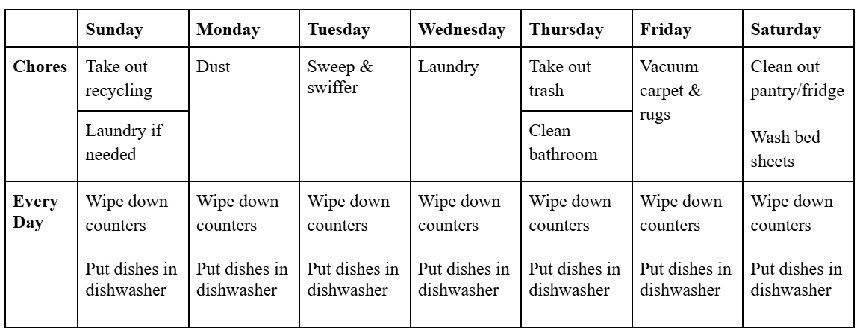
For example…

Slide 12
For example…
Compress FBA and behavior intervention plan into a quick read “Mini BIP”
Record, edit, and upload training videos to a shared drive of tasks like putting on orthotics or transferring from bed to wheelchair.
Take photos of the individual out at a store to create a social story of appropriate behavior in the community.

Slide 13
Support to Individual through their Caregivers
Greater understanding of the entire process:
Waivers
Self Directed Supports
External providers; VA, DHSS
Basic benefits planning to secure safety nets and support employment
Brainstorming significant decisions
Supported Decision Making vs. Guardianship
Financial solution analysis
ABLE accounts, Special Needs Trusts, insurance
Strategization around all support options to design long term plans for individual in the context of family
Troubleshooting problems;
Medicaid,/Medicare, SSI/SSDI, Spend Downs, loss of benefits, support to work

Slide 14
Brainstorm
How do you utilize your community specialist?
Did this presentation give you any new ideas?

Slide 15
Connect with a Community Specialist
Contact info@MOSDS.org for a list of known community specialists. We are always building this list and looking for new community specialists, if you or someone you know is interested.
Brought to you through www.MOSDS.org Family Self-Directed Support Group. Consider becoming a member to support awareness and support like that which you experienced today.

