Slide 3
Challenge #1
Finding a place to live

Slide 5
122,075 extremely low-income households (those earning 30% Area Median Income or lower) in Missouri are unable to secure housing that is affordable to them.
65% are spending more than half of their income on rent
Housing Vouchers

Slide 6
Challenge #2
Lack of affordable housing

Slide 7
Challenge #3
Expiration of affordable housing

Slide 9
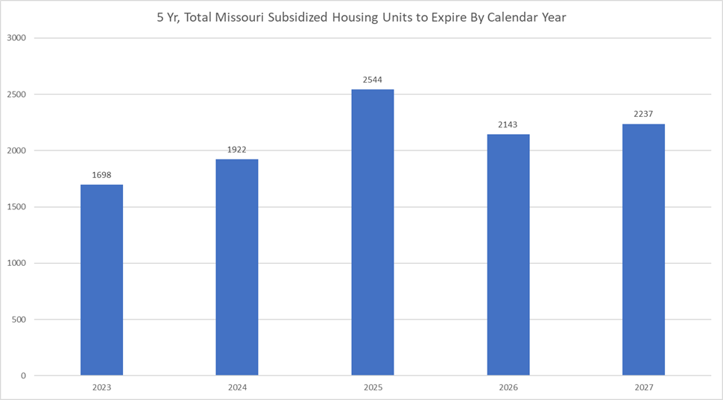

Slide 10
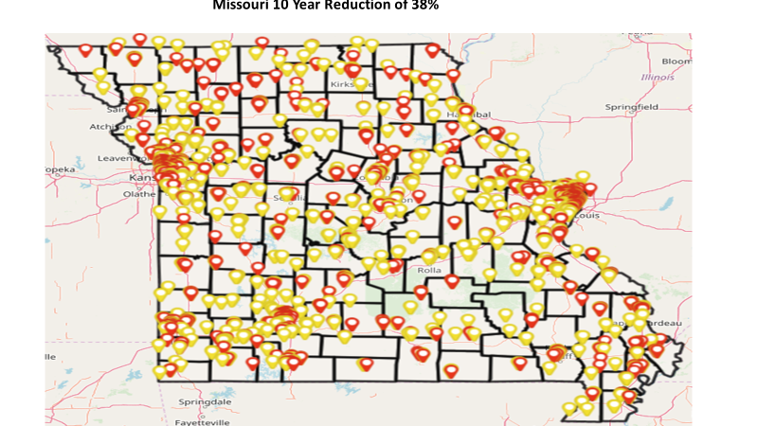

Slide 11
Challenge #4
Housing density ordinances

Slide 12
Challenge #5
Rental application fees

Slide 13
Remove the Roadblocks to Housing

Slide 14
Leading the Development of Affordable Housing

Slide 15
Where do we go from here?

