Slide 1
How To Write Your Own ISP

Slide 2
ISP Guide & Blank Templates
ISP Guide Blank DMH ISP Template Blank CHS ISP Template

Slide 3
ISP Components
Mandatory: These are the required areas to be reflected in the ISP.
Contingent: If it is applicable to the individual/family, it is required.
Optional: Any additional information chosen by the individual, family, or guardian

Slide 4
Section One
Demographic and Contributor’s Information
Legal Demographics
Contributors

Slide 5
Vision for a Good Life
What and who is important to the individual
Hopes, needs, preferences, culture

Slide 6
Vision for a Good Life: What is Important to the Individual
What an overall 'Good life' looks like: Engagement in daily activities; having his communication understood; freedom from pain.
Hopes, Dreams & Wants: A safe, secure nurturing environment, relationships with others; as much independence as possible/as much support as needed (i.e., this can change daily based on health status).
Needs or conditions that must be in place to achieve a good life: Well-trained support staff providing medical, physical and positive behavioral supports during his waking hours, protective oversight while asleep, appropriate pain relief, weekly physical therapy to maintain his mobility, engagement with family and friends, and daily meaningful activities.
Personal strengths and Assets: Great sense of humor, good memory for people, strong auditory skills
Ron likes: Music, his blue comb, swimming (as health permits), parties at his house, visiting family and friends, talking about favorite people, activities and events, his recliner, pizza, salty snacks.
Ron dislikes: medical/dental situations, loud noises, being wet (outside of swimming or the bathtub), food that will not stay on his fork or spoon
What the Ron would like to try: More engagement with friends and family
Support Preferences: Energetic, well-trained staff

Slide 7
What Does Everyone Need to Know or Do to Support the Individual
What is important to know and do
The role of the supporters
Routines

Slide 8
What Does Everyone Need to Know or Do to Support the Individual?
Communication: Donovan will advocate for some of his needs/wants. Although, he will frequently say “you need" instead of "I need" when asking for something, since he struggles with pronoun reversal. He will ask for his iPad/computer time, and he will inform support staff when he needs to use the restroom or if his computer/tv is not working. He will not communicate when he is hungry, but he will answer yes or no when asked if he wants a specific food.
If Donovan is not understood, support staff should say, "say it again" instead of "what?". If you say, "what?" or, “what did you say?" Donovan responds with “thank you," because he does not differentiate between the question or a prompting to say thank you.
Donovan's spontaneous language tends to be more complex than his responses to “wh" questions. He may comment on what is going on in the environment i.e.: "I see an airplane" or "I see the moon" while riding in a car. His response to "wh” questions tends to be 1-2 words. When Donovan is asked a question, he will usually answer in fragmented phrases. If he does not know the answer, he will ask for help by saying, "I need help me please," or he will protest the question by saying no.
When Donovan speaks without prompting, he is usually repeating his favorite movie or game show phrases. He usually enjoys acknowledgement and when these phrases arc echoed back to him.
Eating: Donovan eats with verbal prompting or monitoring. He does not communicate when he is hungry, so staff needs to monitor his diet schedule. He drinks from a cup with or without a straw. He can cut his own food, but staff needs to frequently remind Donovan how to cut the food as he eats. He needs verbal prompting to use a napkin or he will wipe his hands on his clothes.

Slide 9
Relationship, Community Based, and Other Eligibility Based Supports
Define the support, purpose, and frequency of supports

Slide 10
Natural Supports and Non-Division Supports
Information about natural supports available to the individual:
Ron's parents are very involved in his life. Ron lives in a walkout basement apartment of his parents' house, so Ron sees his mom and dad daily. Ron has two siblings, Liz and Andy. Ron also has an extended family - aunts, uncles and cousins, and grandparents whom he sees at family get-togethers and on holidays. Ron frequently makes phone calls or writes a letter to family members to keep in touch. Ron has a photo address book that has pictures and contact information for the important people in his life. Ron has many friends he enjoys seeing. Ron developed relationships with a few of his peers from school and other activities and with former staff who are still a part of Ron's life.
State Plan Supports:
Ron receives three hours a day of personal care assistance through DHSS. These supports are not self-directed, though typically individuals employed by the designated representative are also employed by the agency Ron uses for PCA. He is not allowed to leave the house when using these hours and the pay for workers is significantly less creating a disincentive for employees to maintain employment with the home healthcare agency. Employees hired directly by the agency do not have the skill set or training to work with Ron.
Non-Division Waiver Programs: None
Community Resources being utilized:
Ron attends Adult Music Therapy at the St. Louis ARC every Thursday. He swims at Heman Park Pool and Webster University Pool as his health and pain levels permit. He shops and engages in recreational activities in the community as his health and pain levels permit.

Slide 11
Daily Life and Employment/ Career Planning
Participating in meaningful activities of their choice
Helpful Resources: https://mo.db101.org/
https://dmh.mo.gov/media/pdf/promoting-employment
https://www.mynextmove.org/
https://dmh.mo.gov/dev-disabilities/housing

Slide 12
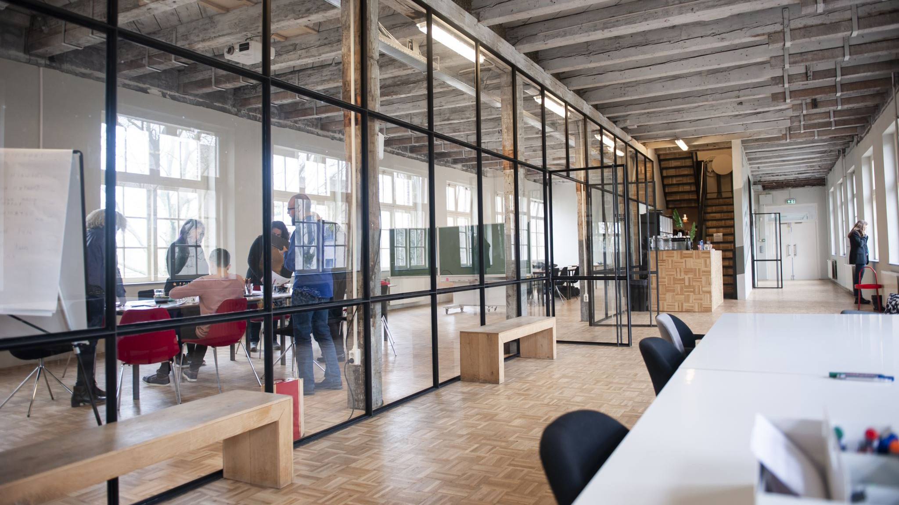
Career Planning
Eric is enrolled in Special School District's Vocational Skills Program and works at Monsanto cleaning the building and working in the cafeteria. He will be evaluated by Vocational Rehabilitation for continued employment and job exploration after he leaves the VSP program at age 21. Eric participated in the Arc's Neighborhood Experience program for four years and has an extensive resume of volunteer work. Eric participated in the SWEP (Summer Work Experience Program) during the summer of 2016. He was moved from the original assignment of a bagger at Schnucks in Eureka to work at Maritz in Fenton. Eric had a very bad experience at Schnuck's as both customers and the cashiers were unkind to him because he could not bag quickly enough and he had difficulty determining how to pack certain items in the plastic bags. Eric has submitted an application to participate in SWEP for summer 2017 and he will return to the VSP program in August of 2017.

Slide 13
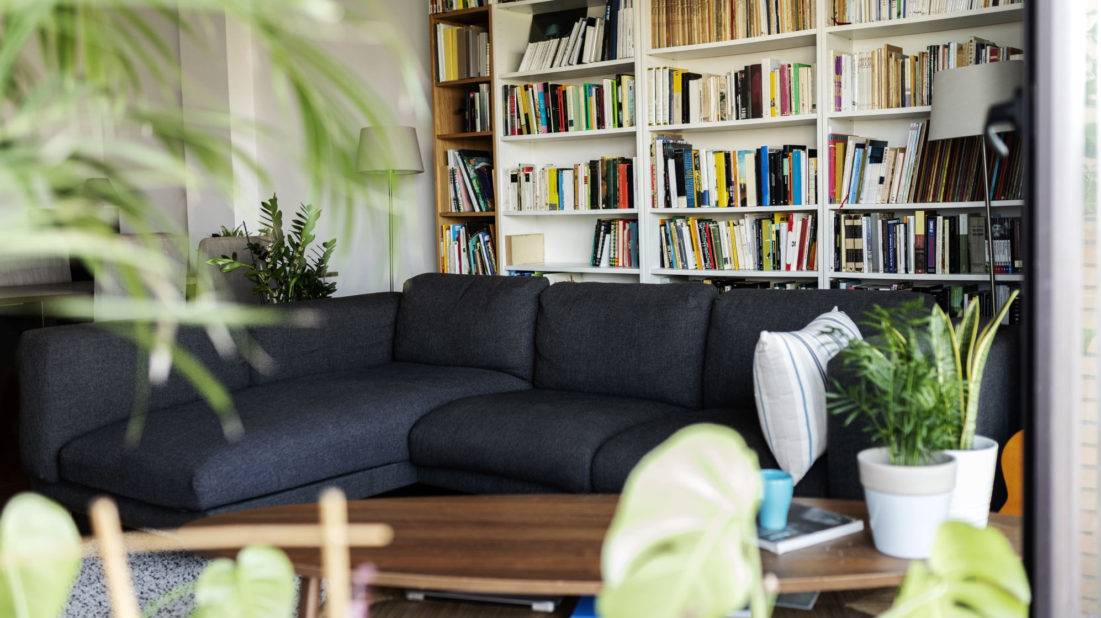
Community Living:
Reflect that the setting in which the individual resides is chosen by the individual:
Ron lives in an accessible apartment with separate access in his parents' home. Trials with two community living providers with an in-home ISL were attempted and both were w1successful as the staff turnover was high and the training that support staff received was inadequate to meet Ron's complex medical, physical and behavioral support needs. Ron and his family utilize self-directed supports through DMH.

Slide 14
Social and Spirituality
Supports or 'Personal Outcomes’
discovered during the assessment process
as part of planning:
Donovan practices making phone calls to family members. He develops relationships with his staff and his tennis coaches. Future goals would include developing a Facebook page and engaging more frequently with family members and the community.

Slide 15
Healthy Living
Choose mental/health resources
Identify health needs and supports
https://dmh.mo.gov/dev-disabilities/health
https://dmh.mo.gov/dev-disabilities/hrst-project
https://dmh.mo.gov/dev-disabilities/positive-supports
https://dmh.mo.gov/media/pdf/tools-choice-competency

Slide 16
Healthy Living
Diagnoses: Autism, intellectual disability, seizure disorder
Medical History: Diagnosed with autism at age 3. Most recent seizure was in May of 2016.
Prevention: Donovan takes medication to prevent seizures
Primary care physician (name, contact, service, frequency)
All other health providers (name, contact, service, frequency)
Maintenance of current health issues:
Medical, Vision, Hearing, Oral Care: He takes medication for his seizure disorder and sees a neurologist.
Dietary Needs: Donovan has mild/moderate digestive issues. They escalate in the form of gas and constipation when exposed to his sensitive foods: wheat, dairy, and processed sugar. His diet should be monitored and consistent; his diet is specified by his mother and prepared by either family or support staff. Donovan has a bowel care plan that includes monitoring bowel movements, following his diet plan, and, if necessary, a suppository or an enema.
Allergies/Sensitivities: Food sensitivities to meat, dairy, and sugar.
Mental Health Supports: NIA
Administration of Medications: Donovan is unable to monitor his own schedule and take medications at the correct time, and he does not understand the prescription labels. He takes pills and liquid medications without a problem. He is able to take the medications with minimal prompting and monitoring.
Current medications: oxcarbazepine, risperidone, seizure meds

Slide 17
Safety and Security
Supports needed for safety
http://www.redcross.org/images/MEDIA_CustomProductCatalog/m4240199_A4497.pdf
https://dmh.mo.gov/node/42206
Behavioral risk and prevention
https://dmh.mo.gov/media/pdf/guideline-83
Individual rights and due process:
https://dmh.mo.gov/dev-disabilities/quality-programs/individual-rights
https://dmh.mo.gov/media/pdf/directive-4-200-appendix-c

Slide 18
Safety and Security
Supports needed: for potential home dangers, cooking, water temperature, chemicals, etc. Mobility supports needs, falls, supports and adaptations for evacuation, etc.: Donovan is not able to summon help in case of an emergency. He needs support dialing 911 in case of an emergency. Donovan is not generally able to make safe choices at home. He is not able to stay in his home without supervision.
Altered levels of supervision: Donovan sleeps through the night without attention, but someone must be in the home. His seizure disorder is monitored through a bed sensor; an alert will wake the guardian if necessary.
Risk of Exploitation: Donovan is not able to avoid being taken advantage of financially. He requires assistance with money handling and budgeting. He is able to count and add coins and bills less than $10 with guidance. His mother has guardianship. He may not sign a contract and is never alone with strangers.
Provide information on Preparing for Disaster for People with Disabilities and other Special Needs: Donovan is able to exit the residence in case of emergency with direct verbal and physical guidance (i.e., "follow me".) Donovan is not able to respond appropriately to emergencies. He does not respond appropriately when he hears a fire alarm/siren. He will often hide and cover his ears, since he is afraid of loud noises. He needs support in understanding what is happening and where to go.

Slide 19
Behavioral Risk and Prevention
Positive Behavior Supports: Donovan becomes agitated after being exposed to loud environments, uncomfortable situations activities, or any foods he is sensitive to wheat, dairy, and processed sugar. If Donovan appears agitated because of this or another irritation, support staff must avoid telling Donovan "no" directly, demanding anything, or suggesting a task that requires exertion. If Donovan becomes excessively upset, he will begin externalizing his anger. At first, he will aggressively point his hand, simulating a slap, scream, and/or he will bounce/shake. Staff need to offer Donovan comfort items: food, computer, iPad, and then staff need to leave the room and let Donovan calm down independently. Staff should not use demands, ask questions, or speak loudly or aggressively. Rarely, it will escalate to the point that he hits a person, hits a wall, or throws an object. If he is extremely upset, staff should not offer him his iPad or laptop; staff should turn on Wheel of Fortune, give him a snack, and say he can take a break; staff should go sit in an adjacent room out of sight.

Slide 20
Citizenship and Advocacy
Personal income
https://www.ssa.gov/pubs/EN-05-10076.pdf
Self directed supports
https://dmh.mo.gov/node/42206
Choice of setting, service provider, and option of self-directed supports
https://dmh.mo.gov/dev-disabilities/supporting-families/services

Slide 21
Citizenship and Advocacy
Guardianship:
Ron’s mother and brother are his guardians. He does not vote.
Ability of Individual to manage funds:
Ron requires assistance with money handling and budgeting. Parents have guardianship and he may not sign a contract and is never alone with strangers.
Supports required to manage Ron’s funds:
Ron has a wallet for picture shopping cards and participates in money exchange with support. His mother buys most of his food using his EBT card; his parents pay for bulk items from Costco and co-pays on medication.
Spending funds:
He receives $100 a month for personal spending. This is typically spent with staff during community outings. Staff help Ron prepare for purchases and place change and receipts in his financial binder.
Payee of benefits:
Ron's mother is his representative payee for his SSI benefits.

Slide 22
Personal Outcomes, Goals, and Implementation Strategies
Personal outcomes:
The individual is interested in trying, learning, and/or doing
Goals:
Actions to be taken to achieve the outcome
Implementation Strategies:
The provider responsible for assisting with and achieving outcomes

Slide 23
Personal Outcomes
Personal Outcome: | Ron will increase his independence and self-determination by engaging in meaningful activities at home with appropriate physical and behavioral supports.
Individual’s definition of the outcome: | Ron engages in an average of ten meaningful activities per day. Ron will go out in the community at least twice per week.
Current Situation: | Ron engages in an average of five activities per day ranging from 0-15 activities depending on health. Ron engages in chores when physically able. Ron averages six trips per month in the community, typically to drive-through restaurants. Ron has the most difficulty when traveling when he is in pain. When he is not in pain, his behavior is appropriate 90% of the time when positive behavior supports are used. When Ron has been at home for extended periods due to health concerns, he has a greater need for behavioral supports when returning to community activities. Baseline: 7 trips per month.

Slide 24
Goal Example 1
Goal 3 | Ron will engage in five activities of his choice at home per shift when he is not engaged in community activities.
Strategies for Implementation | Staff will offer choices at each natural transition throughout the day and at least every half hour if Ron has asked to be left alone. Team collaboration will be used for staff to share ideas on how to engage Ron.
Measure of Success: | An average of ten documented activities per day.
Who is Responsible? | Paper logbook documentation by PAs
Estimated Completion Date | 6/30/2025

Slide 25
Goal Example 2
Goal 4 | Ron will access a variety of community settings an average of three times per week. When provided with positive behavior supports, Ron will engage in appropriate behavior when traveling in the car and during community activities 100% of the time.
Strategies for Implementation | PBS strategies for travel in the community: CDs of favorite music, singing, planning, supplying favorite objects, and food. Community Specialist services for new staff training as Ron does not engage in inappropriate behavior when his parents are in the car.
Measure of Success: | An average of twelve documented trips per month.
Who is Responsible? | Paper logbook documentation by PAs
Estimated Completion Date | 6/30/2025

Slide 26
Budget Request/ Authorization
All requests must include the following :
Time span of service(s) - [usually ISP dates. EG 7/1/24-6/30/25]
Name of each service - [PCA, Community Specialist, Day Hab, Transportation, etc. We like to include their CIMOR code here as well]
Name of each service provider - Acumen [name of the PROVIDER that will have access to funding in CIMOR]
Number of units to be provided in the time span indicated for each service - [SDS units are hours, other service units are usually in 15-minute increments (e.g., 4 units = 1 hour)]
Service rate per unit for each service. Current regular PCA for SDS is $33.00. [get the unit rate from your SC or the Provider]
Total cost per time span of each service [Units X cost = Total
Once the ISP is approved by Utilization Review (UR), these amounts will be entered into CIMOR and the Provider will be able to confirm they are available for use. In SDS’s case, the employer will be able to see the Authorization and Dates in their DCI portal under budgets.

Slide 27
Monitoring of ISP
Who is responsible for monitoring the plan?
Personal assistants via Daily notes
Community Specialist and therapists via service notes
Designated representative via Monthly summary
SDS specialist monitor on a 3-year cycle

Slide 28
DMH Internal Monitoring
Integrated Quality Management Functions
Complaint Response
Fiscal Reviews
Health Risk Screening
Licensure and Certification
Mortality Reviews
Individual Plan Reviews
Provider Relations Review
Quality of Services Review
Support Monitoring
IQMFD Database of Incidents

Slide 29
External Accountability
Call your Regional Office After Hours Emergency number.
Missouri Protection and Advocacy
www.MOAdvocacy.org
National Suicide Prevention Lifeline 988

Slide 30
Questions info@mosds.org https://www.facebook.com/groups/wecaresds

