Slide 1
SELF-DIRECTED SUPPORTS Intro to Self-Directed Services
8/1/2017

Slide 2
Training Objectives
What is Self-Directed Supports
Navigating the SDS & PPL’s website
Designated Role
Support Broker service
What services can be self-directed
Required SDS information in the ISP
Who can be an SDS employee
Mapping out paid & non-paid supports
Understanding the Fiscal Management Service (PPL)
Service Monitoring & Reviews

Slide 3
What is Self-Directed Supports?
Self-directed supports (SDS) is an option for service delivery for individuals, who live in their own private residence or that of their family member, who wish to exercise more choice, control and authority over their waiver supports. SDS is firmly grounded in the principles of self-determination.
Notes:
Please take out the Got Choice handbook.
Self Directed Supports(SDS) is about individuals with developmental disabilities exercising control over their own lives, working toward achieving individualized life goals, and obtaining the skills and supports necessary to create their vision for the future while building opportunities and relationships.
Individuals must live in their own private residence or that of their family member. Individuals can not live with an non related person who provides supports. The provision of service can not be a condition of where they live. i.e. SDS can not be set up where the individual would be living in the employee’s home and they would need to move if the employee were to be terminated.

Slide 4
Self-Determination as System Change
If individuals and families are in control of resources quality will go up and cost will do down.
Freedom
Confirmation
Support
Authority
Responsibility
Notes:
Page 6 & 7 of Got Choice
Give Real Life Examples of each of the principles of Self Determination
Freedom: Individuals will live a meaningful life in the community and make choices about their lives.
Authority Individuals will have meaningful control over a set amount of dollars that can be used to build the supports that they need by purchasing only what is needed and paying for what is received.
Support: Individuals will have support to organize resources in ways that are life enhancing and assist them in reaching their dreams and goals. Individuals have a circle of supports made up of family, friends, and both paid and unpaid supports.
Responsibility Individuals assume responsibility for giving back to their community, for seeking employment, and for developing unique gifts and talents.
Confirmation Individuals are recognized for who they are and what they can contribute, having a leadership role in developing policies that affect their lives and helping others reach success.

Slide 5
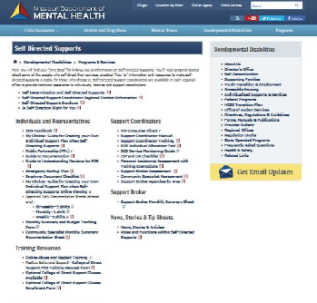
http://dmh.mo.gov/dd/progs/selfdirect.html
Notes:
Your one stop of info on SDS

Slide 6
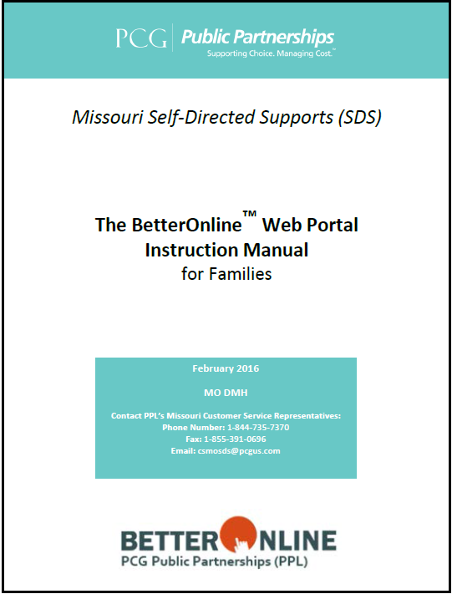
Self-Directed Supports
Individual/Designated Representative has both budget and employment authority and must follow both Medicaid and Department of Labor regulations.
Budget Authority allows the individual/DR flexibility over managing a yearly individual budget allocation. They set the rates of their employees, can utilize more services in one month and less in another or request to change from one approved waiver service to another as long as they stay within the authorized budget allocation.
Notes:
The Individual/Designated Rep must follow the Medicaid regulations as outlined in Got Choice Handbook the Fiscal Agent Agreement and regulations defined by the Department of Labor.
Must only use SDS services that are authorized in ISP but utilize more services in one month and less in another, increase or decrease employees pay (based on approved maximum rates),
Must stay within budget allocation
Can not authorize family members to work more then 40 per week.
The Employer Manual provides information in order to be in compliance with Department of Labor (DOL) regulations.

Slide 7
The Employer of Record
The Employer of Record is the individual receiving services through a Medicaid program.
For individuals under the age of 18 the parent/guardian is the Employer of Record.

Slide 8
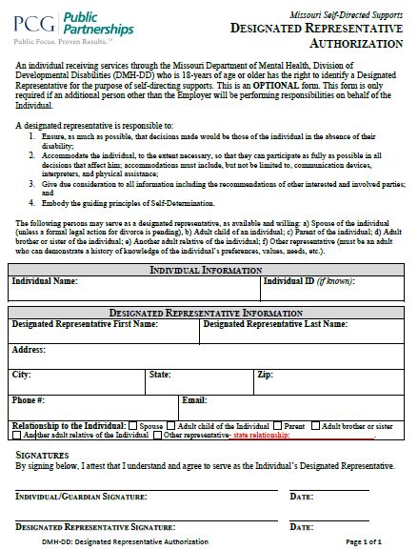
Appointment of a Designated Representative (DR)
The individual or guardian may select a designated representative (DR) in the event the individual is unable to direct and manage the day to day activities of their employees.
The Designated Representative (DR) will be the responsible party
Designated Representative is unpaid
Acts on the individual’s behalf and in their best interest
Cannot be an employee for any services
Notes:
Page 12 Got Choice Handbook

Slide 9
Who Can Be a Designated Representative
A spouse (unless a formal legal action for divorce is pending)
An adult child of the individual
A parent
An adult brother or sister
Another relative of the Individual
Other Representative-If the Individual wants a representative but is unable to identify one of the above, the individual, along with the support coordinator and planning team, may identify an appropriate representative. The ‘Other Representative’ must be an adult who can demonstrate a history of knowledge of the individual’s preferences, values, needs, etc. The individual and his or her planning team is responsible to ensure that the selected representative is able to perform all the employer-related responsibilities and complies with requirements associated with representing one individual in directing services and supports.

Slide 10
Individual/DR Responsibilities
Must direct and manage the worker’s day to day activities, making sure the services are provided as written in the ISP and provide other duties of an employer.
Must schedule/approve all hours worked prior to submitting the time to the Fiscal Management Service (FMS)
Must complete monthly summaries on line, and maintain required documents in the individual’s home.
Notes:
A Support Broker can provide information and assistance but can not do these activities for the indiv/DR.
It is responsibility of the Individual/Designated Rep to monitor worker’s day to day activities, ensure services and goals are provided as stated in the ISP, assist with hiring, firing, training, etc of all employees, approve schedule and hours of work prior to submitting time to FMS, complete monthly reviews and maintain required documentation in the individuals home.

Slide 11
Direct & Manage the Workers’ Day to Day activities
Recruit, interview, hire, manage and decide whether Employees are doing a good job
Make sure the Employee completes mandatory trainings.
Train the Employee on the Individual’s needs and preferences
Schedule and supervise the Employee
Review and approve weekly time sheets that are accurate and submit to the FMS
Report any situations of potential Medicaid fraud including, but not limited to: Falsified or made-up hours, Task(s) completed that are not authorized, Forgery
Dismiss Employees when needed.
Notes:
Individual employer/DR responsibilities.

Slide 12
What is Support Brokerage?
Provides the individual/designated representative with information & assistance (I&A) to secure the supports and services identified in the ISP
The Support Broker does not do these tasks for the individual/designated representative, but provides information and assistance in order for the individuals/DR to fulfill their employer related SDS responsibilities. The goal for everyone in SDS is to move towards ‘Independence’ and for individuals and families to have the support they need in order to self-direct services.
Some Individuals/DR may find that they do not need a Support Broker.
Through an agency- see DMH DD website for providers
Support Brokerage is monitored by the feedback received from the Individual/ Designated Representative and the monthly summaries sent to the Support Coordinator and Individual/ Designated Representative by the Support Broker.
Notes:
Got Choice Handbook page 12 Waiver Manual Support Broker page 81-83
Page
A support broker must be independent – cannot perform any other service for the individual!

Slide 13
Medicaid Waiver, Provider and Services Choice Statement
Ensure the option of self-directing supports is given to all individuals who receive a funded service & assist in the enrollment process if chosen.
Please note that the choice is SDS not the FMS.
FMS is currently Public Partnerships LLC (PPL).
Notes:
The choice is SDS not the FMS.

Slide 14
Which Services can be Self-Directed?
Personal Assistant
(PA)
Medical PA
Community
Specialist
Team Collaboration PA
Notes:
Page 13- 17 of Got Choice handbook
that can be utilized through the option of Self Directed Supports. We will discuss each of these in greater detail later in the training. It is very important as the Support Broker that you provide information and assistance to the employer/ designated rep to ensure they understand what the service is and to ensure that service meets the needs identified in the ISP.
* We currently have a limited number of Self-directed Support Brokers. Our goal is to move to only Agency-based Support Brokerage

Slide 15
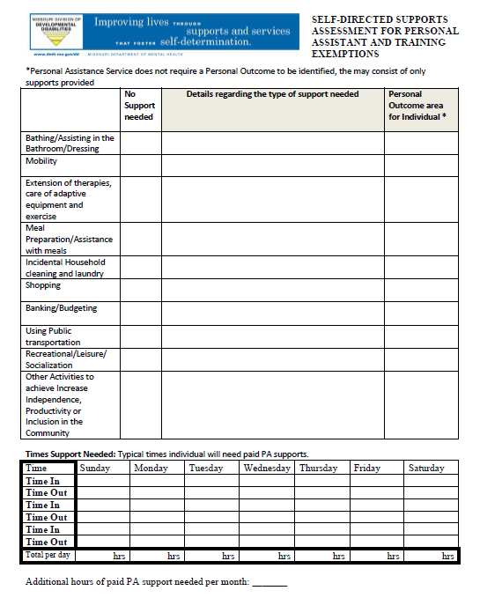
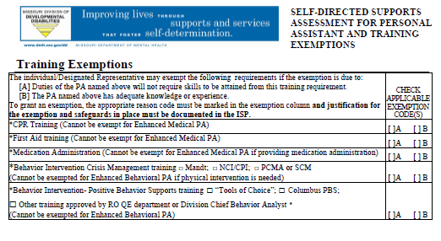
Personal Assistant
Assessment
A tool for ensuring that the ISP is meeting waiver requirements and helps to determine goals and outcomes.

Slide 16
Personal Assistant (PA)
Assists the individual with daily activities at home or in their community
May directly perform these activities or support the individual in learning how to perform them
Assists the individual in achieving the goals and supports outlined in their ISP (a formal goal is not required.
Can be provided up to 24 hours per day, as identified in the individual’s ISP (if not eligible for State Plan Personal Care). There has to be a justification for that as people in SDS utilize their natural supports.
PA is an active service. PA’s cannot be paid to sleep.
Notes:
This is defined differently than “state plan” Medicaid funded services (straight Medicaid).

Slide 17
Personal Assistance Team Collaboration
For self-directed supports Team Collaboration allows the individual’s employees to participate in the ISP and to meet as a team to ensure consistency in its implementation. A team meeting also can be convened by the individual or their designated representative for the purposes of discussing specific needs of the individual, the individualized progress towards outcomes, and other related concerns.
Team collaboration can be included in the individual budget up to 120 hours per plan year.
Notes:
Employee will be paid at their PA rate
For PA only.
Not to be used to replace the Individuals/DR responsibility of training the employees.

Slide 18
Medical PA
Under special circumstances the individual may need enhanced Medical PA services
Each have training requirements which cannot be waived
This level of support must be thoroughly outlined and justified in the individual’s ISP, as per the Waiver Manual
Under these conditions the individual will typically need a SDS Community Specialist or other agency based waiver service to provide oversight for the PA.

Slide 19
Evaluating the need for Specialized Medical PA
The interdisciplinary team has identified that the individual’s level of care requires either the:
Direct delivery of care by a licensed medical professional* or,
Training, delegation and periodic supervision of care by a licensed medical professional*.

Slide 20
Community Specialist
Used when specialized supports are needed to assist the individual in achieving outcomes as specified in the Individual Service Plan. Such as nurse delegation or contributing to the development of a positive behavior support plan.
May not duplicate Support Broker or other waiver service.
Notes:
Community Specialist is used to assist individual in achieving specific outcomes as stated in the ISP. The Community Specialist could be a nurse for medical delegation or a behavior specialist to assist in the development of a positive behavior support plan. Ie. Driver’s Instructor for someone wanting to learn a specific skill of driving. The Community Specialist is available to be used in all of the waivers. It cannot duplicate other waiver services. Can be authorized for up to 24 hours in a day under special circumstances.

Slide 21
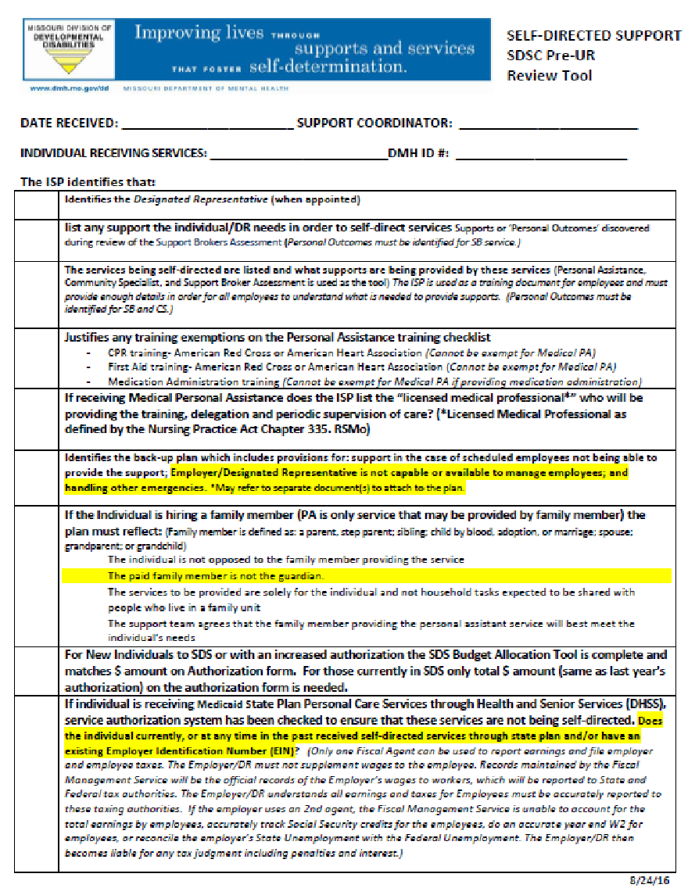
Individual Service Plan (ISP)
The ISP is used as the training document for employees and must provide enough detail in order for all employees to understand what is needed to provide supports.
SELF-DIRECTED SUPPORT SDSC Pre-UR Review Tool – help ensure that all required SDS elements are in ISP
Notes:
This information also matches the ISP Guide.

Slide 22
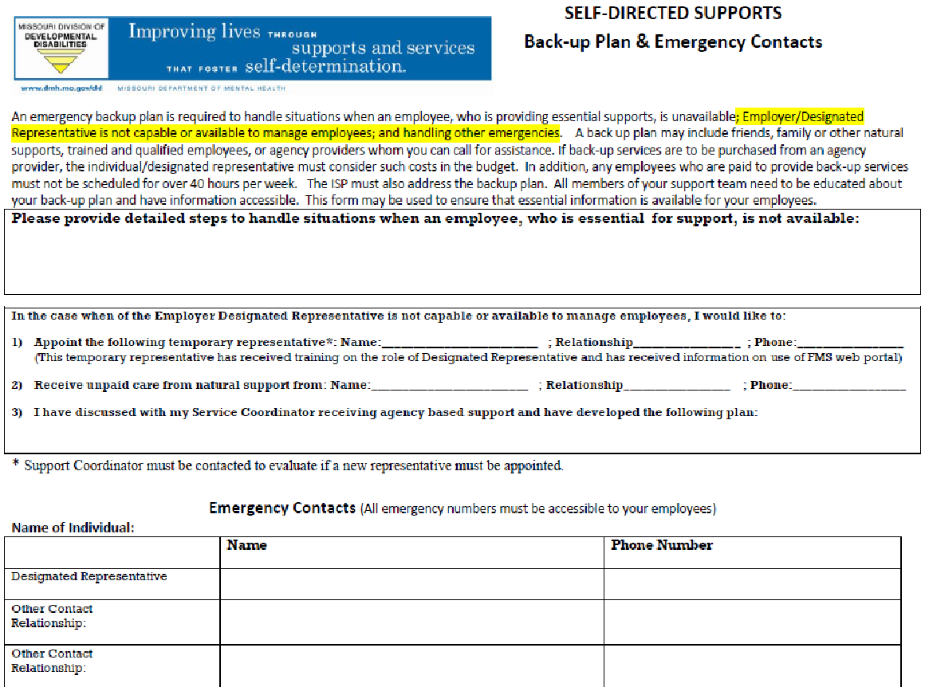
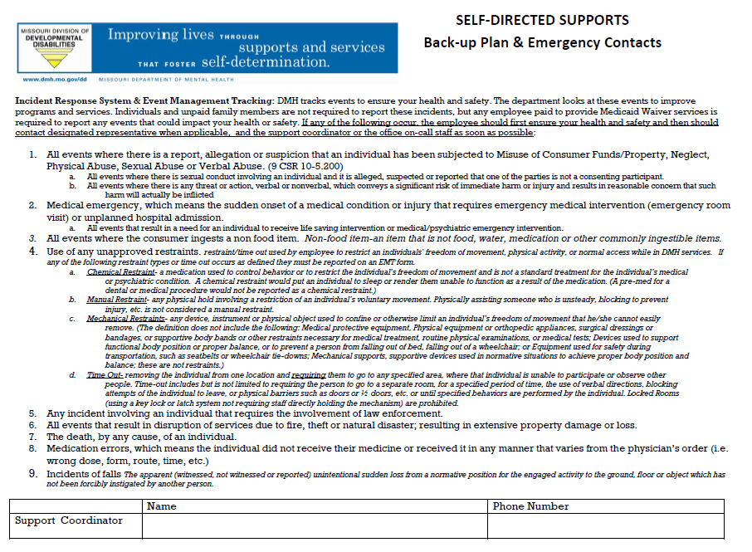
Back-up Plan
Identify the back-up plan when scheduled employees are not available to provide supports, Employer/DR is not capable or available to manage employees or other emergencies arise
Notes:
In developing the Back-Up plan
Does the individual/designated representative have some part time employee who can cover if an employee does not show up without working more then 40 hours per week?

Slide 23
State Plan Personal Care Services
DD Waiver manual states:
“If self-directing services the individual shall only be enrolled in either, as eligible, the state plan PCA self-directed or DD waiver self-directed services, but he or she cannot be enrolled in both at the same time.”
Notes:
(Only one Fiscal Agent can be used to report earnings and file employer and employee taxes. The Employer/DR must not supplement wages to the employee. Records maintained by the Fiscal Management Service will be the official records of the Employer’s wages to workers, which will be reported to State and Federal tax authorities. The Employer/DR understands all earnings and taxes for Employees must be accurately reported to these taxing authorities. If the employer uses an 2nd agent, the Fiscal Management Service is unable to account for the total earnings by employees, accurately track Social Security credits for the employees, do an accurate year end W2 for employees, or reconcile the employer’s State Unemployment with the Federal Unemployment. The Employer/DR then becomes liable for any tax judgment including penalties and interest.)

Slide 24
Who Can be an SDS Employee?
Anyone over age 18 with a High School diploma or GED (4 year degree or 2 year + experience required for Community Specialist) who the individual or their designated representative chooses to hire, with the following exceptions:
SDS Employees Cannot Be:
An individual’s spouse
An individual’s parents, step parents if they are a minor
An individual’s legal guardian
The individual’s Designated Representative
Anyone with a felony or charge which is disqualifying
Anyone under the age of 18.
Notes:
SDSC can use the HS exemption form

Slide 25
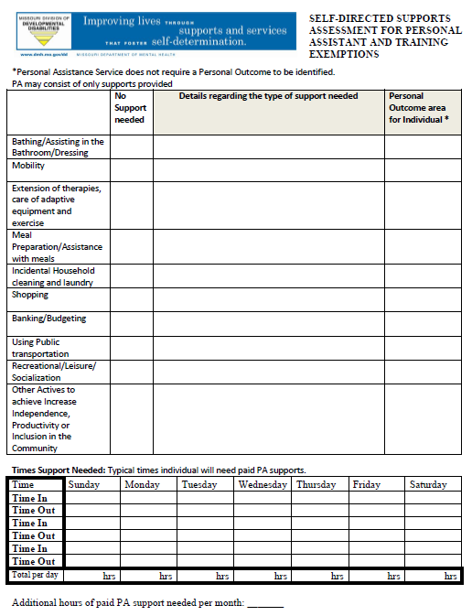
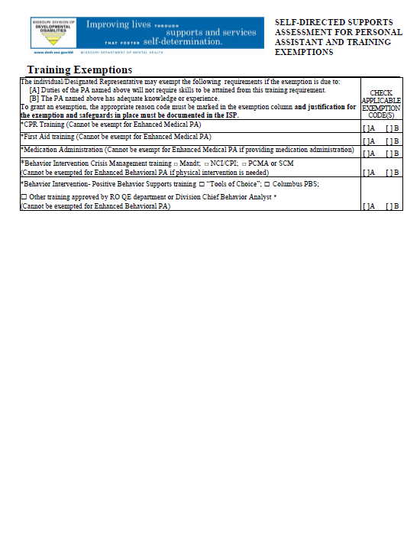
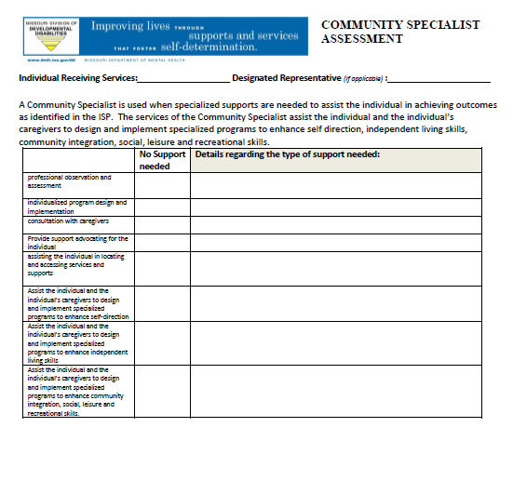
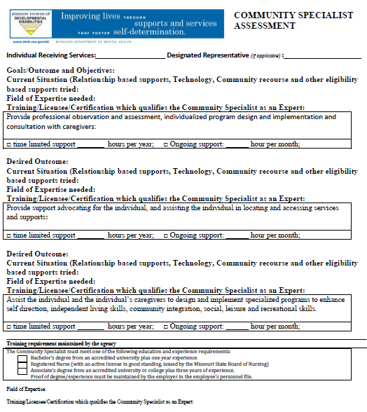
Steps in creating the Individual Budget Allocation
Determine the pattern and intensity of the support needs to meet these “Desired Outcomes”. The “Personal Assistance Assessment with Training Exemptions” and/or “Community Specialist Assessment” are tools used for planning and help to determine the total number of hours needed for the span date of the ISP.

Slide 26
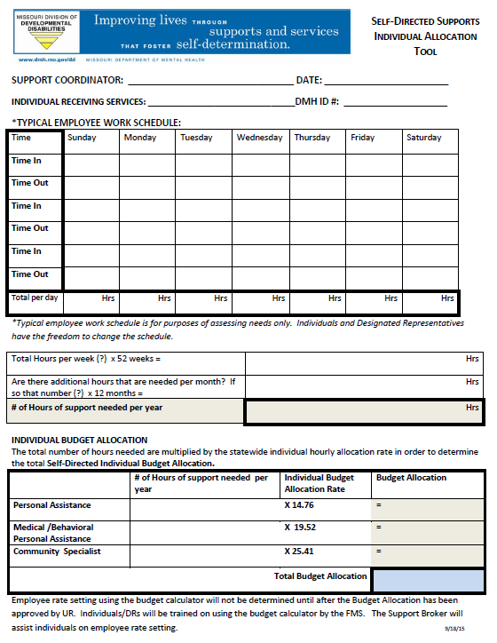
Steps in Creating the Individual Budget Allocation
This information gathered is put into the “Self-Directed Individual Allocation Tool”.
This tool is attached to the ISP for approval by UR .
The total number of hours needed are multiplied by the self-directed statewide individual hourly allocation rate in order to determine the total Self-Directed Individualized Budget Allocation.
The “SDS Pay Rate Calculator” is the tool used for employee rate setting.
The PPL will provide basic information on using the “SDS Pay Rate Calculator” during enrollment.
Notes:
Please note an ISP only has to go to UR is it is an new or increased budget.

Slide 27
Vendor Fiscal/Employer Agent FMS
Setting up payroll records for workers hired
Ensuring federal, state and local tax withholding and payments are made; file required federal and state employer reports on time
Worker’s Comp
Human Resources Functions
Background checks
Tracking employee qualification/ trainings
Maintaining Service Documentation starting 2/7/16
Provide individual with monthly budget information regarding payments that have been issued from the approved budget along with a current balance
Notes:
Public Partnership (PPL) Act as the Human Resource Department for the SDS option

Slide 28
Missouri’s FMS
Public Partnership (PPL) ; their web address is hhttp://www.publicpartnerships.com/programs/missouri/SDS/index.asp
ttp://moconsumerdirect.com
PPL’s phone number is 1-844-735-7370
PPL’s customer service email is csmosds@pcgus.com

Slide 29
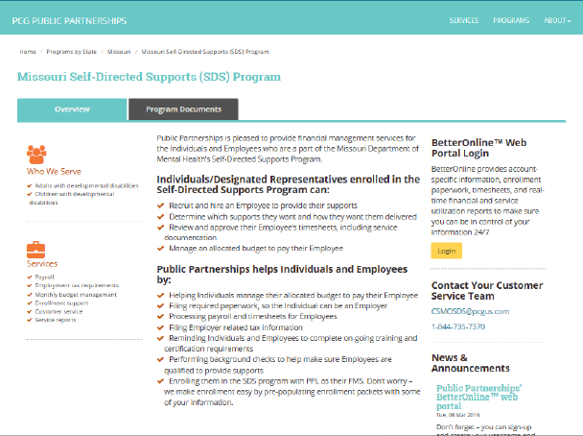
Missouri’s FMS
http://www.publicpartnerships.com/programs/missouri/SDS/index.asp

Slide 30
PPL Web Portal Documentation Maintained

Slide 31
Getting Started…
The individual may utilize the SDS option if they receive funding through Medicaid Waiver or POS, pending Utilization Review and Administrative approval

Slide 32
Individual is interested in SDS
Discusses with SC
SC may contact SDSC for assistance
SC amends ISP, creates budget & authorization form; contact SDSC for assistance
SDSC sends PPL Referral Form information also sends Intro letter to Indiv/DR
SDSC reviews UR packet & ensures PPL New Referral Form is complete
UR approval and entered into CIMOR
PPL completes FCSR background check on employees & E-Verify, collects training information "
PPL contacts Employer/DR to complete enrollment process
Ok to Work Form" to Employer/DR

Slide 33
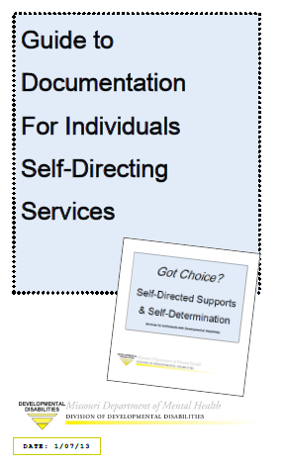
Service Documentation Maintained
Service Documentation describes various covered activities or services in which the individual participated, progress towards goals, and unusual events
Must be sufficient so that it is understandable, explains what was provided, and can be verified with reasonable certainty that the services were provided
Service documentation must be maintained by the employer for a period of 6 years (prior to 02/07/16)
The employee is responsible for writing the documentation on the date they provide the service.

Slide 34
Service Monitoring
Case notes should reflect observations related to the following key areas:
Environment – Are there health & safety concerns; is the individual’s home adapted to meet their needs, etc?
Individual rights – Are the individual’s rights respected and protected? If there is a designated representative are they serving the best interest of the individual?
Staff and services – Is the employer maintaining all paperwork & documentation? Is it accurate & up to date? If family members are providing services, is it provided in the best interest of the individual? Are the employees qualified? Is the employee training checklist completed prior to providing services and annually thereafter? Have you signed each training checklist?
Money – Are the individual’s services being provided within the parameters of their budget?
Health & safety – Have there been reports of unusual events; has the team followed up? Has the individual experienced major changes that may influence support needs?

Slide 35
APTS: Action Plan Tracking System
Division of DD data base used to collect information on issues/positive outcomes that affect consumers.
Collecting the information is for prevention purposes
Address any patterns or trends in issues that are occurring before they develop into a critical situation.
This data is maintained for quality assurance purposes and could be used for a corrective action plan.
Notes:
The Action Plan Tracking System (APTS) is a Division of DD data base used to collect information on issues/positive outcomes which were discovered through the Division’s integrated quality management functions. APTS also collects additional information on actions that were taken to resolve the issues. Information is entered into APTS by the domains of health, safety, rights, services, fiscal, and positive outcomes which assist in trending and tracking the information.
The purpose of collecting the information is for prevention purposes. We want to address any patterns or trends in issues that are occurring before they develop into a critical situation.
The integrated functions include; service monitoring, nursing reviews, personal plan reviews, fiscal reviews, QE reviews, PR reviews, licensure and certification, and mortality reviews.
The data base is use as a central point for issues to be collected regarding consumers and agencies.
Agencies include Regional Offices, TCM Entities, and contracted providers
APTS collects positive outcome information that is discovered during the functions as well and categorizes them by the Missouri Quality Outcomes.

Slide 36
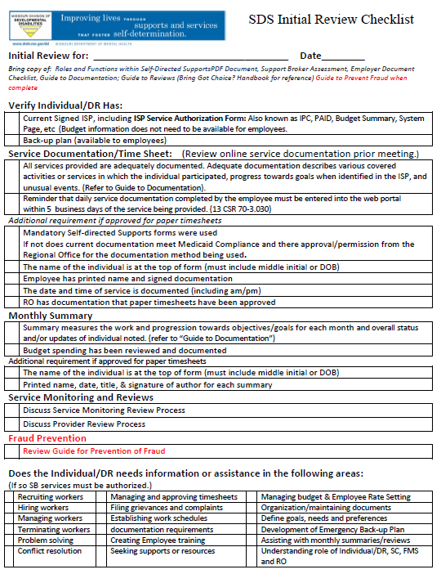
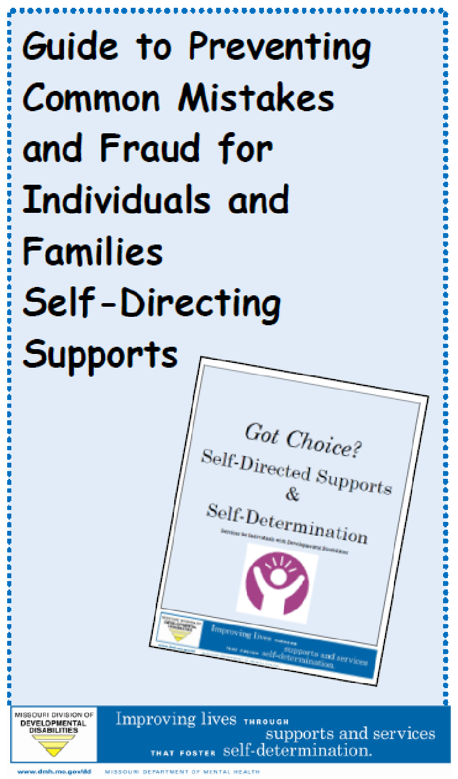
SDS Reviews: Initial Review
The SDSC will in collaboration with the SC will do an ‘Initial Review’ and go over the “Guide to Preventing Common Mistakes and Fraud” during the first SC Service Monitoring visit after the start of SDS.

Slide 37
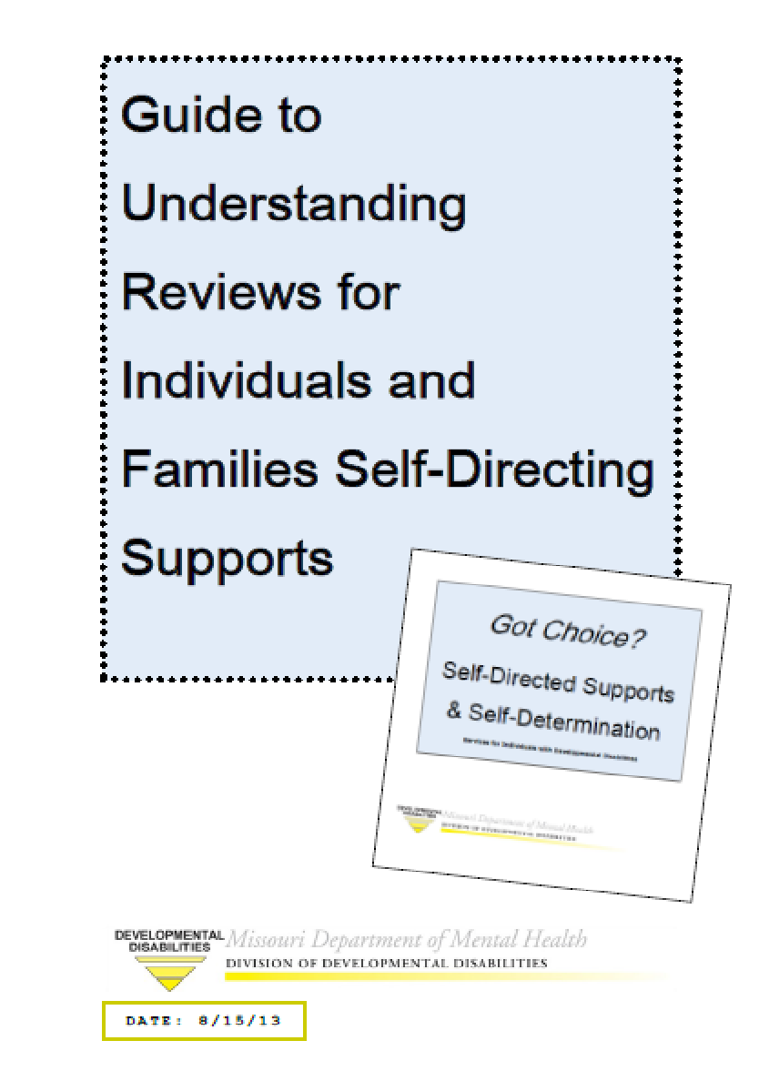
SDS Reviews:
Provider Review
The Regional Office does a Provider review no less then every 3 years.

Slide 38
SDS Improvement Plan
When multiple issues have been identified, a pattern of issues repeatedly occurring, or serious situation that must be corrected a Self-Directed Supports Improvement Plan will be jointly developed.
Issues may be identified on monitoring visits, event reports, reviews or issues reported by the FMS (PPL).

Slide 39
Termination of Self-Directed Supports
Voluntary Termination If an individual decides they do not want to continue self-directing their supports, they may stop at any time. The service coordinator should help them begin that process and assist them in transitioning to agency-based services.
Involuntary Termination of Self-Directed Services
In the event the planning team determines the individual’s health and safety is at risk, there are concerns regarding their willingness to ensure proper records are accurately kept, or that they are unwilling to supervise employees to receive services according to the plan, the choice of self-directing their supports may be terminated. Before terminating self-directed options, the service coordinator and other appropriate staff will first counsel the individual or their designated representative to assist them in understanding the issues, let them know what corrective action is needed, and offer them assistance in making changes. If the SDS option is terminated, the same level of services will be offered through a traditional agency-based model.
Notes:
Page 29 of got choice handbook

Slide 40
QUESTIONS??

