Slide 1
Letter Of Intent Planning for the Future
Jim Jordan,
jajordan725@sbcglobal.net

Slide 2
Purpose of Letter of Intent
To Communicate their Wishes and Knowledge about their Son or Daughter with a Disability to Future Caregivers
May be short term (hospitalization or long term care recovery)
Long term (You die before they do)

Slide 3
The WHO
You/Spouse-Partner
Relatives that may be involved
Friends
Lawyer & Accountant
Trust
Support groups/Institutions

Slide 4
The WHAT
HOW CAN YOU, AS A PARENT, BE ASSURED THAT YOUR SON OR daughter will lead as complete a life as possible after your death? What can you do to make sure your hopes and aspirations are realized?

Slide 5
The WHY
Writing a letter of intent is a critical step in the planning process. This critical document permits parents to communicate future wishes and vital information about their son or daughter to future caregivers.

Slide 6
Parents are the experts on their child
No one understands your son or daughter’s needs and desires better than you.
If you become incapacitated or die, it is vital that future caregivers have access to your knowledge.
Although not a legally binding document, a Letter of Intent is an ideal format.

Slide 7
Your major concern is to make sure that your child will have a happy and meaningful life. Write clearly enough so that anyone who reads the letter in the future will understand exactly what you meant.

Slide 8
The WHEN
ASAP!
You need to have legal documents completed and your lawyer part of the team.
Annual Review and Revisions

Slide 9
The How
Overwhelming to consider all the pieces needed
Gather all the legal documents
Who will be designated representative, disperse money, do taxes, etc.
IEP or ISP
Residential Placement, education/workforce, social, spirituality
Medical Care, Final Arrangements
Care Manual
The Letter (hardest document I have written)
Supporting Documents
Review and Revise annually or sooner

Slide 10
Avoid Frustrations for Designated Person
All Legal Documents Scanned and on Desktop of Computer AND Hard Copy at Home
Provide a copy of Table of Contents to main people
Original Will and Other Legal Documents in Safety Deposit Box
How will they access all docs (password protected, safety deposit box key, phone #’s)

Slide 11
Chapter 2 of Book Planning For The Future 1. Good Source for more information & template. 2. You can use their guide or modify to meet your needs (I modified). On SDS Google Drive Folder Letter of Intent Compassion & Choices - Care and Choice at the End of Life

Slide 12
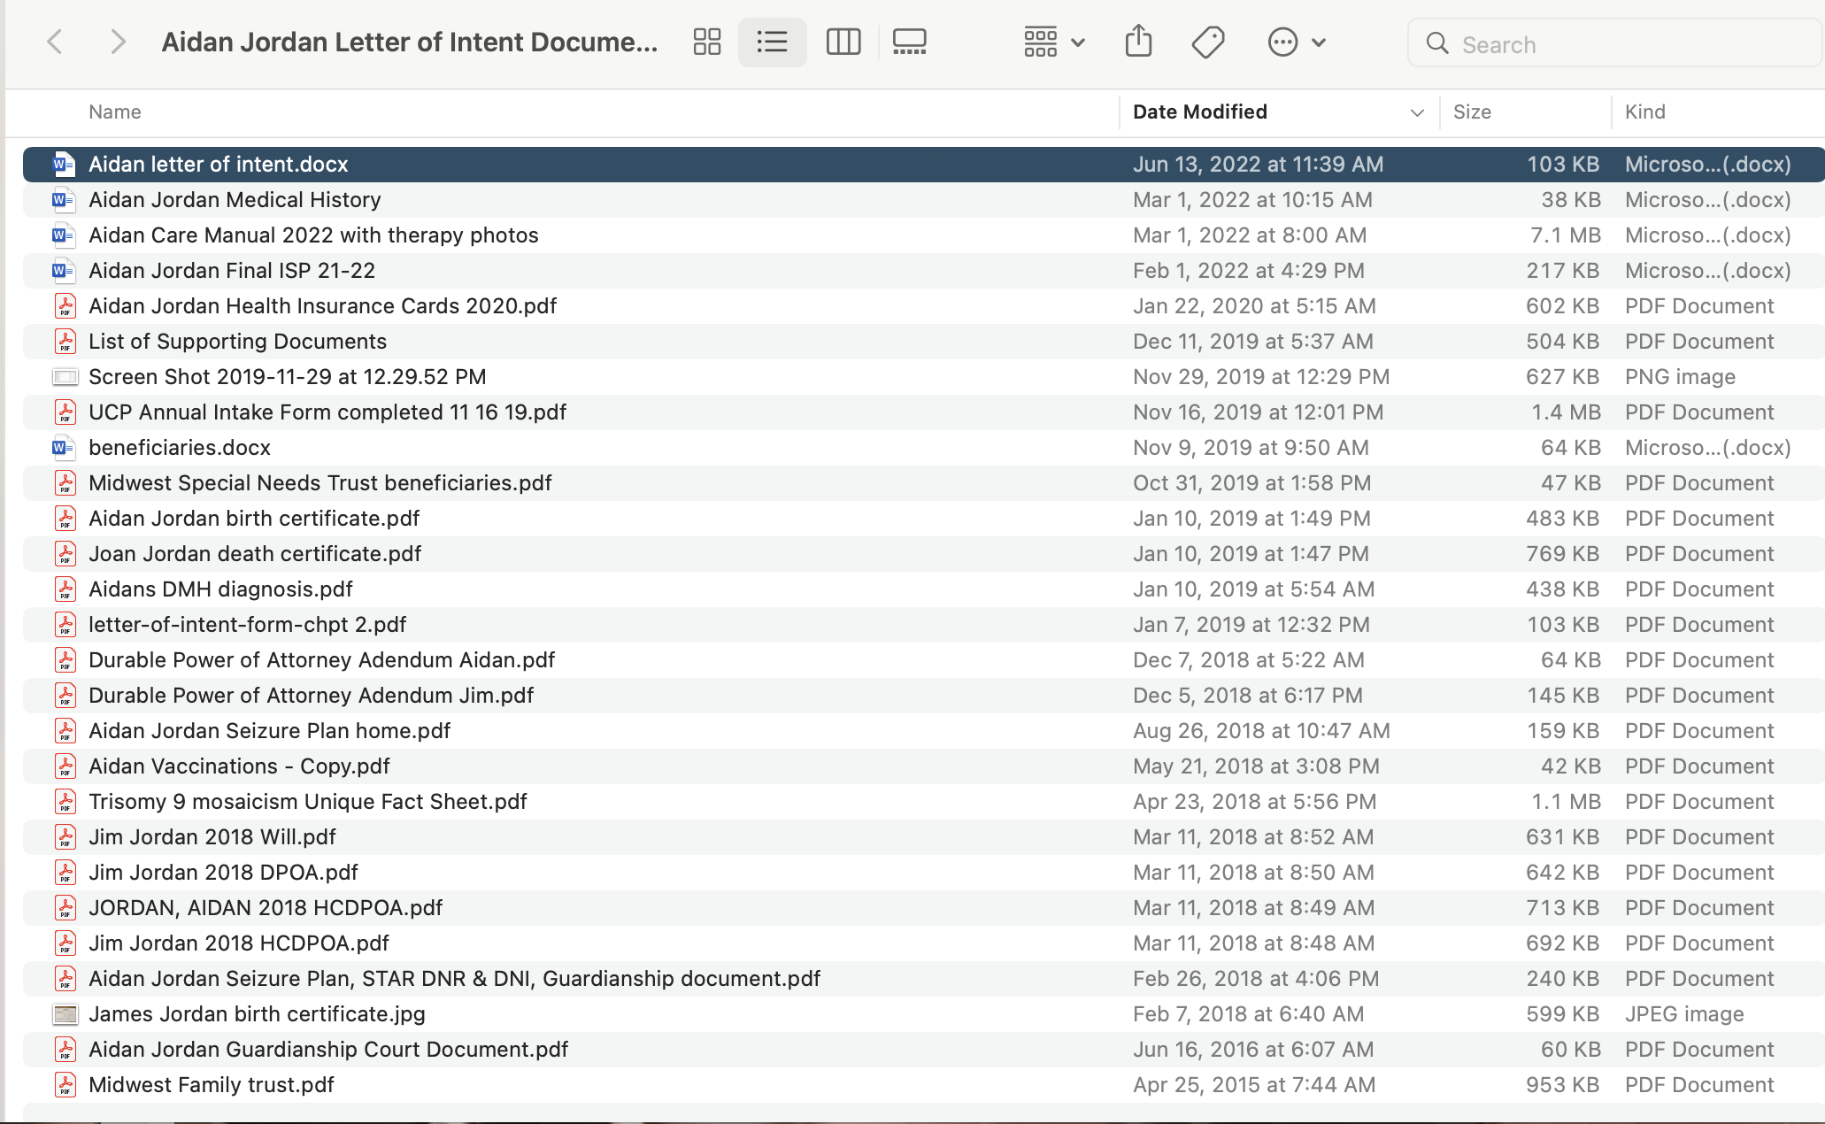

Slide 13
Legal Document Categories
Birth Certificates, Social Security Cards, ID Documents
Medical Diagnosis from Dr and DMH
Court Guardianship Document
Will
Durable Power of Attorney
Durable Power of Health
Living Will
How will body be treated/disposed of after death
Special Needs Trust

Slide 14
Organizing and Developing Your Wishes
What is the Prime Directive?
What are Your Beliefs?
What Are Your Values?
What are Medical Directives?
Other Dispositions?
What is Your Vision of Life?

Slide 15
What is the Prime Directive?
That Aidan maintains a high quality life and is able to engage in his own way to ensure that he: is healthy and can have some form of autonomy by communicating his wants and needs/is able to have basic physical abilities/physically able to engage in his favorite activities with some form of assistance/help, is happy and is able to engage in activities that he enjoys, is comfortable and wants to be with his care providers and peers, gets out into the community and be part of the “scene”, and shows satisfaction with his life/not exhibiting failure to thrive or checking out because he isn’t able to be stimulated.

Slide 16
Underlying Beliefs
Science is the guiding principle guiding my beliefs, values and actions
Aidan’s wants and needs should be met with assistance of people and technology
Aidan is experiential and personal interaction is essential
Death is a natural part of the life cycle and US citizens have a hard time accepting death.
We play God in that we can keep people alive with medical interventions beyond the natural order of life

Slide 17
Underlying Values
Quality of Life – Not Isolated but part of Society
Inclusion & Acceptance with Dignity, Respect, Equality
Resource Equity and Distribution
Eco-Centric not Homo-Centric

Slide 18
Medical Directives
DNR
DNI
Do not use heroic medical interventions if quality of life will be compromised
Avoid failure to thrive

Slide 19
Other Dispositions
Aidan lives at home – Dautel Center will be deeded house as long as this is the case.
Aidan lives with others at home.
Money in trust be used to enrich and engage Aidan in personal life

Slide 20
Your turn – 7 minutes
On the worksheet list as it would pertain to your son or daughter
At least 2 Beliefs
At Least 2 Values
At Least 2 Directives or Dispositions
One or Two Challenges for Designated Rep you have in mind

Slide 21
In Breakout rooms (10 minutes)
Have two people share their beliefs
Tell person, what you would want to know regarding their belief to understand it better in the Letter of Intent
Have two different people share their values
Tell person, what you would want to know regarding their value to understand it better in the Letter of Intent
Have one or two people share their Directives or Dispositions
Tell person, what you would want to know regarding their Directives or Dispositions to understand it better in the Letter of Intent

Slide 22
Jim Read What He Wrote To Explain
Or in Document I can Provide

Slide 23
Important Benchmarks to consider when faced with tough decisions and choices
Aidan has lived a good life, experiencing many things that have enriched and challenged him.
Aidan’s quality of life requires him to be out of his chair and in the community doing things such as meeting and interacting with others.
Aidan has outlived most trisomy 9 kids and has received exceptional care in hospital and at home.
Aidan has been a change agent in St Louis’s disability community regarding which individuals should be accepted into recreation programs. His legacy has been established and his life has had impact.

Slide 24
Aidan is totally experiential, his quality of life declines with declines in his physical abilities. He has been in a slow decline for standing and walking since 2008.
Jim has seen an increase in Aidan wanting and wishing to do things he can no longer do. It is getting harder and harder to physically support him in doing these things and has taken a huge toll on Jim physically supporting Aidan. You need to consider a care providers health AND Aidan’s need to participate in activities.
Aidan has lived a good life, experiencing many things that have enriched and challenged him. Do not blame yourself for him becoming ill or reaching an end of life decision.
Remember death is a natural part of life, I believe Aidan would accept it or discard it based on his current condition.

Slide 25
Write Down 3 Benchmarks to Consider in Decision Making

Slide 26
Other Criteria to Include
Aidan aspirates and cannot have a G-Tube
Aidan is Known in Maplewood
Aidan’s Home was designed with him in mind
Aidan does not do screens, technology or TV/movies
Aidan Loves Live Music

Slide 27
List three criteria that are important to include and discuss

Slide 28
NOW IT IS TRULY YOUR TURN USE THIS POWERPOINT CHAPTER 2 MY DOCUMENT FOR AIDAN

Slide 29
Contact Me by email with any Q’s or discussion
jajordan725@sbcglobal.net

