Slide 1
Quality of Life is Hard to Define, But I Know It When I See It
Notes:
v

Slide 2
Quality of Life Outcomes
Personal Development
Self-Determination
Interpersonal Relations
Social Inclusion
Self-Advocacy, Human Rights, and Dignity
Emotional Well-Being
Physical Well-Being
Material Well-Being
Notes:
v

Slide 3
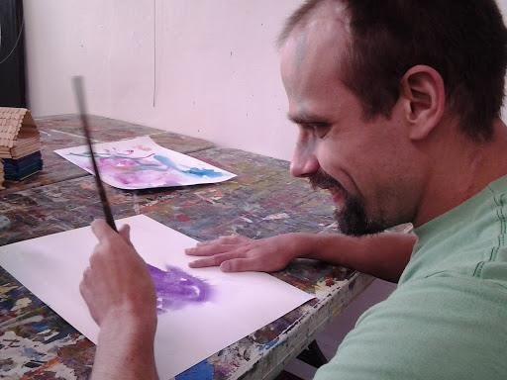
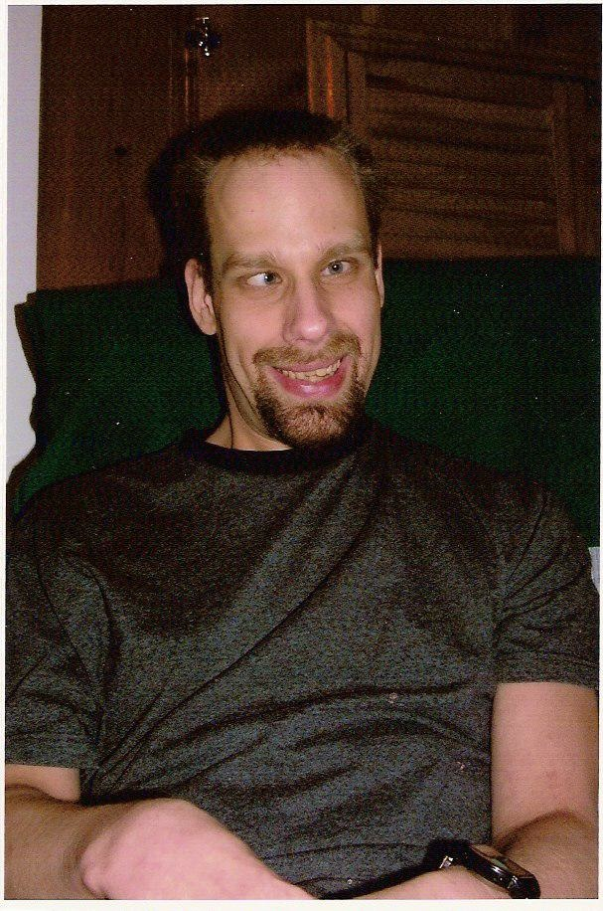
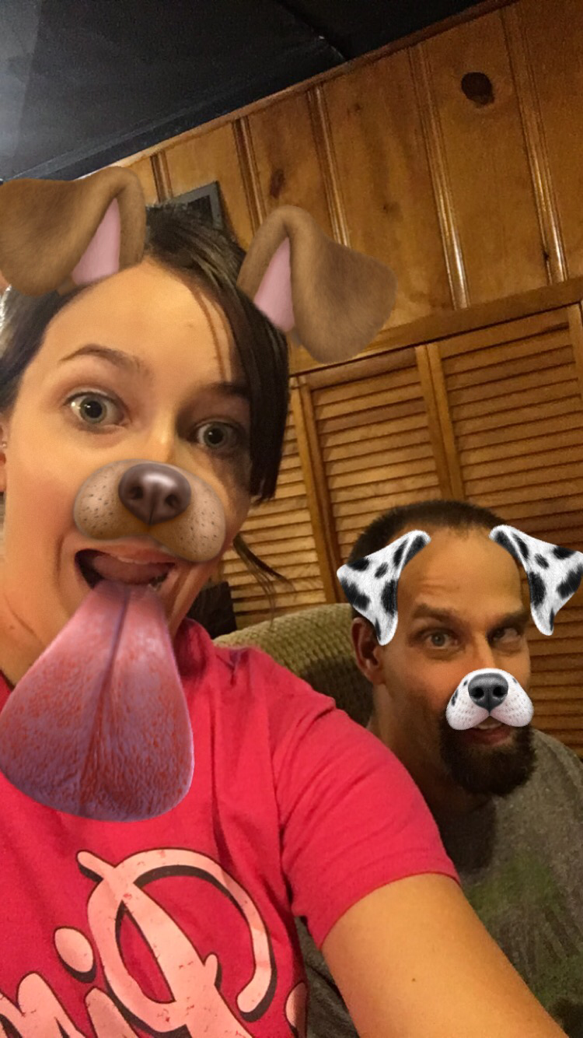
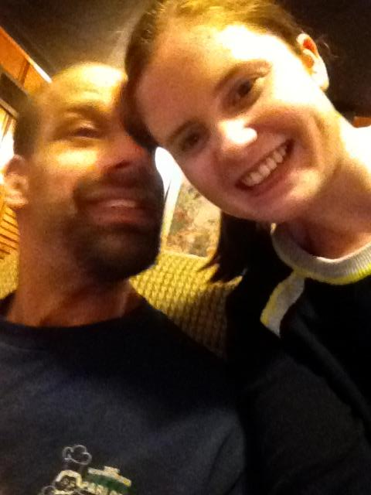
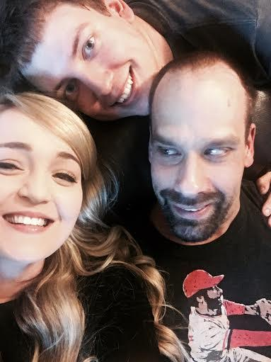
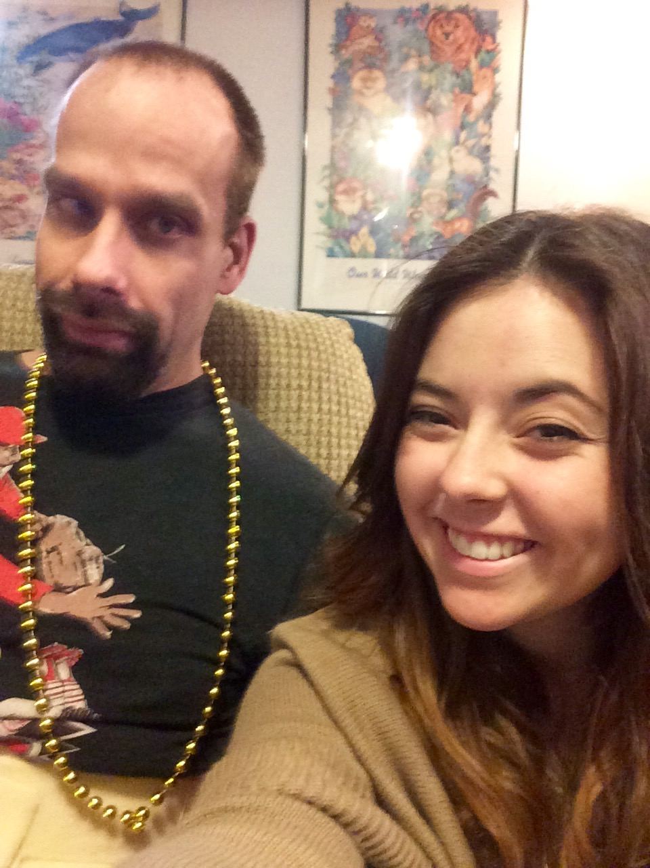
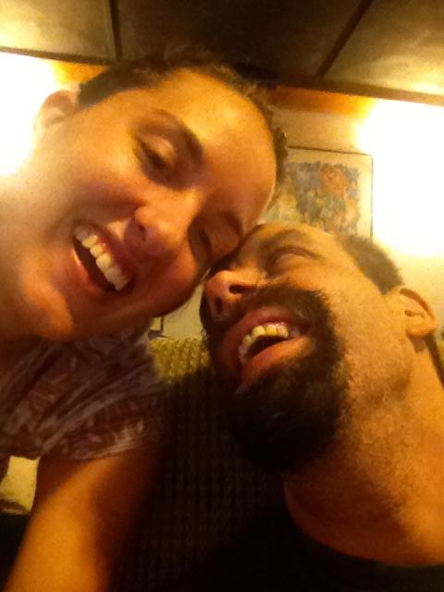
Notes:
j

Slide 4
Ron’s History
Ron is a 37-year-old male with multiple disabilities that include intellectual disability (secondary to extreme prematurity and hydrocephaly), mixed type cerebral palsy and autism. He had 6 shunt failures in the first 6 years of his life. Ron was adopted at age five. At that time his prognosis was not good as he was not expected to be able to walk at and to have serious trouble with developing verbal communication skills. However, with support from his family and friends, Ron has been able to overcome many obstacles to exceed original expectations.
Notes:
j

Slide 5
Personal Development
Support Strategies | Anticipated Outcomes
Facilitate goal setting Maximize incentives Build on personal strengths Implement self-management programs Implement skill development programs Provide assistive technology Modify environments | Develops motivation Increases self-efficacy Facilitates internal locus of control Increases access and independence
(Van Loon, in press)
Notes:
v

Slide 6
Ron’s Life
Ron needs physical and behavioral supports for all activities of daily living. He partially participates by engaging in the core motor components of activities or verbally directing the activity. He needs assistance with accessing materials. Individuals supporting Ron must listen and observe carefully to understand his communication. He needs encouragement to participate in new activities.
Notes:
j

Slide 7
Support Plan Goals
Ron will engage in five activities at home per shift when he is not engaged in community activities.
Ron will engage in one household chore five days a week with staff support.
Notes:
j

Slide 8
Self-Determination
Support Strategies | Anticipated Outcomes
Allow/facilitate choice and decision making Teach self-regulation | Facilitates internal locus of control, self esteem, and sense of empowerment Enhances personal control
(Van Loon, in press)
Notes:
v

Slide 9
Ron’s Life
Ron is able to advocate for many of his needs/wants. Ron expresses to staff when he is hungry and will often say “hungry again” when he wants something else to eat. Ron can also communicate to staff when there are activities or items that he wants around the home. Ron has a calendar where staff will help Ron paste picture cards that reflect the activities that Ron engaged in that day. Staff will review with Ron what each of these pictures is and go over Ron’s day with him.
Notes:
j

Slide 10
Support Plan Goal
Ron will use scheduling tools to predict, choose, and review daily activities.
Notes:
j

Slide 11
Interpersonal Relations
Support Strategies | Anticipated Outcomes
Use communication/social media devices Involve in social skills training program Involve in peer-group (e.g. PALS, Best Buddies) Maximize family involvement Emphasize personal strengths (e.g. attitudes, skills, knowledge sharing) | Increases social engagement Increases social networks Increases perceived societal contribution
(Van Loon, in press)
Notes:
v

Slide 12
Ron’s Life
Ron’s apartment is the basement of his parents’ house, so Ron is able to see his mom and dad on a daily basis. Ron has two siblings, Elizabeth and Andy. Ron also has an extended family – aunts, uncles and cousins, and grandparents who he sees at family get-togethers and on holidays.
Ron has many friends he enjoys seeing. Ron has great relationships with a few of his peers from school and also with former staff who are still a part of Ron’s life.
Notes:
j

Slide 13
Support Plan Goal
Ron will keep in contact with important people in his life by sending birthday cards and invitations as well as making phone calls and using email and Facebook on a regular basis.
Notes:
j

Slide 14
Social Inclusion
Support Strategies | Anticipated Outcomes
Access/interface with natural supports Use social media Facilitate transportation Use prosthetics (sensory or motor devices) | Increased community access, participation, and involvement
(Van Loon, in press)
Notes:
V

Slide 15
Ron’s Life
Ron needs physical and behavioral supports to access community recreational settings (i.e. Centennial Commons Recreation Center, Webster University swimming pool, community science and cultural events). Staff also support Ron in contacting friends and family through phone calls, letters, and Facebook.
Notes:
J

Slide 16
Support Plan Goals
Ron will participate in music activities at the ARC or by attending karaoke an average of one time per week.
Ron will engage in regularly scheduled community activities an average of two times per week.
Notes:
J

Slide 17
Self-Advocacy, Human Rights, and Dignity
Support Strategies | Anticipated Outcomes
Advocate for full citizenship, access, due process Involve in self-advocacy Treat with respect (e.g. privacy, recognition, dignity) | Ensures equity, inclusion, and legal rights Maximize empowerment and inclusion Respect human rights
(Van Loon, in press)
Notes:
V

Slide 18
Ron’s Life
Ron is given choice within and between all activities. He has access to all areas of his apartment and is able to be alone when he wants to be. He is able to visit with friends and family whenever they are available. He has a positive behavior support plan and all staff receive Ron-specific PBS training.
Notes:
J

Slide 19
Support Plan Goal
Ron will use scheduling tools to predict, choose, and review daily activities.
Notes:
J

Slide 20
Physical Well-Being
Support Strategies | Anticipated Outcomes
Provide prosthetics (i.e. sensory or motor enhancement devies) Implement nutritional programs Implement or increase involvement in exercise programs Access professional services | Increase sensory processing and physical mobility Maintain weight control and encourage proper and balanced nutrition Enhance human functioning and reduce negative effects of obesity and/or inactivity Maintain or improve medical/physical condition
(Van Loon, in press)
Notes:
V

Slide 21
Ron’s Life
Ron experiences a variety of chronic pain conditions. His mobility is decreasing as he ages. Staff provide encouragement in appropriately communicating about pain and physical needs. Staff provide appropriate medication and behavioral supports based on Ron’s communication and their assessment of his well-being throughout the day.
Notes:
J

Slide 22
Support Plan Goals
Ron will engage in an exercise routine as designed by the physical therapist for 15 minutes on days that he does not go out in the community.
Maintain Ron’s high fiber diet.
Maintain physical therapy to help with ambulatory needs.
Notes:
J

Slide 23
Emotional Well-Being
Support Strategies | Anticipated Outcomes
Provide safe and predictable environments Maximize incentives (e.g. rewards, recognition, opportunities to succeed, acknowledgements) Use positive behavioral supports Access professional services | Reduce fear and anxiety Increase motivation and satisfaction Reduce challenging behaviors and increase positive interactions Maximize mental/behavioral health
(Van Loon, in press)
Notes:
V

Slide 24
Ron’s Life
Ron has a history of engaging in problem behavior transitioning home from activities in the community, especially when he was in pain. Supports for the ride home include making and talking about a plan, engaging Ron in singing his favorite songs and snacks. New staff need to be trained to transport Ron from multiple locations by the community specialist before they can effectively support him in the car.
Notes:
J

Slide 25
Support Plan Goals
Ron will improve his ability to appropriately communicate about pain he is experiencing.
When provided with positive behavior supports, Ron will engage in appropriate behavior when traveling in the car and during community activities 100% of the time.
Notes:
J

Slide 26
Material Well-Being
Support Strategies | Anticipated Outcomes
Involve in supported employment program Provide paid sheltered workshop employment Network with generic employers Enroll in vocational training program Participate as a volunteer | Increase economic self-sufficiency and sense of accomplishment Increase job-related skills and behaviors Increase sense of contribution and purpose
(Van Loon, in press)
Notes:
V

Slide 27
Ron’s Life
Ron has a comprehensive Medicaid waiver and receives 16 hours a day of personal care assistance. Ron’s mother is his representative payee for his SSI benefits. Ron requires assistance with money handling and budgeting. Ron has a wallet for picture shopping cards and is able to participate in money exchange with support. His mother buys the majority of his food using his EBT card. He receives $100 a month for personal spending.
Notes:
V

Slide 28
In a Nutshell
Ron’s Quality of Life is determined by freedom from pain, engagement in meaningful activities, a circle of family, friends and staff who care about him, being encouraged to do as much for himself as he can and being provided as much support as he needs.
Notes:
v

Slide 29
Self-Directed Supports
Self-directed Medicaid services means that participants, or their representatives if applicable, have decision-making authority over certain services and take direct responsibility to manage their services with the assistance of a system of available supports. The self-directed service delivery model is an alternative to traditionally delivered and managed services, such as an agency delivery model. Self-direction of services allows participants to have the responsibility for managing all aspects of service delivery in a person-centered planning process.
Notes:
V

Slide 30
Self-Directed Supports
Self-direction promotes personal choice and control over the delivery of waiver and state plan services, including who provides the services and how services are provided. For example, participants are afforded the decision-making authority to recruit, hire, train and supervise the individuals who furnish their services. CMS calls this "employer authority." Participants may also have decision-making authority over how the Medicaid funds in a budget are spent. CMS refers to this as "budget authority."
Notes:
J

Slide 31
Ron’s History of Self-directed Supports
Initiation of Self-Directed Supports at age 21 2000-2012
Initiation of provider support in an in-home ISL setting with the goal of moving out of home within two years
April, 2012 to October, 2013
Change of provider
November, 2013 to April, 2014
Return to Self-Directed Supports
Notes:
V (ABBA or BAAB design)
Baseline was self directed

Slide 32
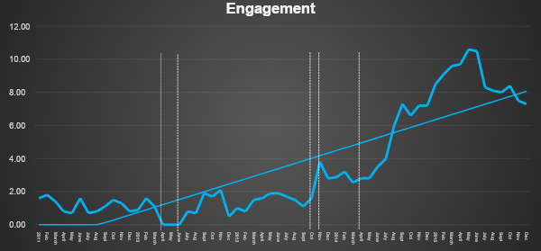
Engagement per Hour

Slide 33
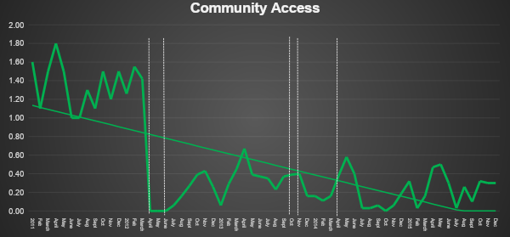
Community Access per Month

Slide 34
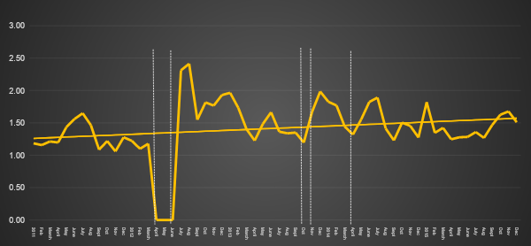
Average Well-being Rating per Day

Slide 35
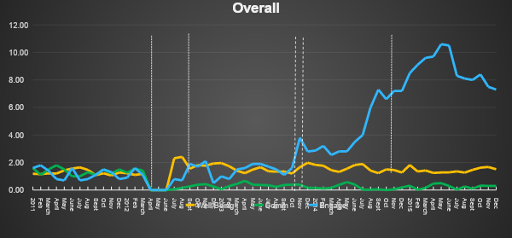
Combined Data

Slide 37
For more information: mcmullen@webster.edu
justines39@webster.edu
With many thanks to Ron’s family, friends and support staff:
Sierra, Erin, Jesse, Liz, Jackie, Jilli, Molly, Sidney, Maggie, AJ, Eric, Jennifer, Lauren, Thomas, Amber, Amanda, Chris, Stephanie, Grace, Kysa, Tasha, Lesley, Alice, Nicole, Megan, Brett, Mary, Nick and Virginia.
In memory of JT Turnbull and thanks to his parents Ann and Rud Turnbull for leading the way in creating enviable lives for individuals with complex support needs.

