Slide 1
SDS Family Support Group
Recruiting, Interviewing and Hiring PCAs

Slide 2
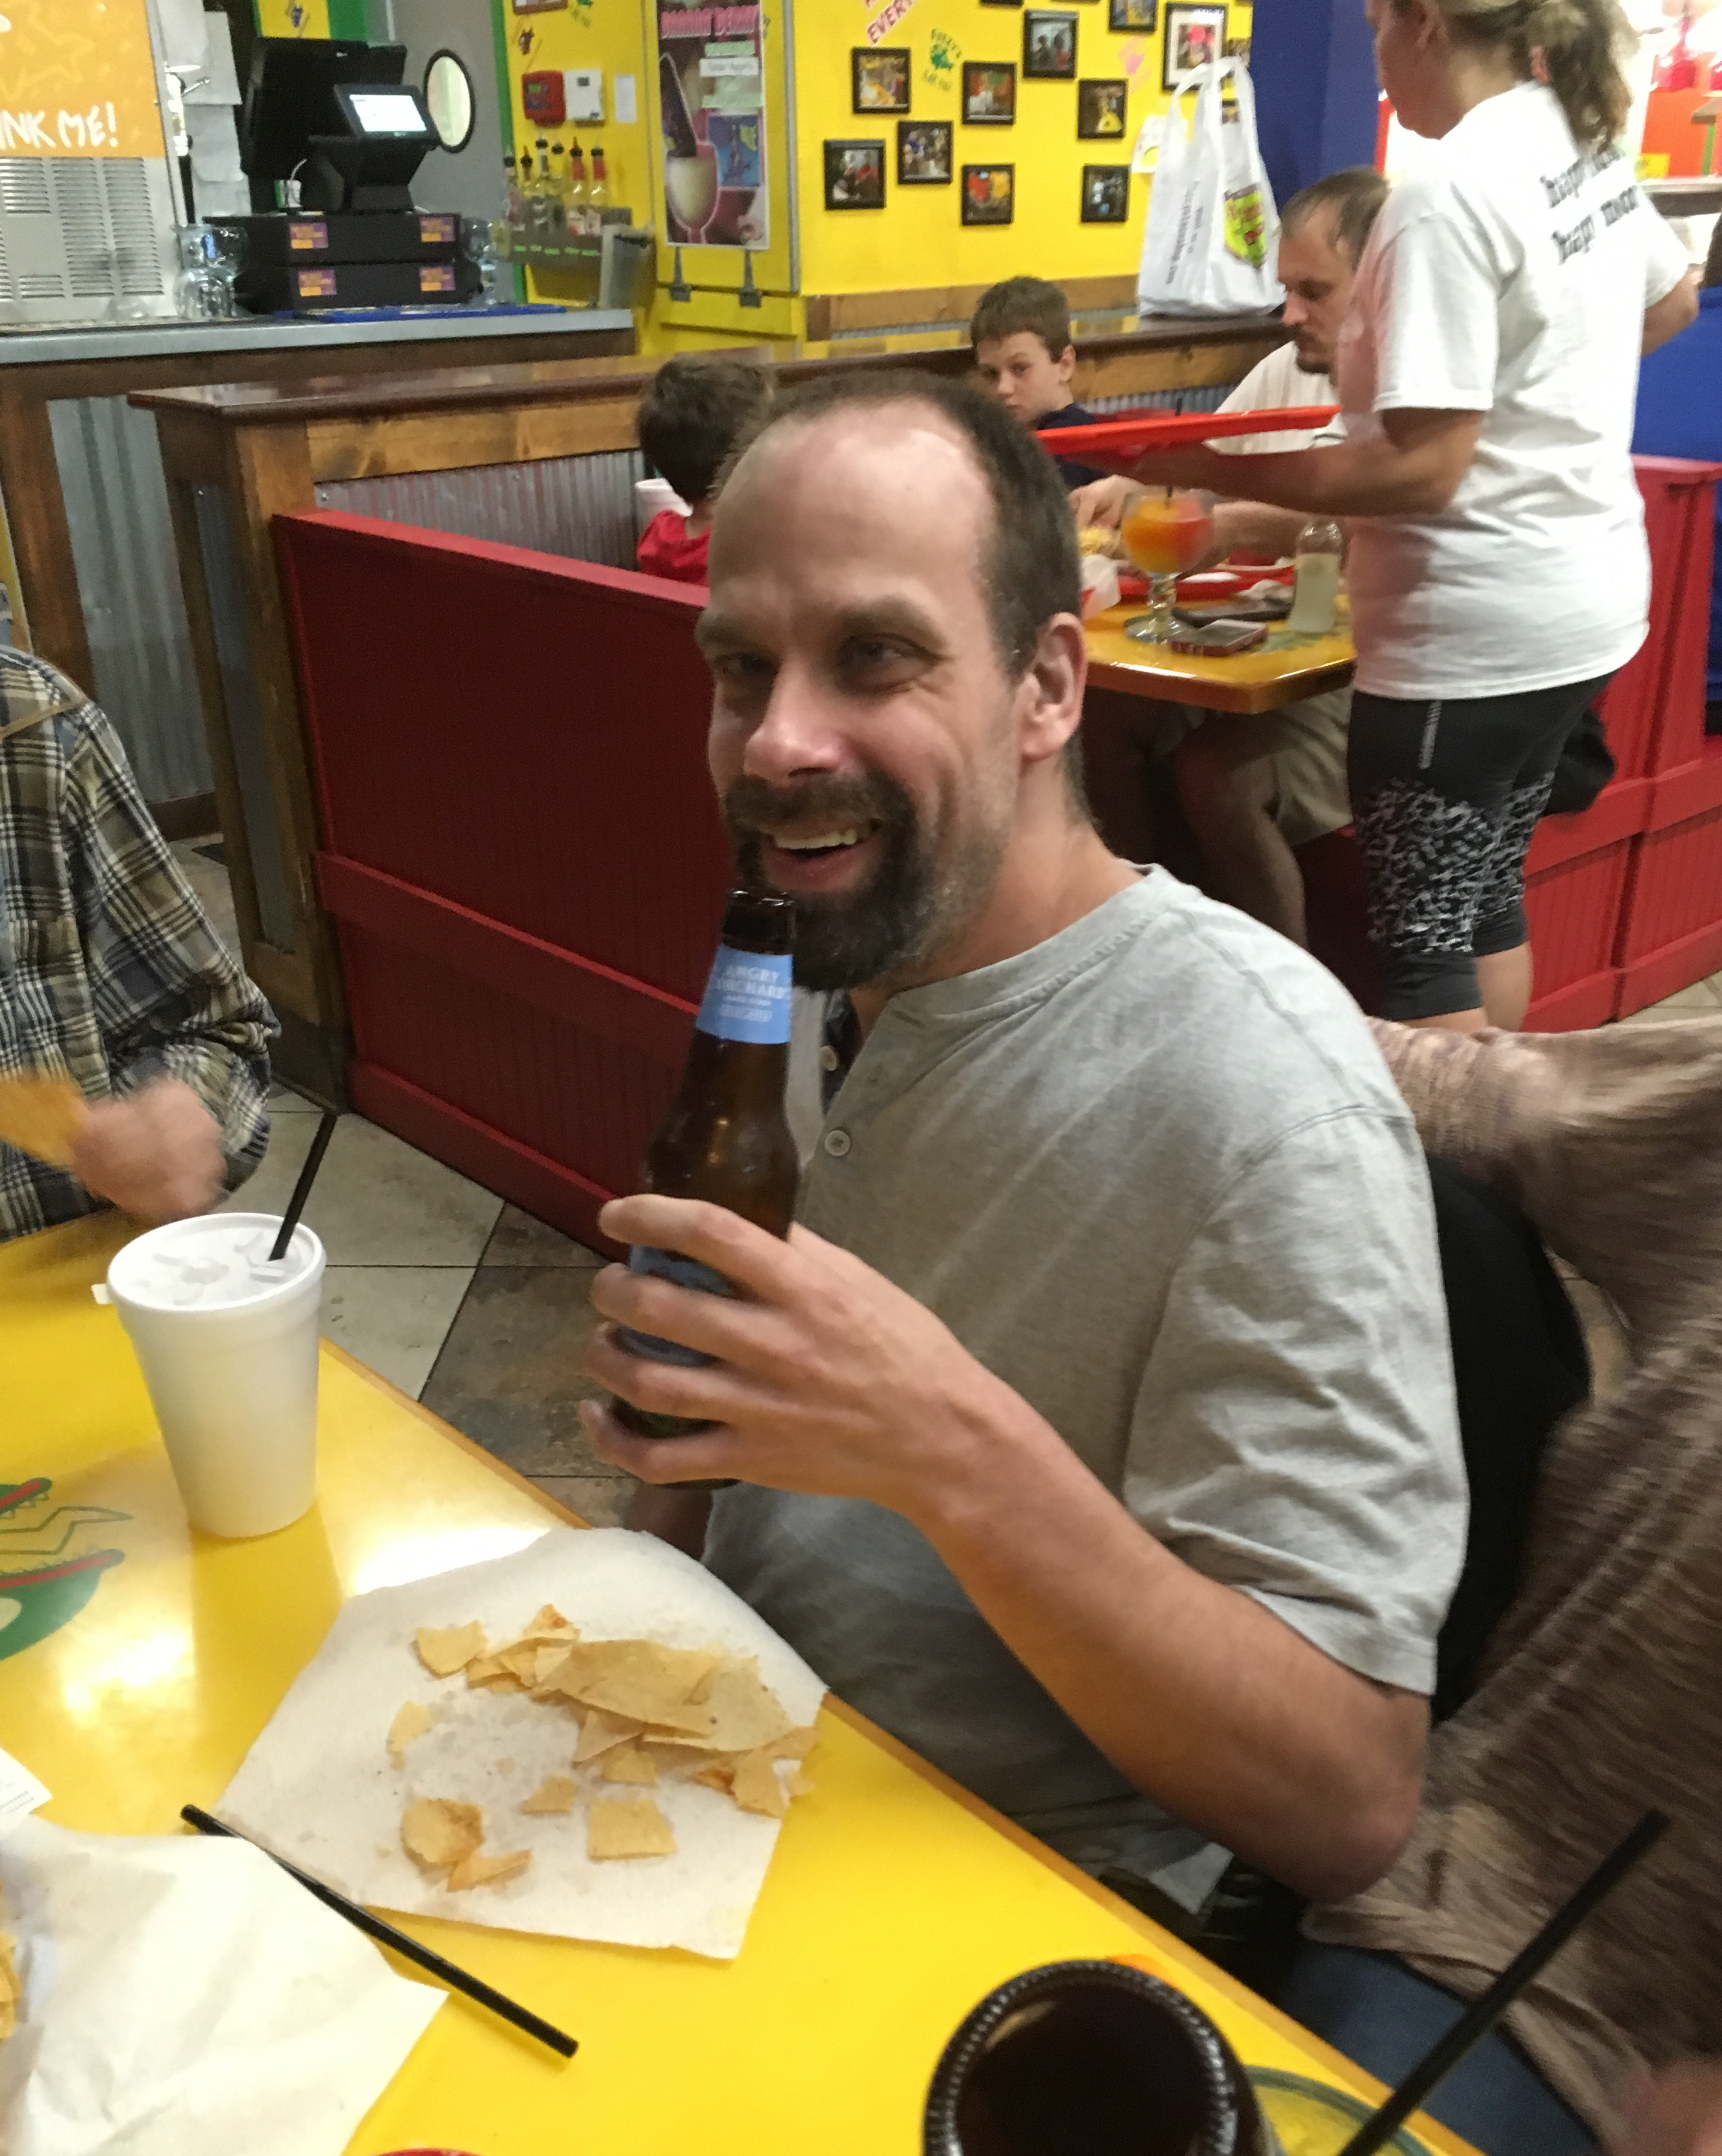
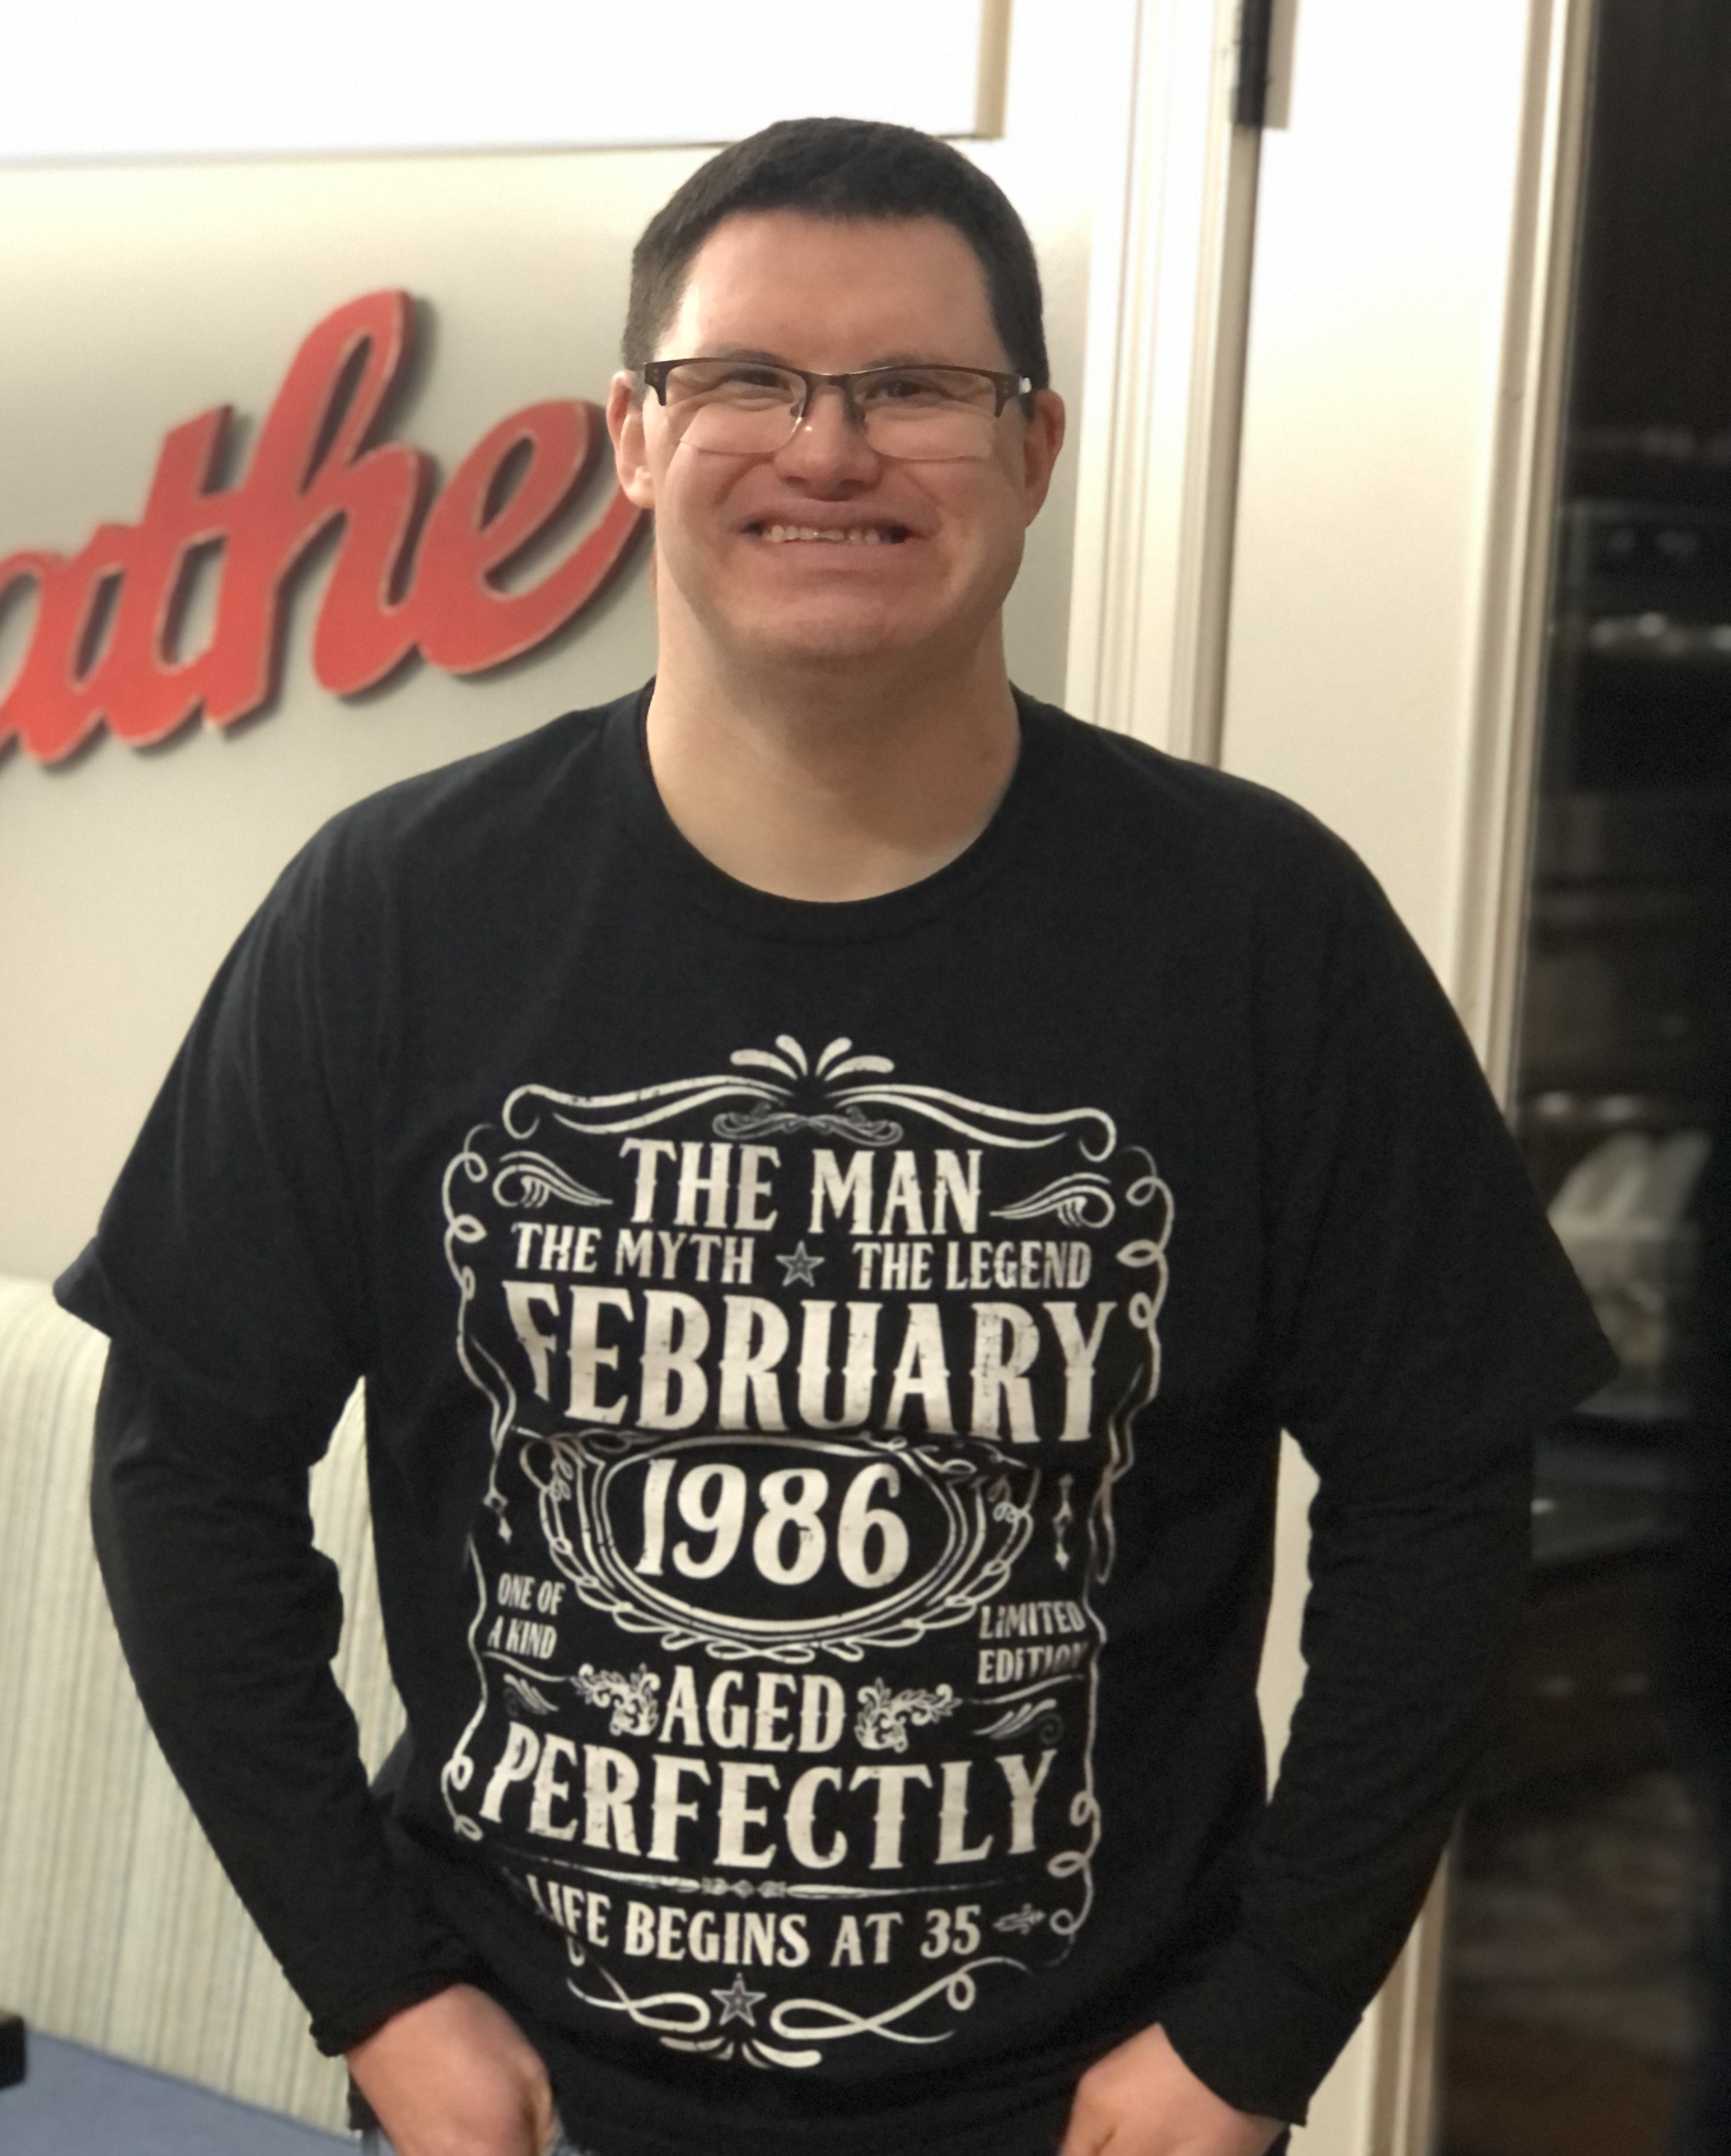
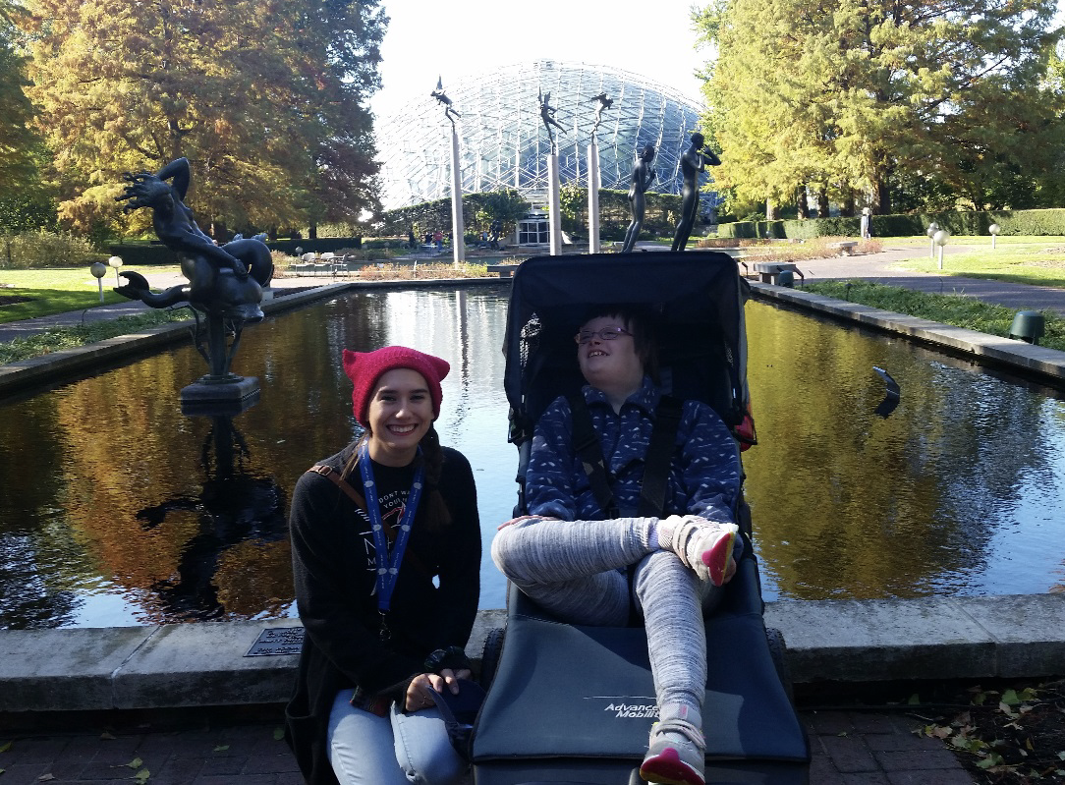
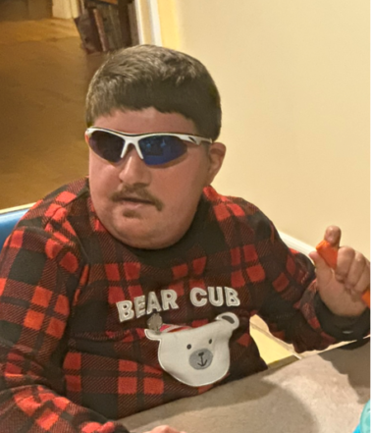

Slide 3
Where do you start?
How many hours, days, times. Minimum hours needed?
CDS vs. SDS
Demographic of staff desired
What they will do - define job
Budget - start $- increases - frequency
BUILDING A TEAM - TRUST

Slide 4
Support Manual - Community Specialist
Job description
Expectations
Rules of the house
Evaluation criteria / increases
Language - People First / not “babysitter”/ respect
Getting Organized

Slide 5
Advertising your job
Word of mouth - don’t be shy !!
School, day program, family, friends
SDS-MO Handshake
Paid online job boards - Care.com, Monster, Indeed
Personal contacts at colleges- Health sciences, education, social work (professors)
Places where your potential job seekers are in person and online (twitter, instagram, snapchat, Facebook, etc.)

Slide 6
Got leads?
Follow up on ALL leads
“Selling” the job
Ideas for the ‘process’
Phone interview
Reference check
In -person interview
Trial hours.

Slide 7
Interview Questions:
Why this job? - Great opener
Experience with…
Family life - siblings, significant others, where from?
Interests - What they do in their free time, hobbies, passions, what type of communities are they in.
Limitations of ability? Driving, lifting, phobias, time
Work history - resume, best/worst job
Gender identity, marital status,
Religion
Disability
HABITS * - tricky one
Don’t ask

Slide 8
Tell them about the JOB! Hours desired.
Explain Acumen (and HCY/DHSS if applicable)
Training requirements
Are they available/How much they want to work?
So you found someone that fits?

Slide 9
JOB OFFER
Acumen Employee packet & Sample Packet
Social Security Card
Picture ID - Drivers License
Voided check or bank letter
Proof of HS graduation (HS or college transcript or diploma)
Abuse and Neglect Certification
Med PCA - First Aid/CPR Certification

Slide 10
Support manual and checklists.
Logs - Bathroom, eating, screen time, etc.
Team Collaboration with other staff
Rules of the “house” (promptness, cancellations, personal phone use, breaks, etc.)
Notes for Acumen - EVV, a sentence per hour, DCI app
Evaluation Criteria - milestones, clear expectations, self-evaluation.
TRAINING TIME

Slide 11
Train,
evaluate,
Praise ($$?),
rinse,
repeat
A happy employee is a good employee.

Slide 12
Examples of job descriptions
Examples of Training checklists
HOW - TO schedule?

Slide 13
Closing Thoughts
Each PWD is unique and so is each Employee.
Most of the time, no employee will do it as well as you … and that is ok.
This is a key, lifelong skill needed to keep your loved one in the community.
It is a tough market out there, but you have to keep trying to find staff daily.
You never know where the next good idea is going to come up,
Be an active listener.
DON’T GIVE UP!!
We are here to support you. mosds.org

