Slide 1
What is Inclusion in Recreation?
Leisure without Limits
Presented by
The Recreation Council
of Greater St. Louis
Funded in Part by

Slide 2
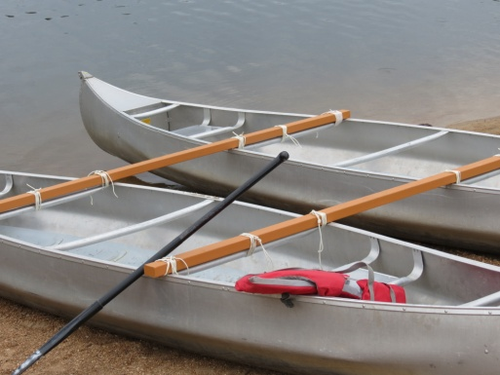
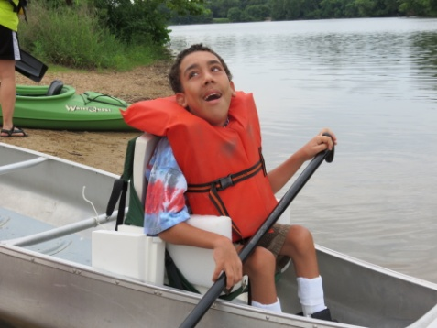
Inclusion Looks Like . . . .
Being accepted and appreciated for who you are
Being with friends who share your interest, not your disability
Having the same choices and opportunities in recreation as other people
Activities that don’t limit individuals because of social or environmental barriers

Slide 3
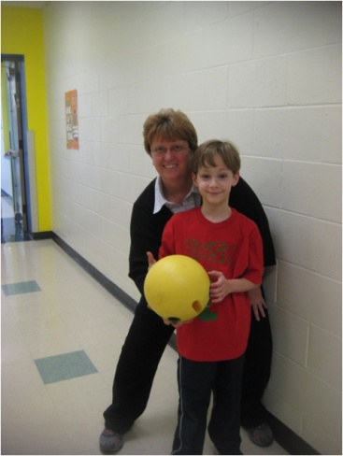
WHAT ARE INCLUSIVE PROGRAMS AND SERVICES . . .
Programs that welcome and encourage participation by everyone in the community
Programs & services that provide a variety of options to meet many different needs
Communication, coordination, and shared responsibility among individuals with disabilities, family members, educators, recreation providers, and others

Slide 4
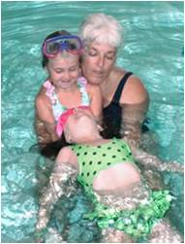
WHAT IS INCLUSION . . .
Providing the necessary individual adaptations, accommodations, and supports so everyone can benefit equally
Facilities and areas that are accessible and easy to use by everyone
Staff & volunteers that provide individual support to assist someone in having a positive experience

Slide 5
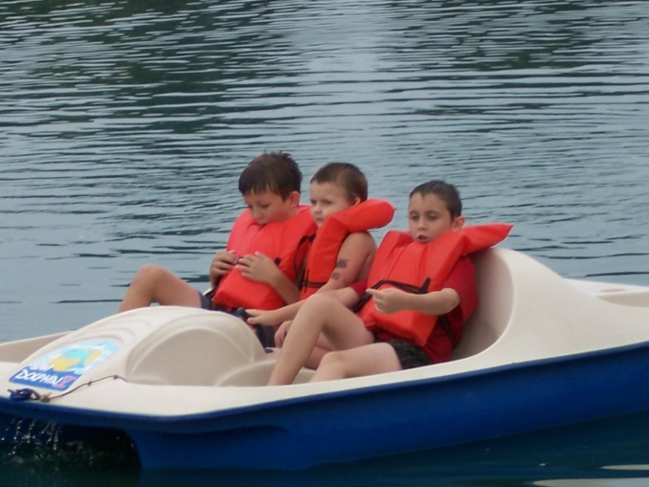
BENEFITS OF INCLUSIVE PROGRAMS & ACTIVITIES
Increases opportunities for individuals with disabilities
Builds strong families
Reduces alienation, loneliness, and
anti-social behaviors
Promotes diversity
Increases quality of life
Provides appropriate role models

Slide 6
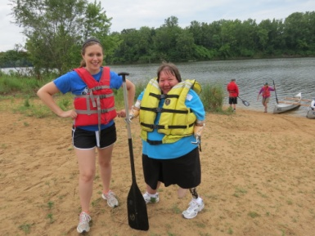
BENEFITS OF INCLUSION
Improves self-esteem & positive self-image
Builds stronger communities
Increases positive attitudes
Increases social skills & social interaction
Increases independence
Contributes to a full and meaningful life

Slide 7
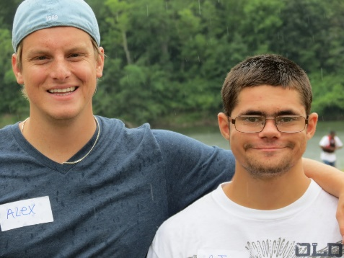
Examples of Inclusive Recreation Park & Recreation Departments The Boxing Therapy Trout Lodge Wilderness Inquiry Strength & Honor Missouri Dept. of Conservation

Slide 8
BARRIERS TO INCLUSION
Role Confusion
Lack of Networks and Resources
Language
Communication
Lack of Administrative Support
Attitudinal
Lack of Awareness
Inaccessible Facilities
Inaccessible Programs
Inadequately Trained Staff

Slide 9
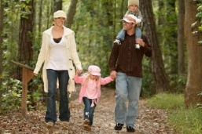
Planning for Successful Inclusion Do Your Research! Look for Programs that Provide the Support that Your Son/Daughter Needs Educate the Recreation Provider Visit the Program Prior to Attending Get References Communicate!!!

Slide 11
Leisure without Limits
For More Information about Inclusion in Recreation,
Contact the Recreation Council
of Greater St. Louis
www.recreationcouncil.org
info@recreationcouncil.org
(314)726-6044

