Slide 1
Creating an Enviable Life
Wednesday, March 6, 2024

Slide 2
Ann Turnbull
Enviable Lives: A lifespan perspective on family and community partnerships – 2013 Conference
How Ann and Rud created an enviable life for their son Jay
A philosophy and set of principles, not a ‘system’
Ann Turnbull - Enviable Lives Video
‹#›

Slide 3
IDEA Outcomes & Results
Same chances and
opportunities in life
Opportunities to be included
in all aspects of the community and protected from attempts at segregation
Equality of Opportunity
Full Participation
Economic Self-Sufficiency
Independent Living
Opportunities to engage in income producing work that contributes to household
Opportunities to fully
participate in decision making and to experience autonomy in making choices
Ann – IDEA Video
8:59-10:05
‹#›

Slide 4
Lifespan
Average lifespan for people with disabilities is approximately 80 years
School provides support from birth to 21 or even 25-ish years with transition programming…so…
That’s roughly ¼ of a lifespan!
What supports do they have in the other ¾ of their lifespan?
Ann - Lifespan video
12:30-13:20
‹#›

Slide 5
Envision your loved one’s Enviable Life
Big Rock Items:
1. Community/Partnership
2. Job / Work / Volunteer
3. Living Accommodations
4. Transportation
“Invite support, create connections and envision great expectations”

Slide 6
Envision your loved one’s Enviable Life
Begin with the end in mind…
With WHO
Doing WHAT
WHERE
WHEN
WHY
It’s your job to figure out HOW
* Similar resource: Charting the Life Course

Slide 7
Community Partnerships
Natural Ties @ KU
Mission Statement
Natural Ties fosters friendship and inclusion between individuals with and without disabilities, one tie at a time.
Best Buddies in St. Louis
Best Buddies in Missouri offers One-To-One Friendship and Leadership Development programs for individuals with and without disabilities in Missouri.
So many other programs like this!
* Many factors including age, health & interests change over time and need to be modified
Ann - KU Community
‹#›
37:55-38:45

Slide 8
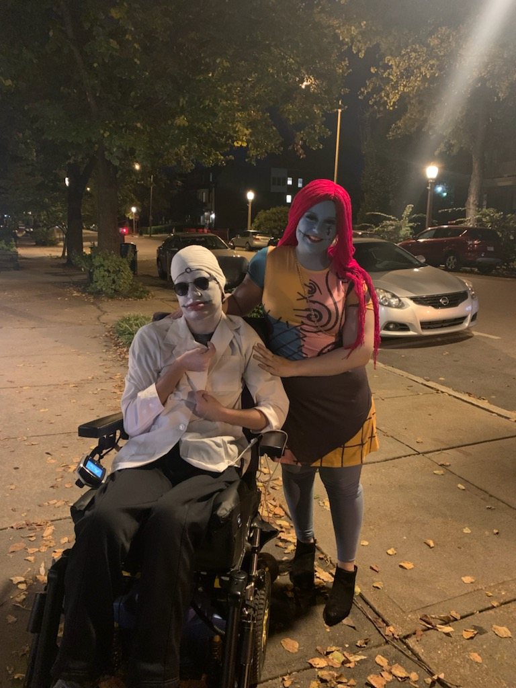
Examples of facilitating friendships & activities

Slide 9
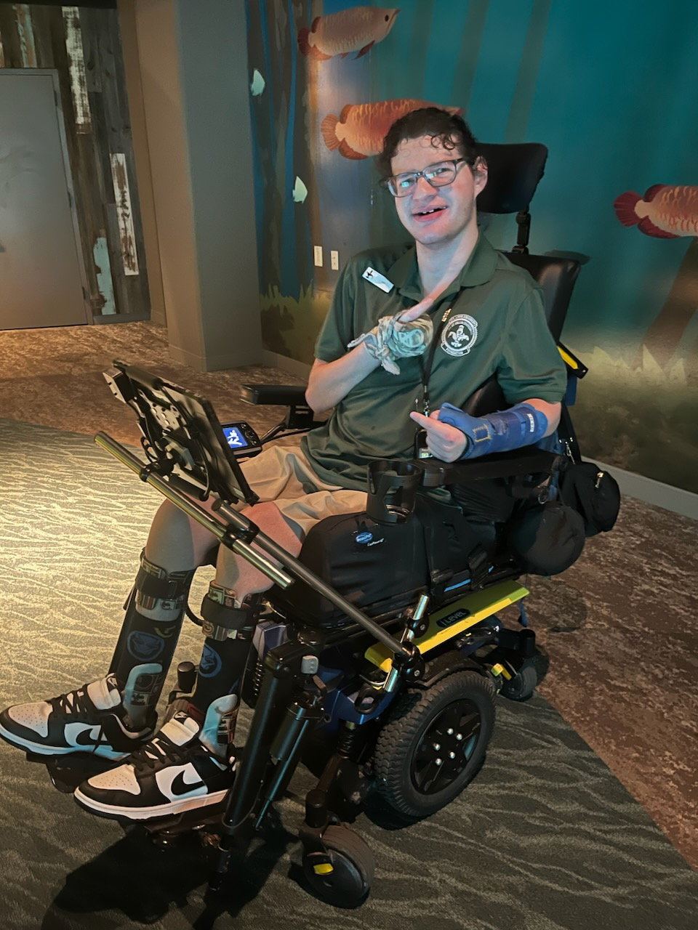
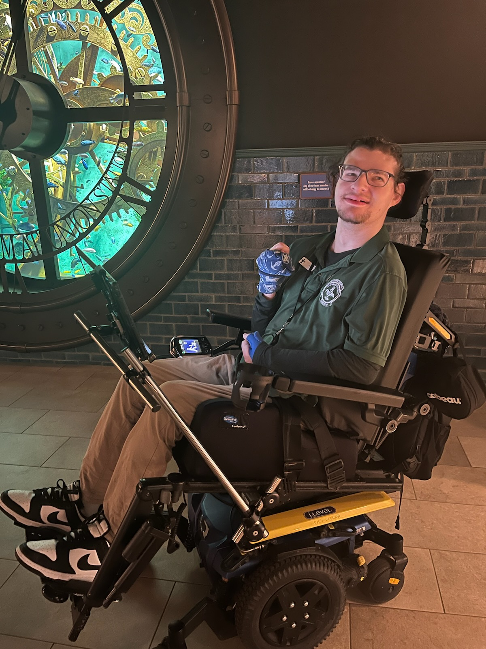
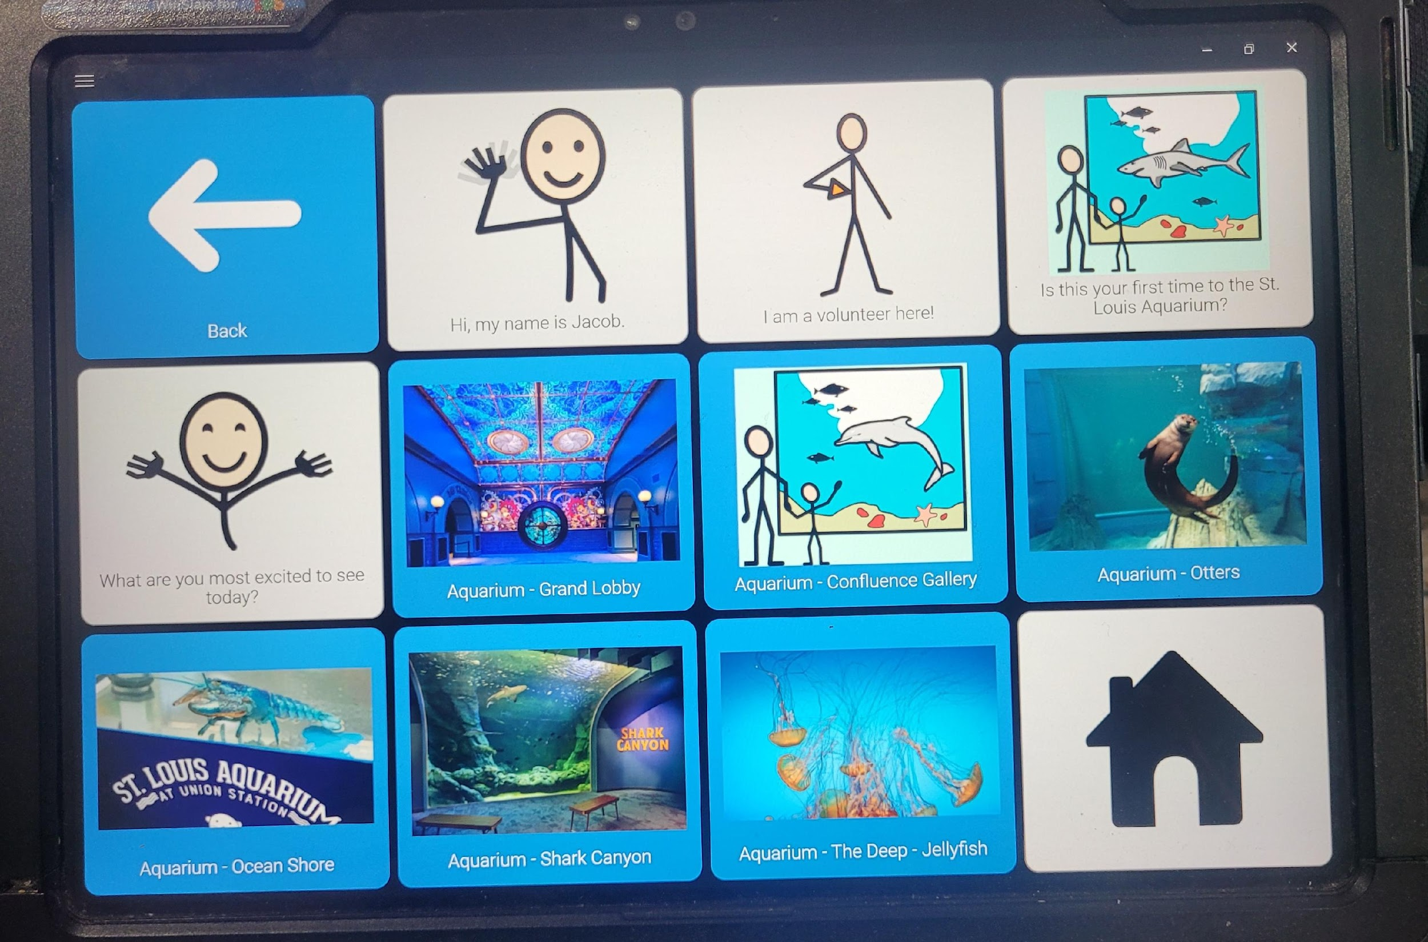
Jobs / Volunteering
Bowling Alleys
Butterfly House
Delivery service – as a passenger, helper
Duo Dogs, Humane Society
Food Bank / Pantry
Grocery Stores - Re-stocking, Bagging
Nurses for Newborns
Restaurants - Host/Hostess, Busser
St. Louis Aquarium
Specialized Employers - Boone Center, Center for Specialized Services, Lafayette Industries, Paraquad
Ann - Job Support Meeting
44:44-46
‹#›

Slide 10
‘Candles’ Support Analogy
“There is potential in collectivity to solve problems and create community inclusiveness”
Group Action Planning
How?
Action / Execution
“Better to light a candle,
than curse the darkness”
“One candle brings a little light,
many candles make it bright”
Ann - Candles
‹#›
1:00:52 – 1:02:05

Slide 11
Creating Community Inclusiveness
Invite support and just ask for help
Educators - Professor of Music Therapy taught Jay how to play two cords on the guitar
Gyms – Kass works out at the YMCA
Local support groups & orgs – Arc, DSAGSL, Easter Seals, JCC
Specialized organizations - Artists First
Camps - day and weekend getaway – Circle Star, Harbor Unlimited
Camps - summer sleep-away – Barnabas, Sunnyhill, Wonderland Camp
Places of worship – supportive environments / special needs ministries
?
What other ideas do you have?
?
?
Ann - Community
50.15-51.32
Anywhere in the community is a good place to start
‹#›

Slide 12
…and there’s More!
Places - zoo, museum, galleries, library, parks / picnics
Home – chores (schedule), meal prep / cooking with staff
Move it! - bowling, dances, hiking / walking, swimming
Therapies + group therapies
Physical, occupational, speech, aug comm, swim, music, programming through Rec Council
?
What other ideas do you have?
?
?
* Consider utilizing a Community Specialist (via your ISP) to assist
‹#›

Slide 13
Withstanding the Test of Time
Jay Turnbull’s Eulogy
News release link read “University Mourns Long Time Employee Jay Turnbull” could have just as easily read, “University mourns son of distinguished professors..”
or “…University mourns special worker…”
Instead, simple fact – Jay was a person in and of himself, independent of who his parents were or whether he had a disability or did not!
Ann - Eulogy
‹#›
104:32-105:51

Slide 14
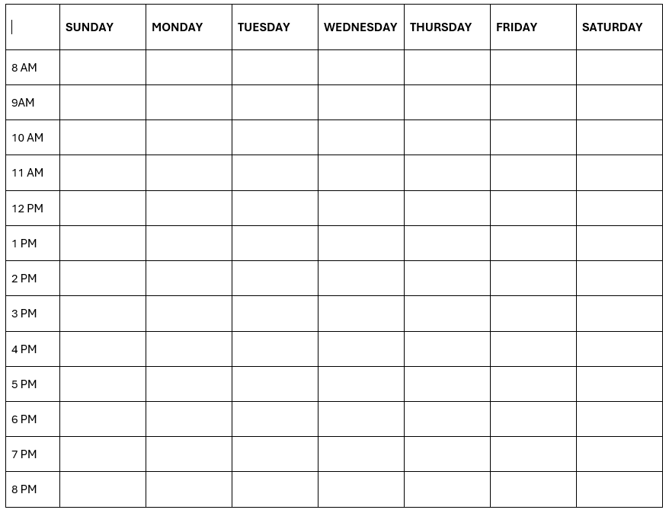
Idea: Weekly Schedule
Literally plan/fill “X” hours in a day
‹#›

Slide 15
Example: Jacob’s Weekly Schedule
MONDAY – MASSAGE WITH RENEE – EITHER 11 AM OR 4 PM DEPENDING ON THE WEEK
TUESDAY – SWIM THERAPY 2 PM
WEDNESDAY – PT 11:30 AM
THURSDAY – OPEN FOR VOLUNTEERING AT THE AQUARIUM. ROCKABILITIES @ 4 PM
FRIDAY – OPEN FOR VOLUNTEERING AT THE AQUARIUM OR ANY OTHER ACTIVITY
Don’t over-schedule – it needs to be enjoyable for all
Start with the ‘big rocks’
Plan according to energy level and logistics
‹#›

Slide 16
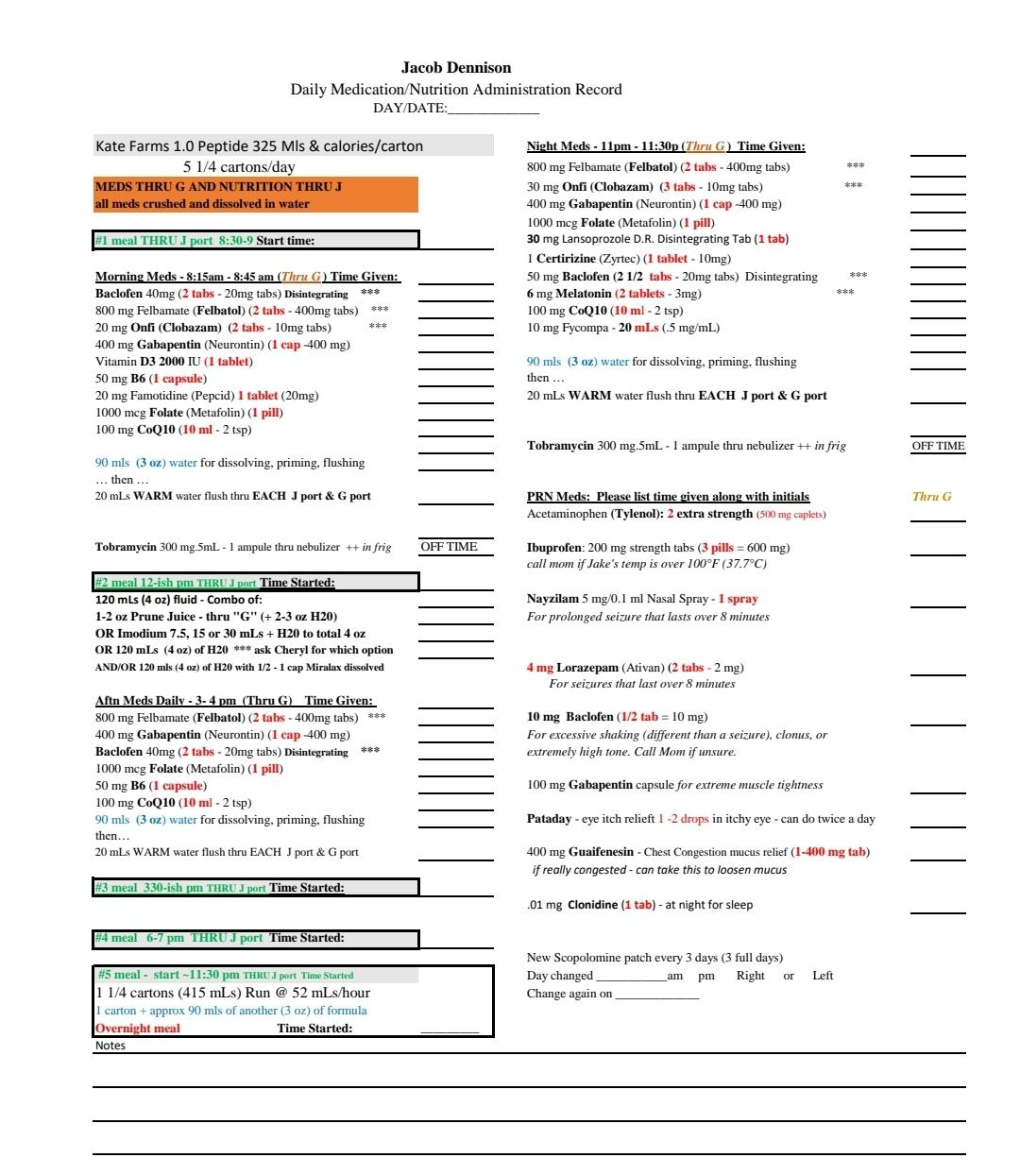
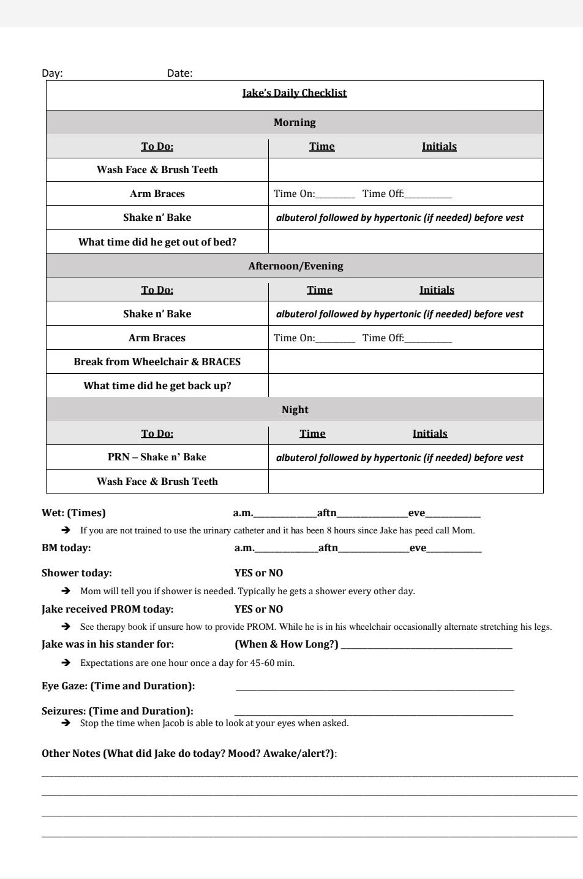
Jacob – A lot to Track
‹#›

Slide 17
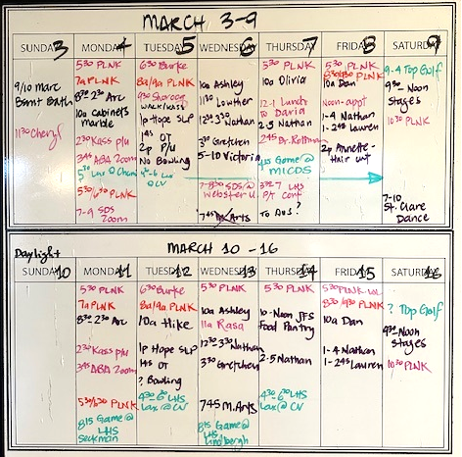
Example: Parr Family Calendar(s)
It takes a village...
Formats: paper, whiteboard, e-calendar – what works best for you and the support team
Logistical planning and coordination
Short-term (e.g. ride coordination) and long-term (e.g. summer vacation)
Provides a single ‘source-of-truth’
Reinforce through weekly meetings / communication
‹#›

Slide 18
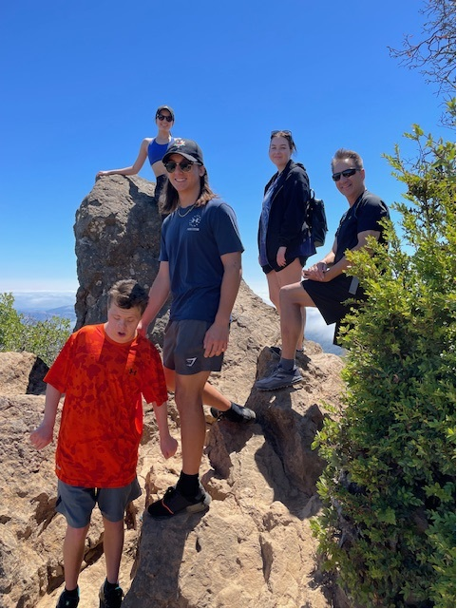
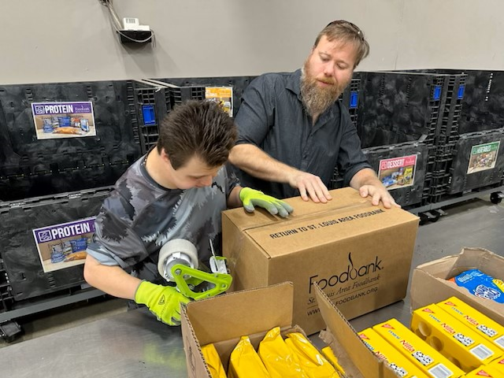
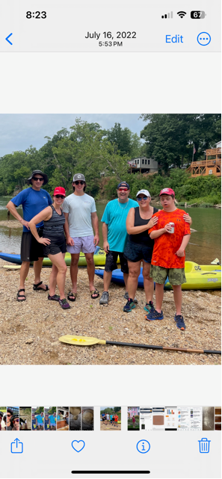
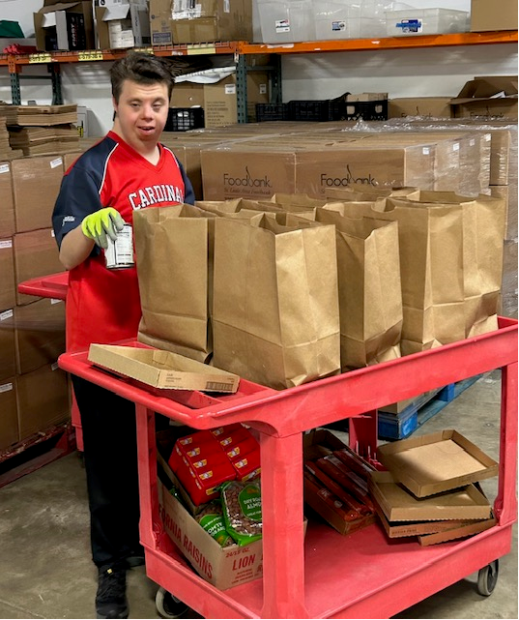
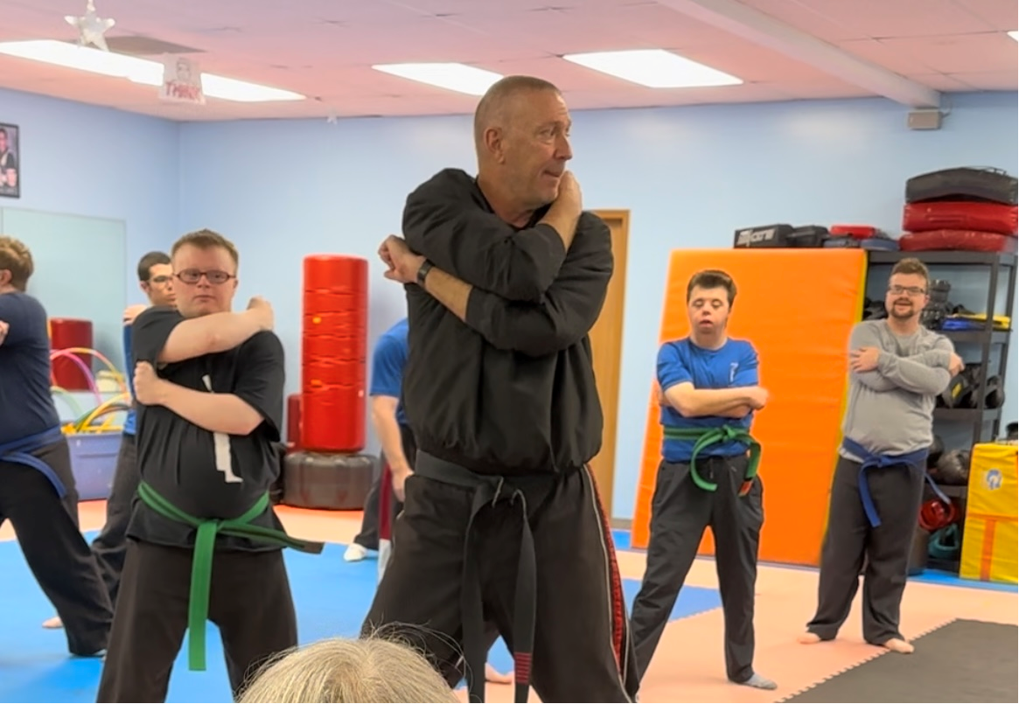
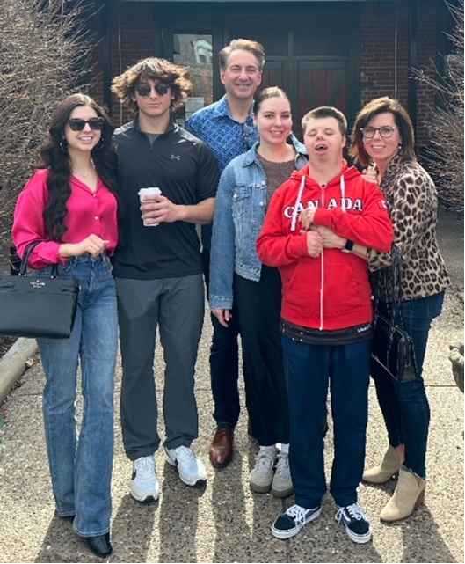
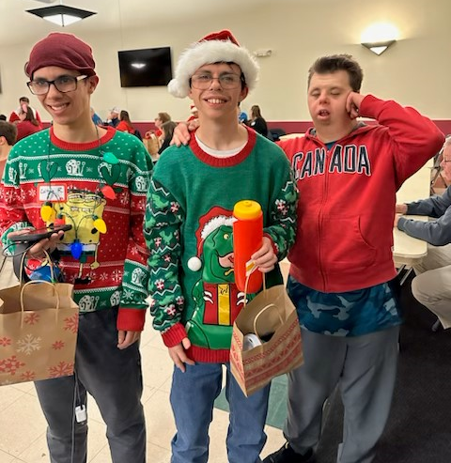
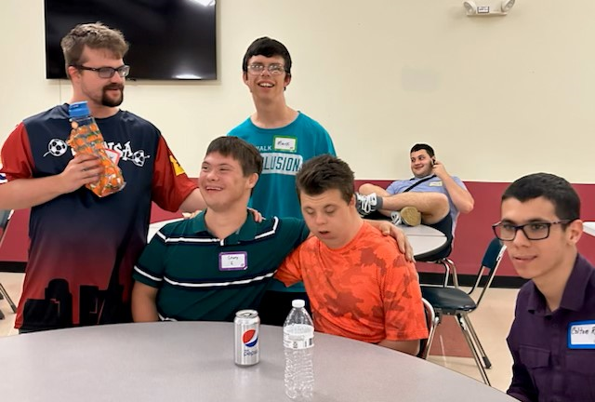
Kass at a Glance
‹#›

Slide 19
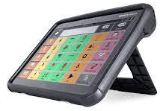
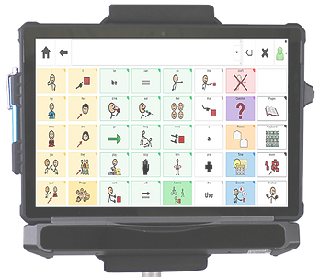
Idea: Communication Devices
First:
Determine your needs (communication vs. visual schedule or both)
Set a budget and identify alternative funding – health insurance, grants
Confirm return policy – because it may not work for your situation
iPad (or Galaxy)
Multiple apps via App Store, mostly paid but can have multiple / change
Touch interface and programmable items
Don’t forget a good case & educational discount
Tobii Dynavox
Touch interface and programmable items
Very expensive but rugged – check insurance
Task independence through self-prompting
Windows Winslate
Enable eyes – cutting edge eye tracking technology
Jacob using his device while at "work'
‹#›

Slide 20
Discussion
SO, LETS TALK, SHARE AND COLLABORATE…
LET’S CREATE ENVIABLE LIVES FOR OUR LOVED ONES!
‹#›

Slide 21
Ann Turnbull
“The key to an enviable life is the power of family and community partnerships throughout the lifespan and beyond”

Slide 22
Announcements
Tomorrow’s HCBS stakeholder forum
Disability Rights Legislative Advocacy Day
Abuse and Neglect Training moves to yearly schedule
Request to Tanner to get Acumen to modify prefilled forms policy
Differing SUTA rates
This presentation and materials can be found here
Next meeting:
April 18 Zoom meeting Self-Directed Supports Statistics presented by Tanner Stephenson,
Director of MO SDS followed by Qand A
‹#›

