Slide 1
Legislative Advocacy and the Power of You

Slide 2
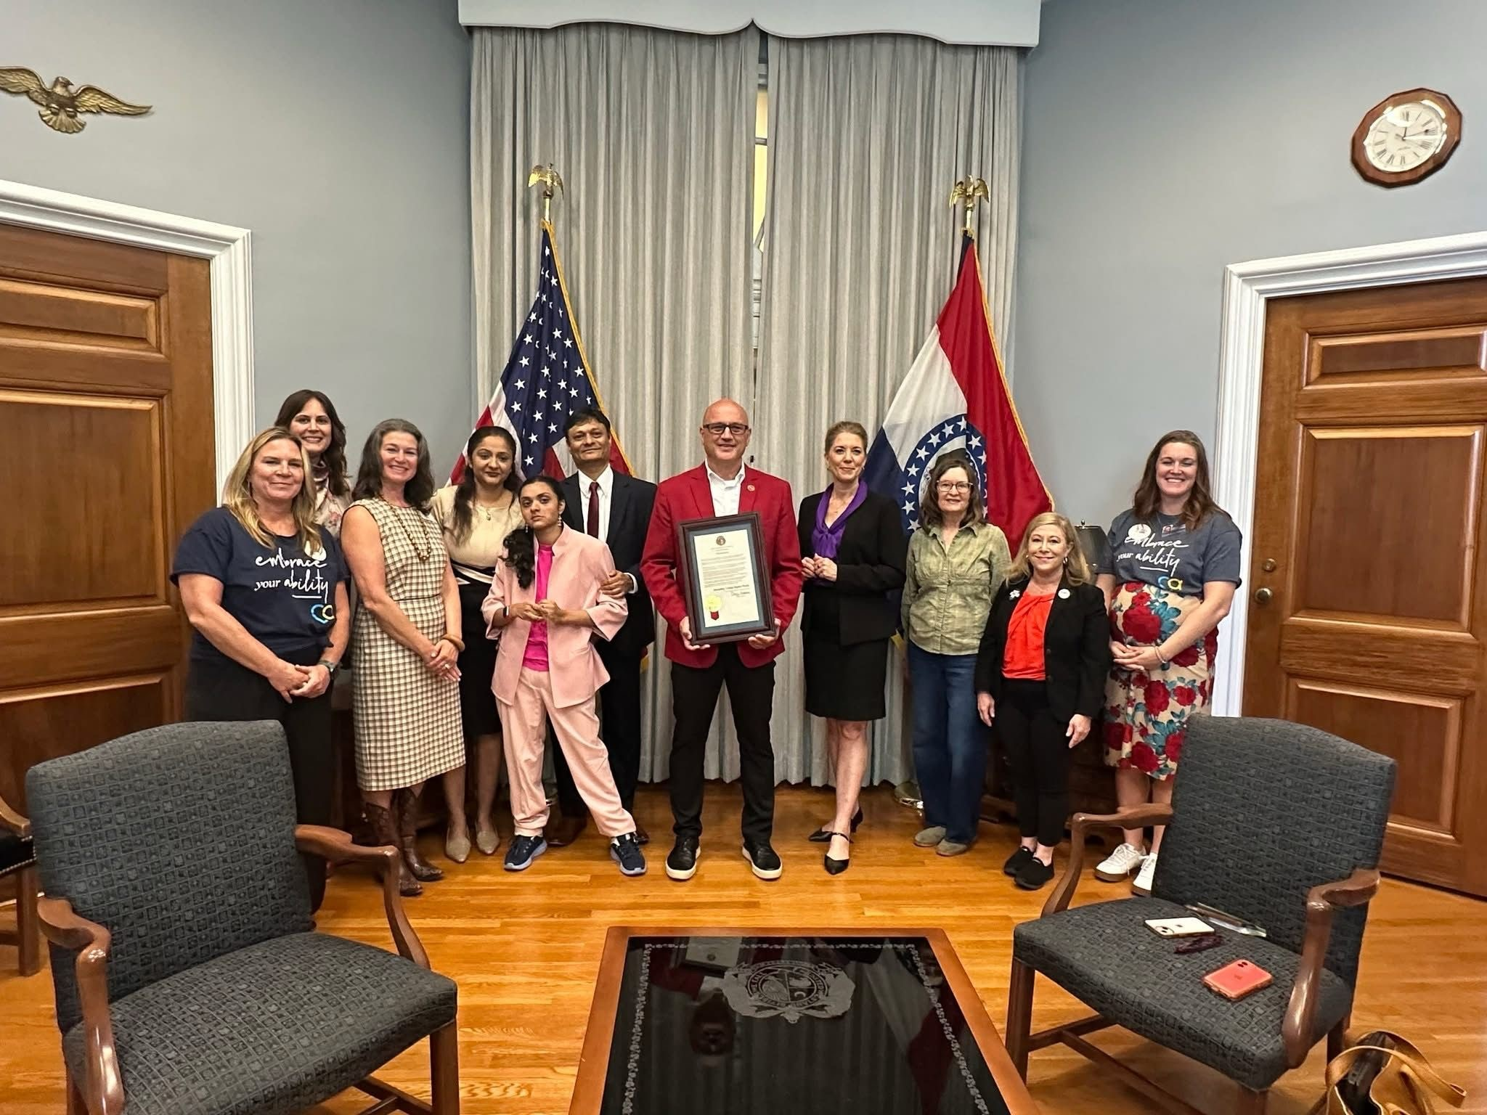
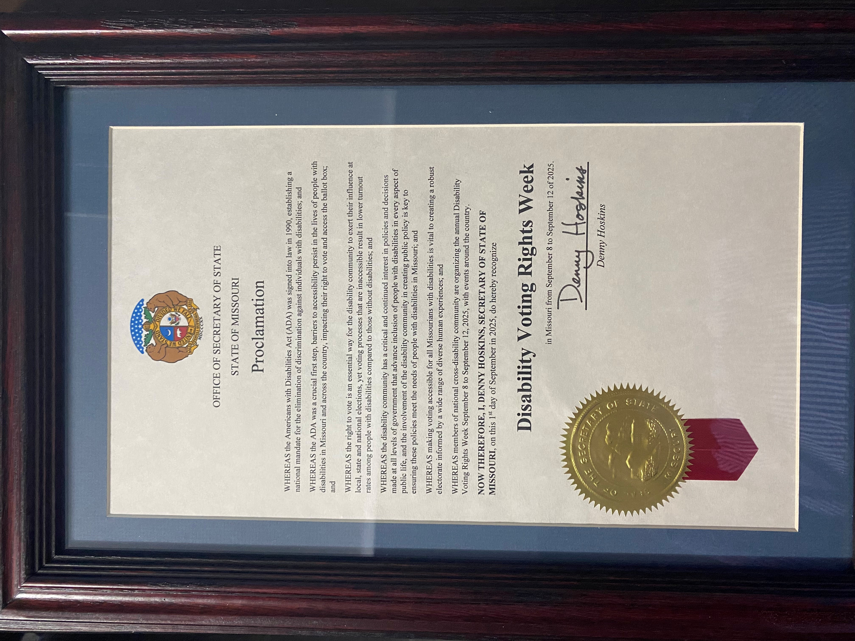
Never doubt that a small group of thoughtful, committed citizens can change the world; indeed, it is the only thing that ever has
Margaret Mead

Slide 3
Agenda
Background
Understanding Legislative Process
Understanding Key Players
Hearing and Testimony
Key Takeaways

Slide 4
Definition
Advocacy
“Advocacy is an activity by an individual or group that aims to influence decisions within political, economic, and social institutions.”
What is Legislative Advocacy?
Legislative advocacy refers to efforts to influence the introduction, enactment, or modification of legislation.
The most common means of legislative advocacy
contacting a legislator and/or their staffers,
sharing your views on an issue of importance to you, and
asking him or her to vote a specific way on a bill.

Slide 5
Why do we need legislative advocacy?
It is the representative—those who make our laws, represent us.
We let them know what we are thinking
We can and should remind leaders of their responsibilities to their constituents and offer them constructive ideas. If we do, we can bring about public policy changes.
It’s not a difficult thing to do, and it doesn’t take a lot of time. It just takes the will to act and speak out for yourself and on behalf of those who may not be able to speak for themselves.
Remember - Someone is already talking to the legislators. If you don’t, then you get what others want for themselves and you have to leave with it. Better speak up and try to get what you want.
Squeaky wheel gets the grease !!!!

Slide 6
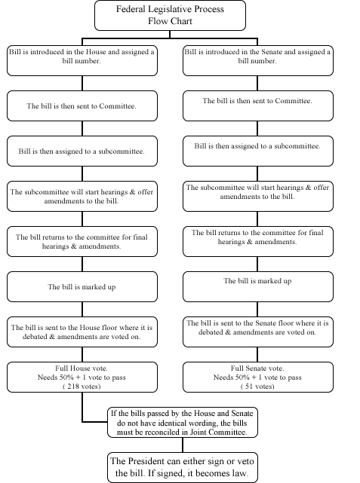

Legislative Process
https://house.mo.gov/Committees.aspx?cluster=true&year=2021&code=R
A committee is a group of people who individually can’t do anything and together decides that nothing can be done !!!

Slide 7
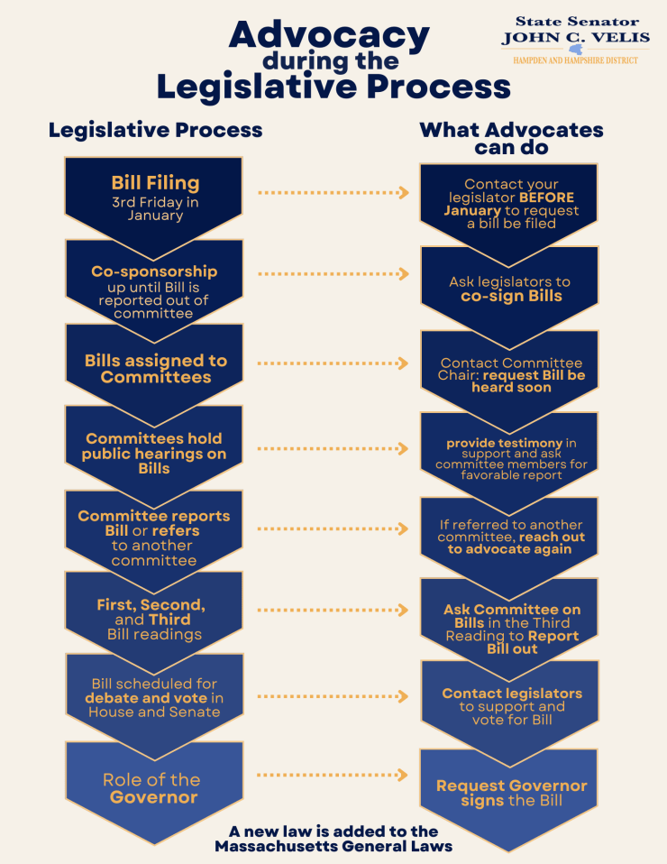
Legislative Process

Slide 8
Key Players
Policy-Makers
The Needs of Elected Officials
  Personal reasons
  Moral, ethical, religious beliefs
  Keen interest in subject matter
  Personal connection to the issue/policy matter
  Political reasons
  the likelihood of good publicity
  Alignment with own political beliefs and that of the party
  With an eye to the future for something bigger
  The likelihood of a nice reward

Slide 9
Key Players
Legislative Staff
The Needs of Legislative Staff
Staffs’ relationship to elected officials
Responsibilities of personal staff
Responsibilities of committee staff
  proposing priorities for the agenda,
  drafting legislation (with assistance of Legislative Counsel),
  negotiating details of agreements among interested parties,
  arranging hearings and identifying and securing witnesses,
  writing substantive components of speeches and preparing briefing materials

Slide 10
Know the staff – They are the key
Introduce yourself. If possible, the introduction should explain why the elected official should care about what you have to say (e.g., president of SDS Group, Missouri Leader of Rett Syndrome Association, friend to the elected official’s spouse, member of individual’s political party or religious institution).
Describe the issue you want to discuss.
Explain your personal experience (if expert, specific anecdotes from your studies) and describe how your experience has implications for pending policies under consideration.
Explain your position (whether you support/oppose an amendment/bill) in light of your personal experience.
Request that the elected official support your position.
Ask the elected official to describe his/her position on the issue and explain why the position is supported.

Slide 11
Other ways to connect and contact
Direct Interactions with Policy-Makers
Correspondence, Fax, E-mail, Telephone Calls
Events, Site Visits, Speeches (ex – DRLD Day)
  Some helpful pointers for getting an elected official to say “yes” to attending an event include:
  recognize the self-interest of elected officials. Consider giving elected officials an award, promise good press and turnout, describe the circulation of your organization’s newsletter in which an article about the event will appear;
  have an opinion leader whom the elected official trusts, respects or owes a favor make the request; and/or
  make a request at place where it can’t be ignored—at a public forum such as a town hall meeting.

Slide 12
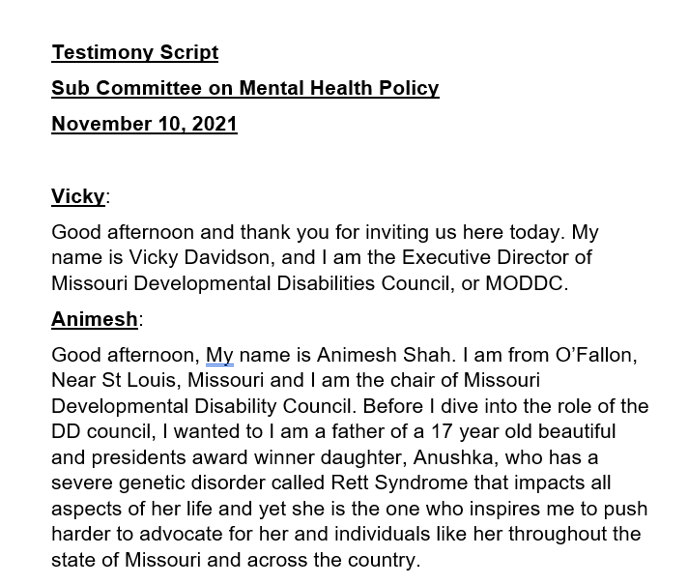
Power of Personal Story
Raise Awareness
Educate
Create a sense of urgency
Personal stories make policy “real”
Motivate People to Act
Close the gap between people

Slide 13
Hearings and Testimony
Key Players
appointed officials of the Executive branch,
elected officials of the Legislative branch,
academics and
interest groups
A hearing can serve several purposes
gain the attention of elected officials and staff, particularly those on or working for the committee holding the hearing.
gain the attention of key officials in the Executive branch
gain the support and enthusiasm of the grassroots
whether a bill is “ready” to move to the next stage in the legislative process—review by the committee or subcommittee in a “mark- up” session.

Slide 14
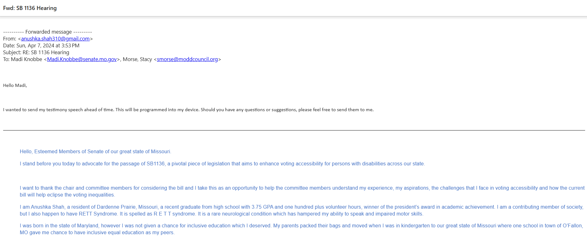
Written/ Oral Testimony
Some guidelines for Testimony
include information about your background, special expertise and who you represent
include anecdotes about “real” people and how the policy affects them;
define the problems that need to be addressed
analyze issues pending before the committee by including references to sources supporting your position (studies, reports, surveys); and
include quotes from “unlikely” supporters, including other elected officials and opinion leaders.

Slide 15
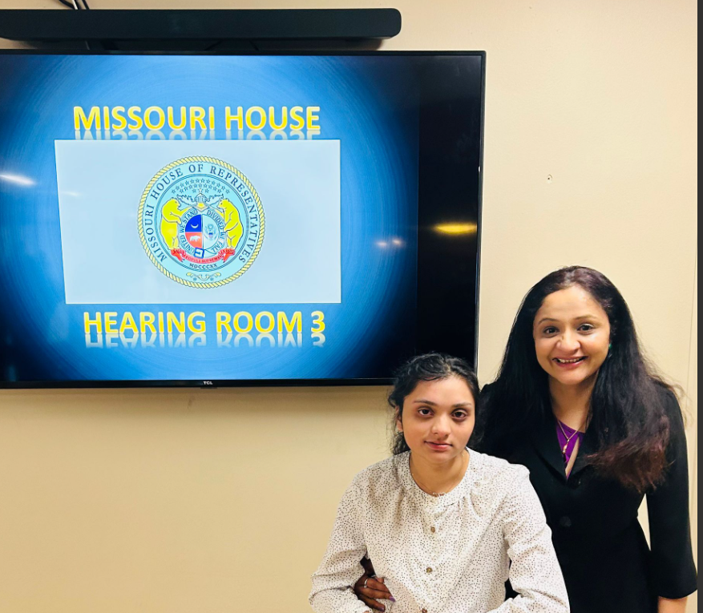
Final Tips & Takeaways
Get involved!
Understand the policy environment and stay up to date
  Gather facts, data and understand the issue
Be timely
Plan your approach
Tell a relevant and engaging story
Be a generalist as well as a specialist
Rid yourself of imposter syndrome
Be objective
Be patient and persistent

Slide 16
Know Your Legislators
https://www.congress.gov/members/find-your-member
https://www.senate.mo.gov/LegisLookup/
https://house.mo.gov/MemberDetails.aspx?year=2023&code=R&district=069

Slide 17

PSA
Join Partners in Policy Making
https://moddcouncil.org/partners-in-policymaking/

Slide 18
Thank you
Animesh Shah
240-925-7904
animesh.shah@gmail.com

