Slide 1

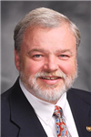
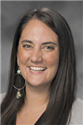
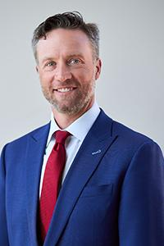
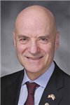
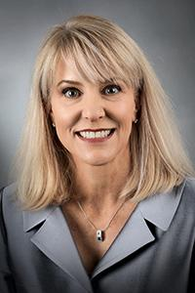
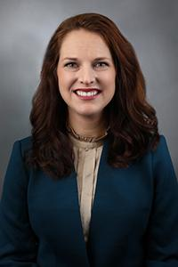
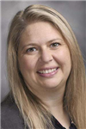
Medicaid Funding Cuts and DMH HCBS Waivers
A Legislative Panel organized by Self-Directed Supports-MO with
Rep.
Gregg
Bush
Rep. Darin Chappell
Rep. Betsy Fogle
Sen.
Lincoln
Hough
Rep.
George
Hruza
Sen.
Tracy McCreery
Sen.
Maggie
Nurrenbern
Rep.
Melanie Stinnett
Notes:
Rep Gregg Bush-D (Boone) House Committee on Health and Mental Health (2024) NURSE
Rep Darin Chappell (Greene) Appropriations subcommittee chair of Health, Mental Health and Social Services and Conference Committee on the Budget (2022) VET-Thank you for your service and for being here tonight
Rep Betsy Fogle-D (Greene) House Committee on Health and Mental Health and Joint Committee on Public Assistance as well as a number of budget and appropriation committees (2020) PUBLIC HEALTH
Sen Lincoln Hough- R (Greene) long history of public service dating from 2011 and his membership on the appropriations committee
Rep George Hruza-R (St, Louis County) House Committee on Health and Mental Health (2024) DR
Sen Tracy McCreery-D (St. Louis County) also having a long history in public service dating from 2011 and her background in public health legislation
Sen Maggie Nurrenbern-D (Clay) Senate Committee on Families, Seniors and Health as well as the Appropriations Committee (2024) TCHR
Rep Melanie Stinnett-R (Chair) (Greene) House Committee on Health and Mental Health (2022) SLP

Slide 2
Meeting Norms
Show respect for the views expressed by others, even if you strongly disagree.
Be brief in your comments so that all who wish to speak have a chance to express their views.
Direct your comments to the group as a whole, rather than to any one individual.
Don't let disagreements or conflicting views become personal. Name-calling and shouting are not acceptable ways of conversing with others. The moderator will mute participants who violate this norm.
Let others express their views without interruption. The moderator will try to give everyone a chance to speak or respond to someone else's comments.
Notes:
These are the typical norms we use in our online public meetings and thought it best to reiterate them for those new to our group. In this panel format, the audience will be muted, and only the legislators and moderators will be unmuted. There will be someone monitoring the chat for comments and questions. Everything in the chat will be made available to all participants on our website within one week after the meeting.

Slide 3
MO SDS Family Group
Introductions
SDS program status - New Fiscal Agent expected January 1 - none named yet
DSP Crisis - remains, more college students coming online (Handshake), but extreme difficulty in recruiting remains.
Budgets - if unused, expect renewal at last year actual rate.
State remains in violation of the CSR as written (since wage freeze in 2024).
Centers for Medicare and Medicaid Services renewal process starting again.
This organization continues representing our stakeholders with regular communication with the department at all levels - SDS/Cronin, DDD/Wunning, DDD/Cooper, DDD/Ghandi.
Medicaid Cuts - They ARE coming per the GBBB (HR1) as passed by our federally elected legislators.
Notes:
The meeting is being recorded. If you do not want to be recorded, you can turn off your video and stay off the chat.

Slide 4
Terminology
As a group, we strive to use person first language – people with disabilities as opposed to disabled people.
DSP – Direct Support Professional
DMH-Department of Mental Health
DDD-Division of Developmental Disabilities
HCBS- Home and Community Based Services
ICF-DD- Intermediate Care Facility for the Developmentally Disabled
SDS-Self-Directed Services
SDS through DMH is NOT the same as CDS (Consumer Directed Supports) through DHSS (Division of Health and Senior Services).
Notes:
As some of us have been in the field of developmental disabilities for a long time, we tend without thinking to use specialized jargon. I’m not going to read this to you but wanted to define some of these for you ahead of time.

Slide 5
Why Support Community-Based Services?
Disability is natural.
Allows us to keep our loved ones at home.
Individuals remain connected with family and community, safe and healthy.
Natural supports are leveraged and supported.
Quality of life and ability to contribute to society is enhanced.
SDS - most efficient. We don’t spend all $$, only what we need.
Community service cost less than residential services and residential services in the community cost less than habilitation center or nursing home placement.
Greater staff retention; higher quality, happier staff who are part of the team
Parents can work, students and others are employed, individuals volunteer in community, abuse is less likely.
Community-based services tend not to be 24/7 vs. Comprehensive waiver services that are always 24/7 at full budget.
Notes:
Who has disability in their nuclear family. Everyone hopes they have a disability… 1 in 4.
Meedicaid lets us keep our loved ones at home. Why..

Slide 6
MEDICAID FUNDING
Federal
Federal House and Senate approve
Great Big Beautiful Bill (HR 1) - 2024
“GBBB”
$840B reduction in Medicaid over 10 years
President Trump Signature
Center for Medicaid/Medicare Service
(CMS)
Funding
distributed
to
States
Notes:
Medicaid Federal reductions expected - how it flows

Slide 7
MEDICAID FUNDING
MISSOURI
Legislature approves Departmental Budgets
Fiscal Year - July 1 - June 30
Governor Signs Budgets
Division Of Developmental Disabilities
(DDD)
Self Directed Supports (SDS)
Department of Social Services
“DSS”
(MoHealthnet)
Department of Health and Senior Services
“DHSS”
(CDS, MFAW)
Department of Mental Health
“DMH”
(4 HCBS waivers)
Division Of Behavioral Health
(Mental Health and Substance Abuse)
Notes:
How is our state using Medicaid - by department.
Where SDS is!

Slide 8
Total HCBS Waiver Slots by Region and Waiver
Ran: 10/29/2025 11:05:46 AM
 | Community | Comprehensive | Lopez | Partnership | Total
 | 6 | 2 | 0 | 0 | 8
Albany Regional Office | 205 | 428 | 16 | 29 | 678
Central Missouri Regional Office | 658 | 1332 | 25 | 96 | 2111
Hannibal Regional Office | 271 | 378 | 6 | 49 | 704
Joplin Regional Office | 588 | 564 | 11 | 60 | 1223
Kansas City Regional Office | 1358 | 1813 | 46 | 277 | 3494
Kirksville Regional Office | 205 | 163 | 1 | 44 | 413
Poplar Bluff Regional Office | 329 | 508 | 2 | 7 | 846
Rolla Regional Office | 557 | 614 | 21 | 190 | 1382
Sikeston Regional Office | 619 | 520 | 11 | 18 | 1168
Springfield Regional Office | 915 | 888 | 62 | 57 | 1922
St Louis Regional Office | 1414 | 1931 | 121 | 288 | 3754
Total | 7085 | 9053 | 319 | 1113 | 17570
SDS Count of Individuals | 2831 | 395 | 217 | 84 | 3527
% of Waiver participants in SDS | 40% | 4% | 68% | 8% | 20%
Notes:
Who we represent currently. Our relevance

Slide 9
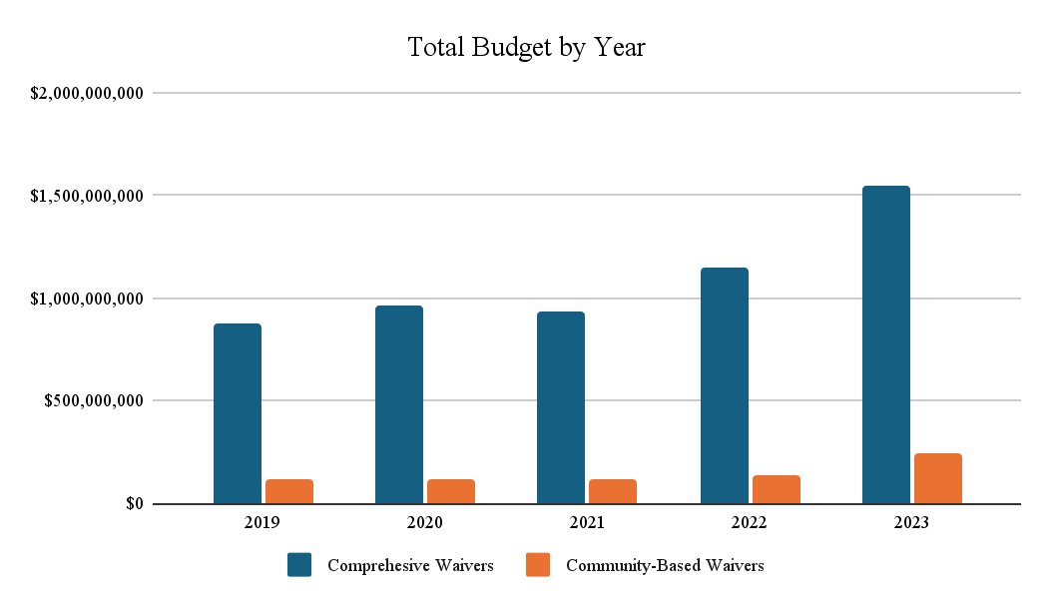
Current MO Costs HCBS
Sources - CMS-372 report and FY27 DMH Program Description Book
Notes:
Trend of HCBS costs according to CMS and the published DMH FY27 Program book

Slide 10
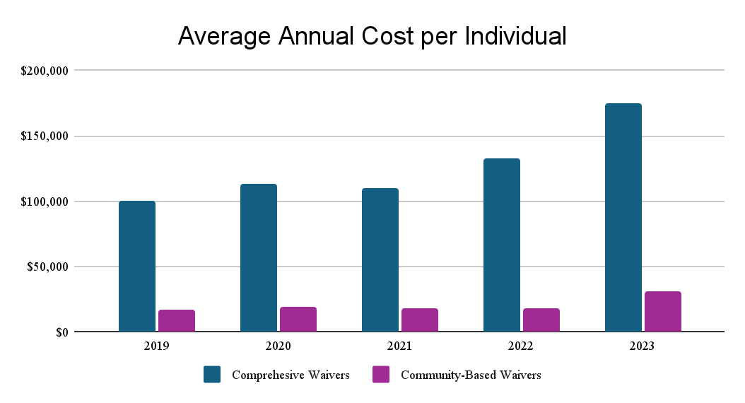
Notes:
Drilling down, cost per individiual in the community vs. at home

Slide 11
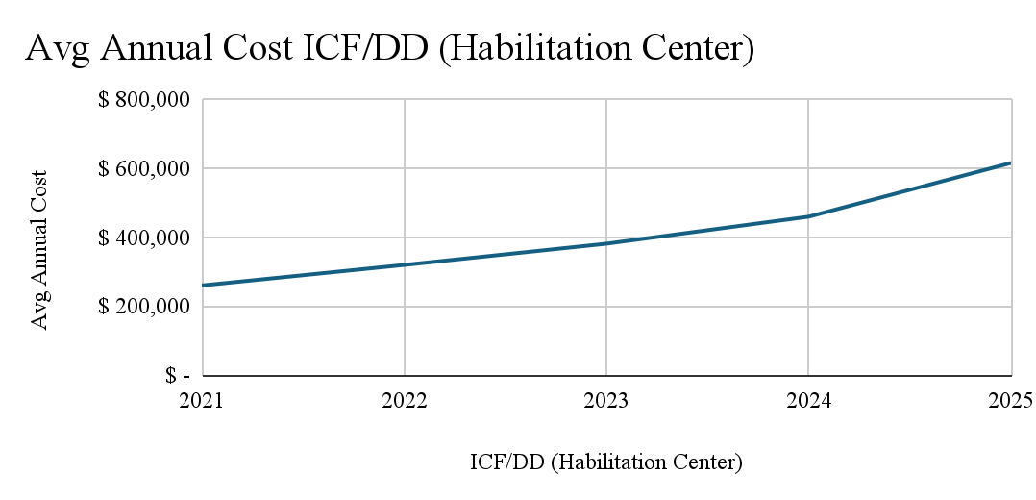
Notes:
If community supports are not funded, our population are the ones that will be added to the hab center population. National conversations so far has suggested that large congregate centers are an apporpriate

Slide 12
Legislators’ Contact Information
Senate Address 201 W. Capitol Ave. Jefferson City, MO 65101 | House Address 201 W, Capitol Ave Jefferson City MO 65101 | Representative Gregg Bush District 50 Boone Co. Rm 109-E 573-751-2134 Gregg.Bush@house.mo.gov | Representative Darin Chappell District 137 Greene Co. Rm 200-E 573-751-3819 Darin.Chappell@house.mo.gov | Representative Betsy Fogle District 135 Greene -Co. Rm 109A 573-751-9809 Betsy.Fogle@house.mo.gov
Senator Lincoln Hough District 30 Greene Co. Rm 419 573-751-1311 Lincoln.Hough@senate.mo.gov | Representative George Hruza District 89 St. Louis Co. Rm 201-G 573-751-1544 George.Hruza@house.mo.gov | Senator Tracy McCreery District 24 Sst. Louis Co. Rm 427 573-751-9762 Tracy.McCreery@senate.mo.gov | Senator Maggie Nurrenbern District 17 Clay Co. Rm 330 573-751-5282 Maggie.Nurrenbern@senate.mo.gov | Representative Melanie Stinnett District 133 Greene Co Rm 203-C 573-751-0136 Melanie.Stinnett@house.mo.gov
Notes:
Here is information on how to contact panel members, but we would like our panel to see where everyone in the audience is from. Please use the chat to list your state senator and state representative. If you don’t know who they are, list the county you live in.

Slide 13
What would you like to take away from this meeting?
Notes:
All-Vicki

Slide 14
The federal GBBB (HB1) has scheduled a massive reduction in federal Medicaid funds. Almost 18,000 Missourians currently use the HCBS portion of Medicaid funding through DMH to be healthy and safe at home, in their community, or in a residential placement. Were there FY26 cuts to DMH related to the GBBB? Do you anticipate there will there be cuts in FY27 because of the federal action? How do you plan to support families who continue to use SDS option?
Notes:
Rep Chappell- Larry

Slide 15
All users of Self-Directed Supports are required to access services through the state plan or to be denied such services before using DMH HCBS waiver services. Do you anticipate that the GBBB funding cuts will affect the DHSS budget? If so, how? What can you do to lower the impact of the funding cuts on the most vulnerable population - disabled individuals with significant support needs?
Notes:
Rep. Fogle-Vicki

Slide 16
Since HCBS waivers are optional programs, with the decrease in Medicaid funding, should we expect the existing HCBS participants to have decreases in their budgets from DMH? If so, when can we expect these changes due to the loss of Medicaid funding to go into place and what can the current HCBS participants do to minimize the impact of decreases in their budgets from DMH?
Notes:
Rep. Hough-Larry

Slide 17
Individuals in the Self-Directed Supports (SDS) model have a less restrictive environment, better community access, and are often cared for by people with deep emotional connections to them. Are legislators aware that the SDS model is much more cost-effective than the agency (provider-based) model? What is a strategy we can use to educate the rest of our elected officials of these facts?
Notes:
Sen. Nurrenbern-Vicki

Slide 18
Are legislators aware that the HCBS agency model can refuse individuals who are medically complex and/or have behavior issues? This leaves SDS as the only model that some individuals can utilize. Under what circumstances would funding be cut to a program that is the last chance for a Missourian with disabilities to stay in their home?
Notes:
Rep Hruza-Larry
This is where we should give examples of the actual refusals. I can add our experience of the support personnel waking up Nita in the middle of night and leaving

Slide 19
We realize that not all individuals have family situations that allow for self-direction and that many still needs services provided through an agency. How can we ensure that the Intellectual/Developmental Disabilities (IDD) population that uses HCBS waiver services does not receive a reduction in hourly rates or client budgets, which would result in a significant loss of services for this vulnerable population?
Notes:
Sen McCreery-Vicki

Slide 20
Given the 5-year nationwide shortage of Personal Care Attendants (also called DSPs), can the legislature consider allowing guardians to work for their adult children, as several other states have already done? Would you please explain the “why” behind the existing ban on guardians being paid to support their loved ones?
Notes:
Rep Stinnett-Larry

Slide 21
There seems to be a dramatic rise in children and young adults with developmental disabilities who have severe anger issues. We have heard parents say that they are in a behavior-based residential facility for anywhere from three months to 12 months. Has there been discussion of an increase in the budget to accommodate this need?
Notes:
Rep Bush-Vicki

Slide 22


