Slide 1
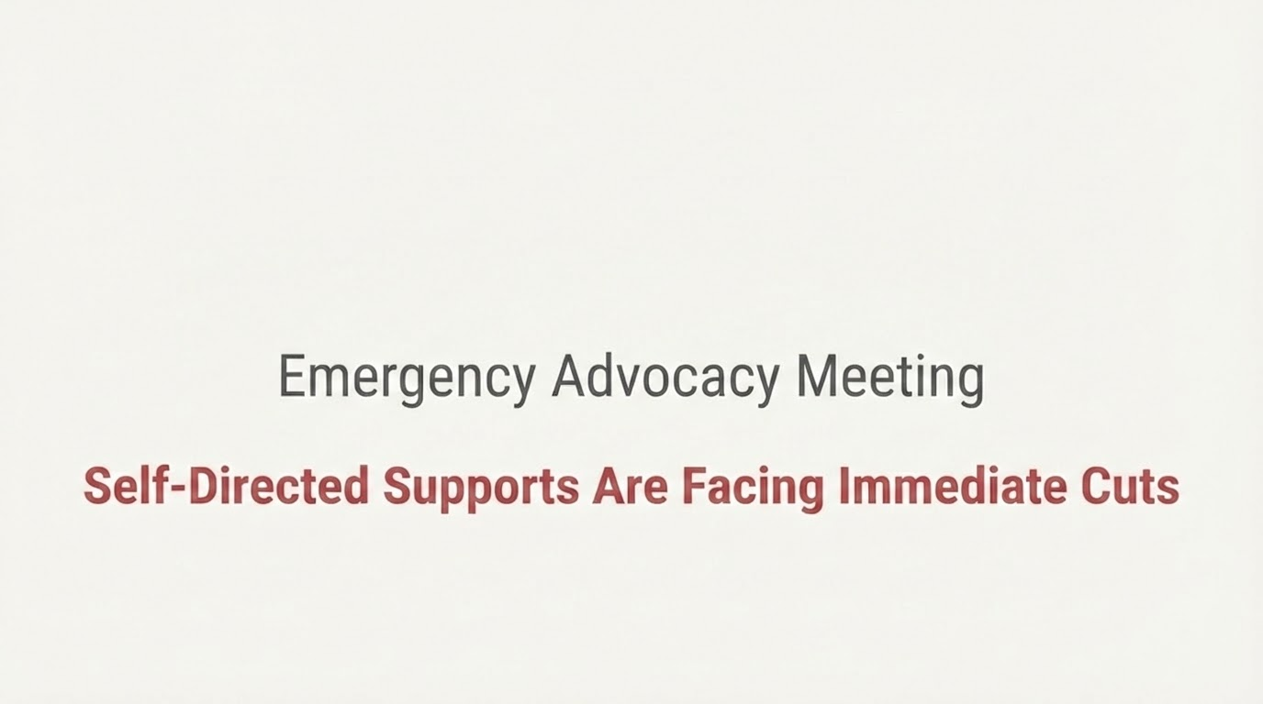


Slide 2
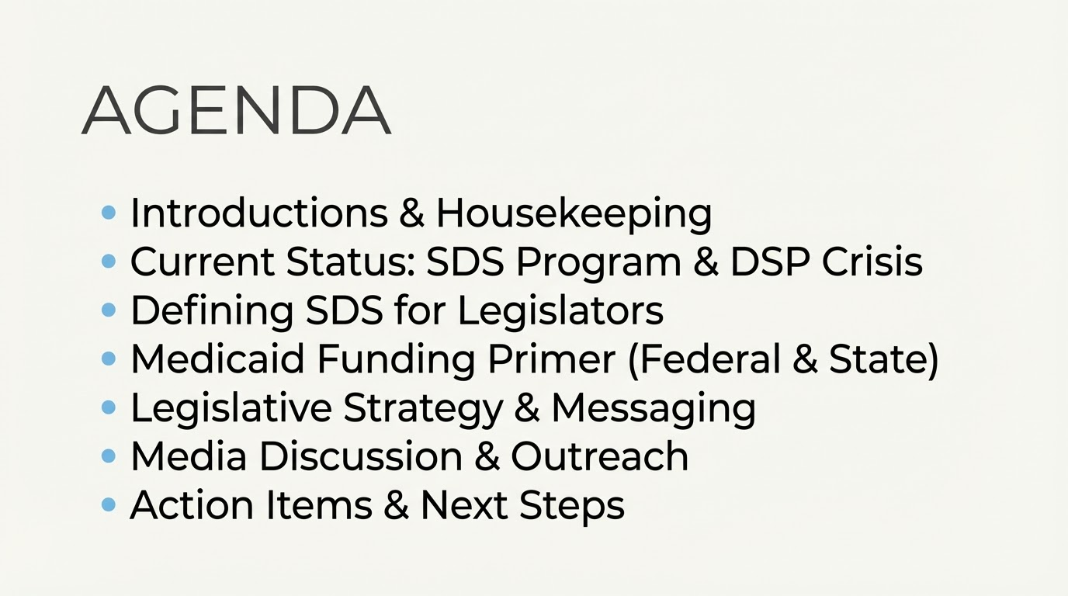

Slide 3
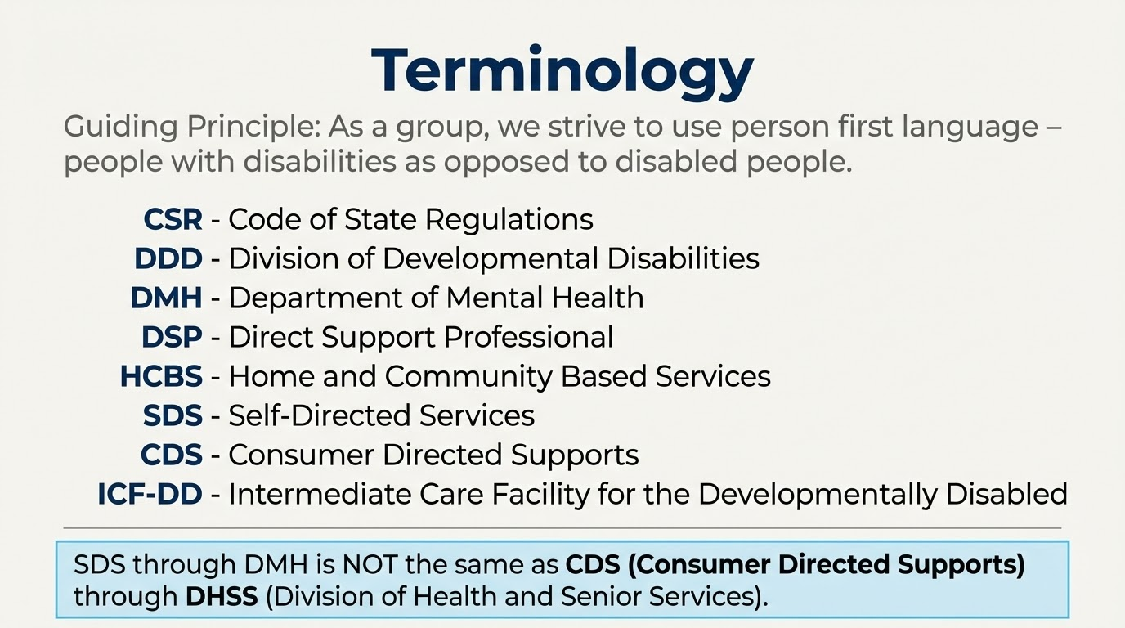

Slide 4
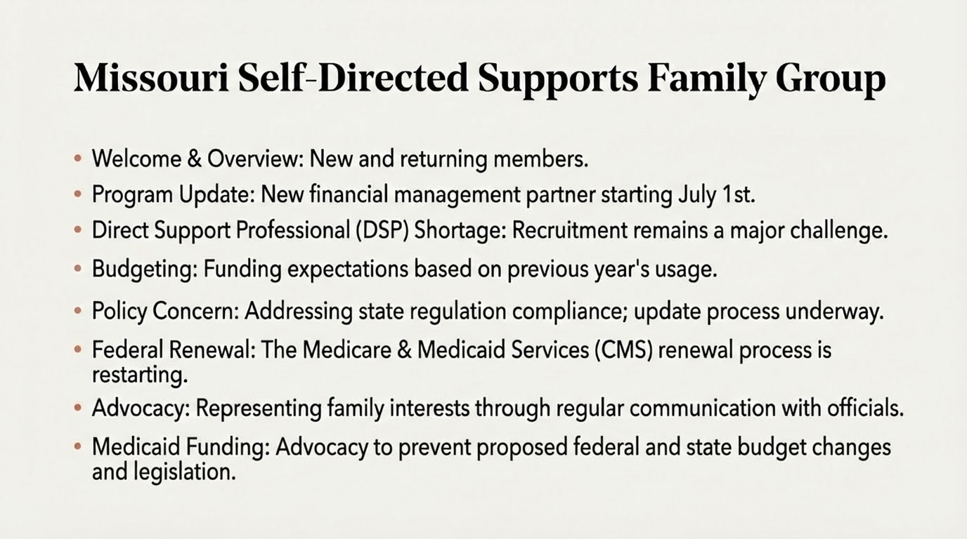
Notes:
The meeting is being recorded. If you do not want to be recorded, you can turn off your video and stay off the chat. Transcription is on. CC is available.
We will post this powerpoint and a recording on our site after the meeting.
Introductions - Housekeeping for SDS Families vs. Newcomers
SDS program status - New Fiscal Agent PPL - July 1
DSP Crisis - remains, more college students coming online (Handshake), but extreme difficulty in recruiting remains.
Budgets - if unused, expect renewal at last year actual rate.
State remains in violation of the CSR as written (since wage freeze in 2024). Origination of the CSR update process has begun.
CMS (Centers for Medicare and Medicaid Services) renewal process starting again.
This organization continues representing our stakeholders with regular communication with the department at all levels.
Medicaid Cuts - the GBBB (HR1) as passed by our federally elected legislators. DMH has presented its requests, the Governor has presented his budget, and HB10 has been filed.

Slide 5
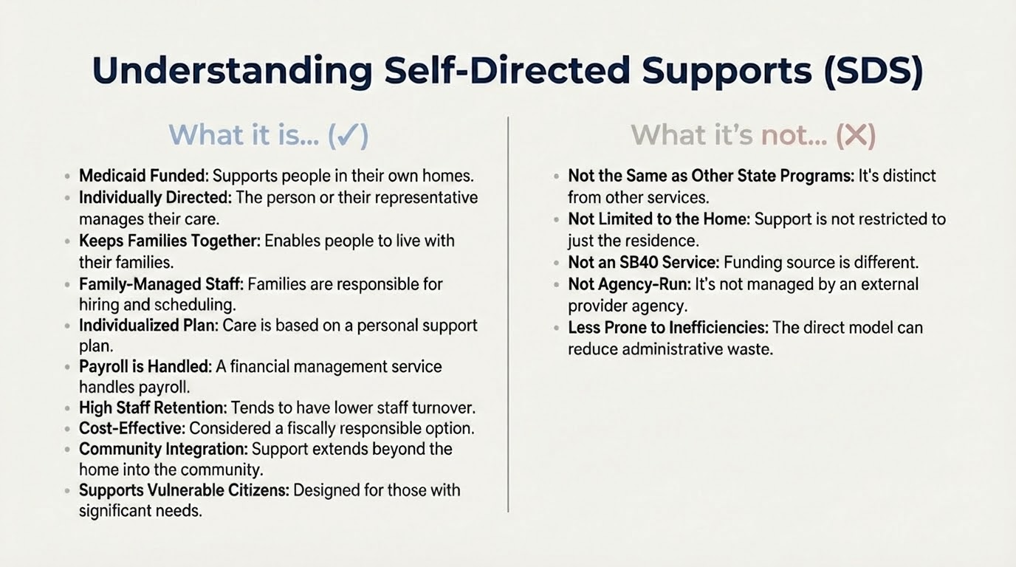
Notes:
What it is…
Medicaid Funded - HCBS Waivers
Run by individual / designated rep.
Allows families to stay together in their natural home.
DR recruits, hires, schedules, trains, and manages all DSPs with no compensation.
ISP governed - hours needed times rate.
FMS (currently Acumen-PPL) does all payroll paperwork.
Lowest turnover of staff of all DSPs.
Most fiscally efficient (vs. Providers/Hab Centers).
Lets DSPs provide support at home AND in their community, including transporting.
Supports the MOST VULNERABLE citizens.
What it’s not…
State Plan Service - DHSS (Consumer Directed Support)
Limited by services ONLY within the home.
SB40 funded service - except for P4H.
Run by an agency/provider.
Full of waste, fraud, and abuse.

Slide 6
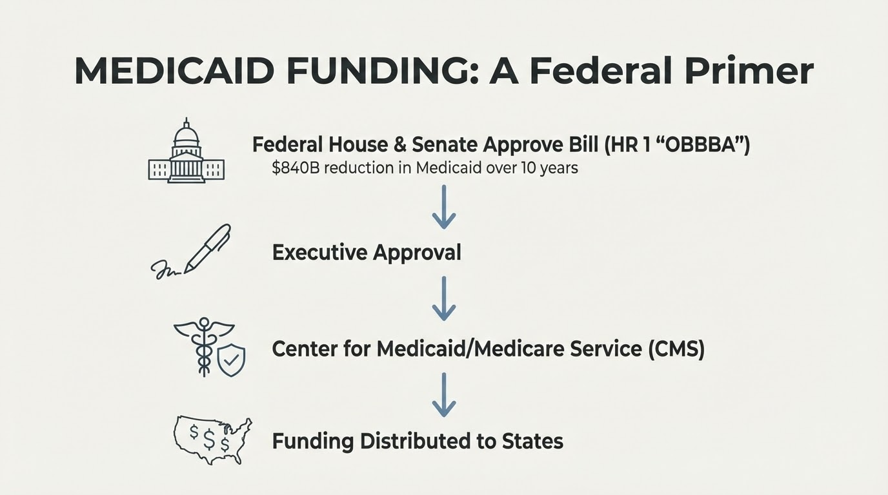
Notes:
How we got here…One Big Beautiful Bill Act , eliminate income tax, politics.

Slide 7
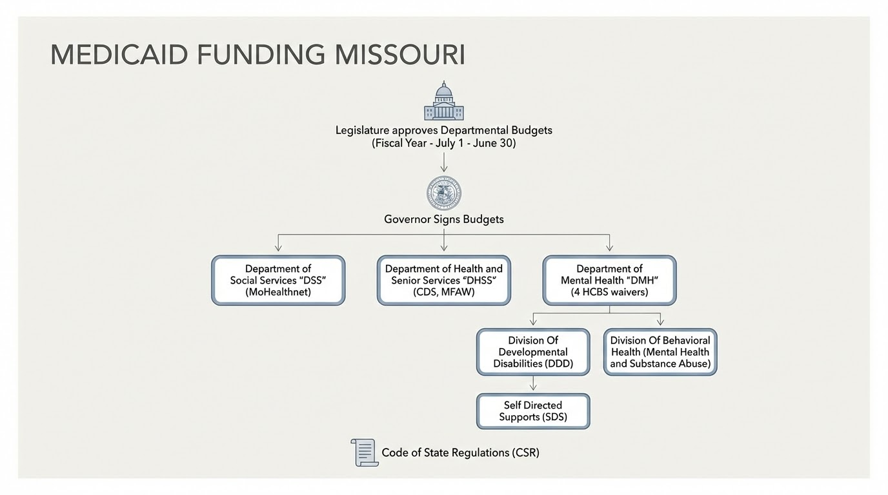
Notes:
Waivers
Federal matching funds - different percentages for different programs
Code of state regulations. History - same pay as providers, not honored in 2023, frozen in 2024, no increases since, rate study.

Slide 8
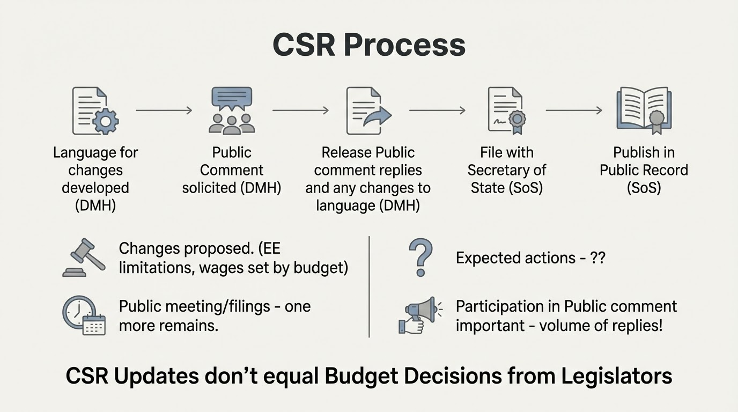
Notes:
Changes proposed. (EE limitations, wages set by budget)

Slide 9
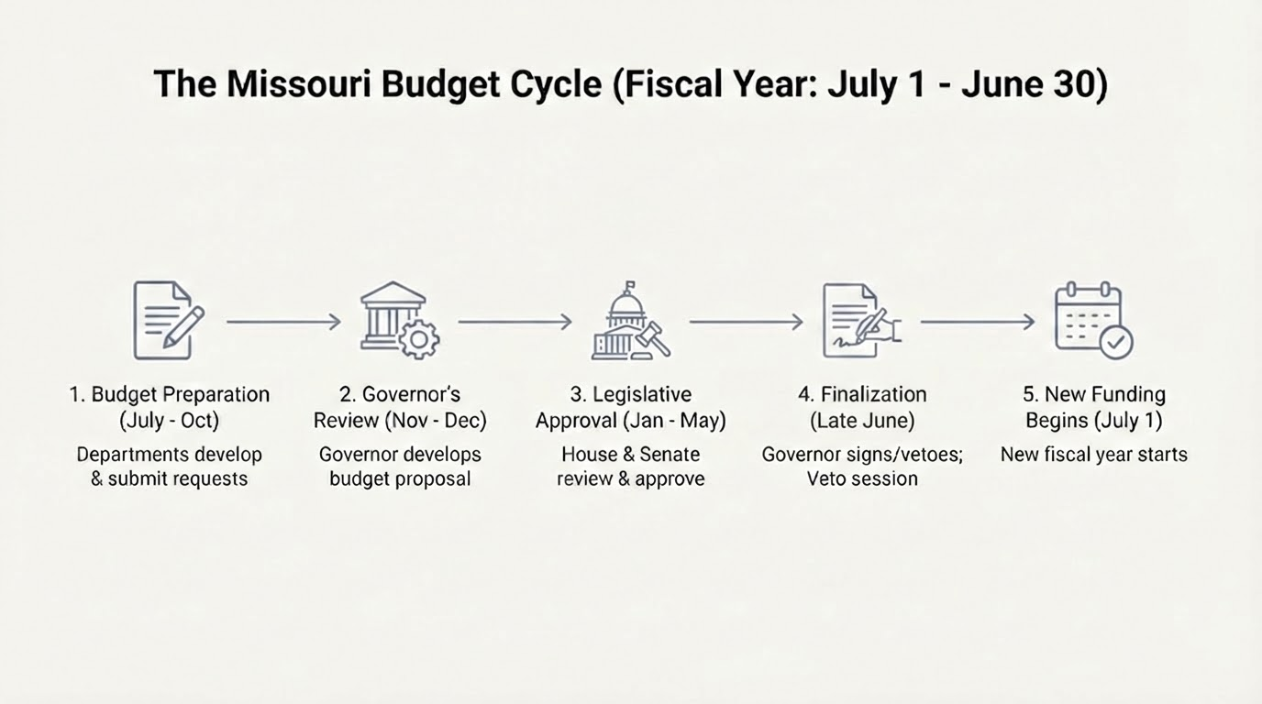
YOU ARE HERE
Notes:
Process - docs presented by DMH, governor prepared, HB 10 filed.

Slide 10
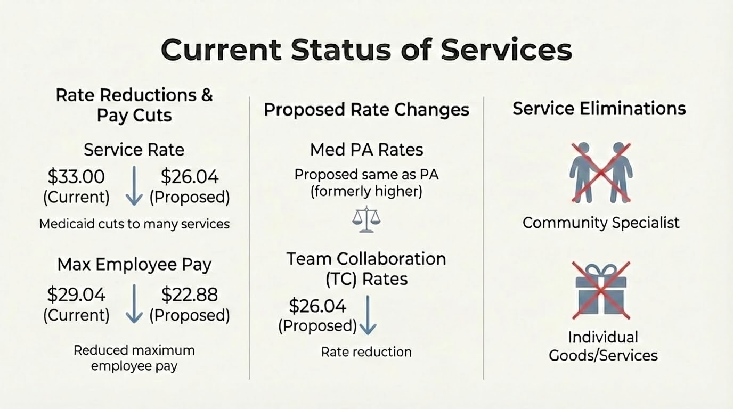
Notes:
TC - explain
Community specialist - explain
IGDS - Explain

Slide 11
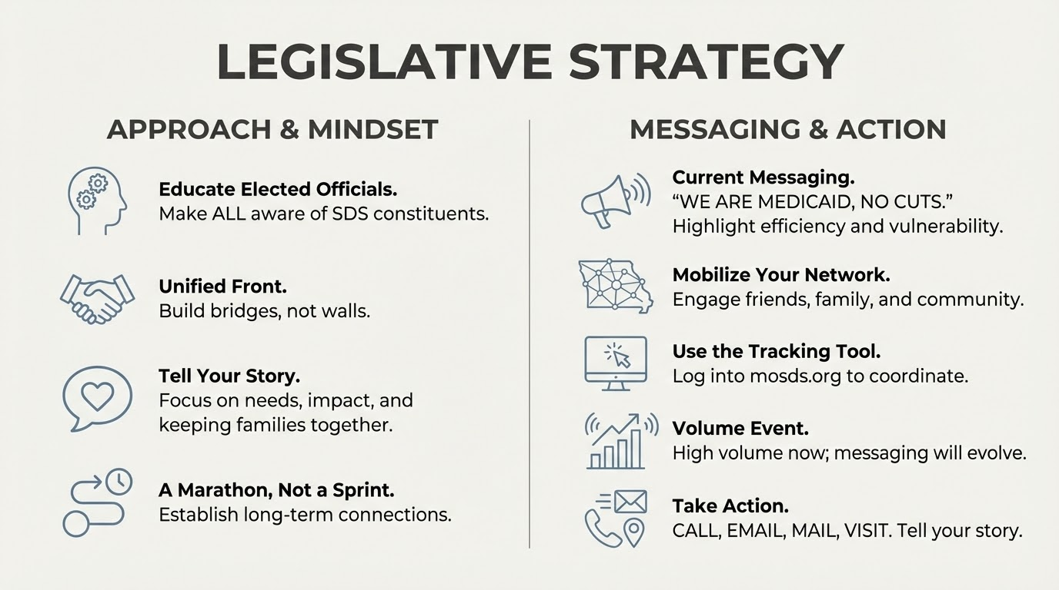
Notes:
Most elected officials are being inundated with advocacy about “their” cuts. Most know NOTHING about SDS.
Making ALL state Representatives and Senators aware of their constituents that use SDS.
Do not make this US vs.THEM at this time.
Tell your story - focus on needs, financial impact if the program is cut at all, pictures, parent/guardians employment, and keeping your family together in your home.
Current Messaging - WE ARE MEDICAID, NO CUTS TO MEDICAID. DSP crisis and we are the most vulnerable population, stay in our homes, SDS is the most fiscally efficient DSP, state plan services not appropriate (only inside the home), live a meaningful life, let parents/guardians work.
Cover up the state map!! Friends, family, caregivers, employers, employees.
Log into our tracking tool at mosds.org
This is a marathon, not a sprint. Not one and done, establish and maintain connections with lawmakers.
Currently we are at VOLUME event - messaging will change as we get more information.
CALL, EMAIL, SNAIL MAIL, in-person visits. Tell your story.

Slide 12
Total HCBS Waiver Slots by Region and Waiver
Ran: 10/29/2025 11:05:46 AM
 | Community | Comprehensive | Lopez | Partnership | Total
 | 6 | 2 | 0 | 0 | 8
Albany Regional Office | 205 | 428 | 16 | 29 | 678
Central Missouri Regional Office | 658 | 1332 | 25 | 96 | 2111
Hannibal Regional Office | 271 | 378 | 6 | 49 | 704
Joplin Regional Office | 588 | 564 | 11 | 60 | 1223
Kansas City Regional Office | 1358 | 1813 | 46 | 277 | 3494
Kirksville Regional Office | 205 | 163 | 1 | 44 | 413
Poplar Bluff Regional Office | 329 | 508 | 2 | 7 | 846
Rolla Regional Office | 557 | 614 | 21 | 190 | 1382
Sikeston Regional Office | 619 | 520 | 11 | 18 | 1168
Springfield Regional Office | 915 | 888 | 62 | 57 | 1922
St Louis Regional Office | 1414 | 1931 | 121 | 288 | 3754
Total | 7085 | 9053 | 319 | 1113 | 17570
SDS Count of Individuals | 2831 | 395 | 217 | 84 | 3527
% of Waiver participants in SDS | 40% | 4% | 68% | 8% | 20%
Notes:
Who we represent currently. Our relevance

Slide 13
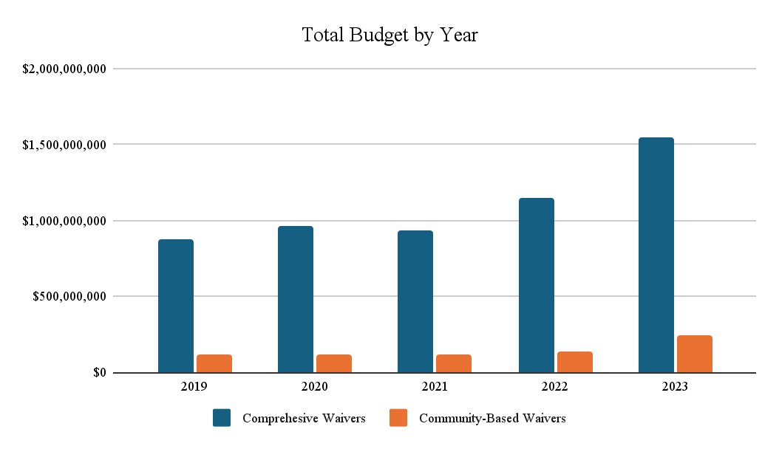
Current MO Costs HCBS
Sources - CMS-372 report and FY27 DMH Program Description Book
Notes:
Trend of HCBS costs according to CMS and the published DMH FY27 Program book

Slide 14
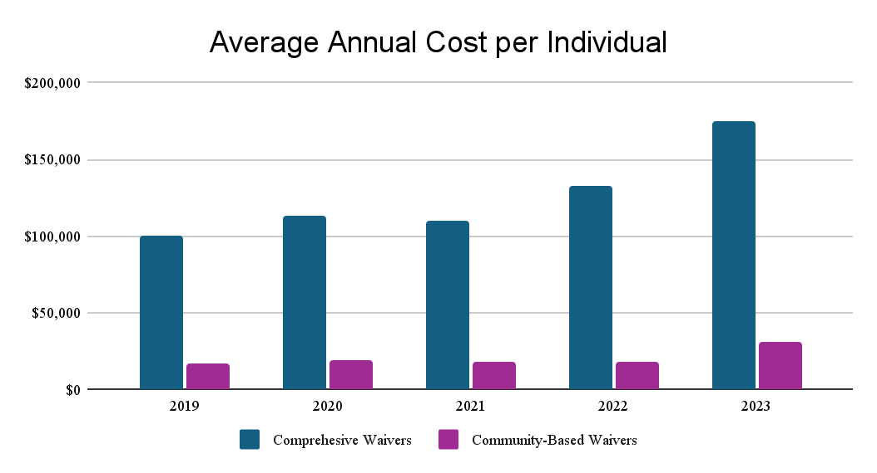
Notes:
Drilling down, cost per individiual in the community vs. at home

Slide 15
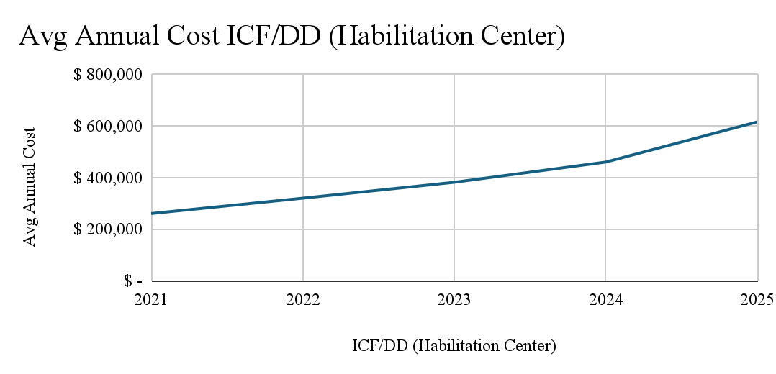
Notes:
If community supports are not funded, our population are the ones that will be added to the hab center population. National conversations so far has suggested that large congregate centers are an apporpriate

Slide 16
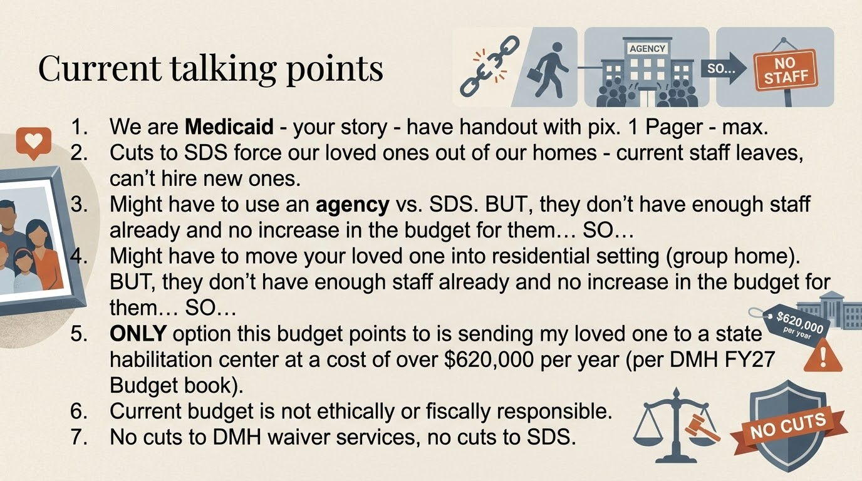

Slide 17
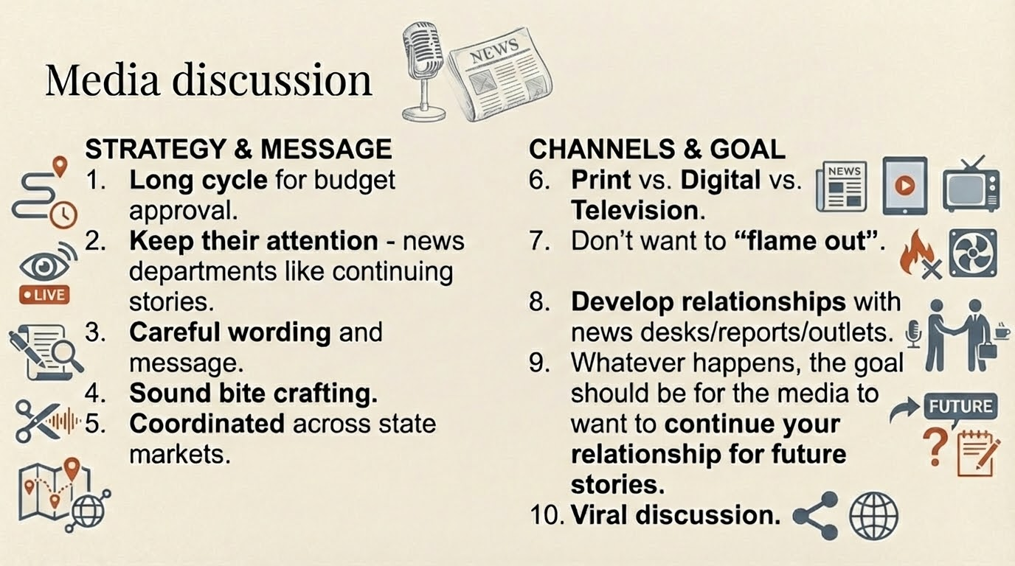

Slide 18
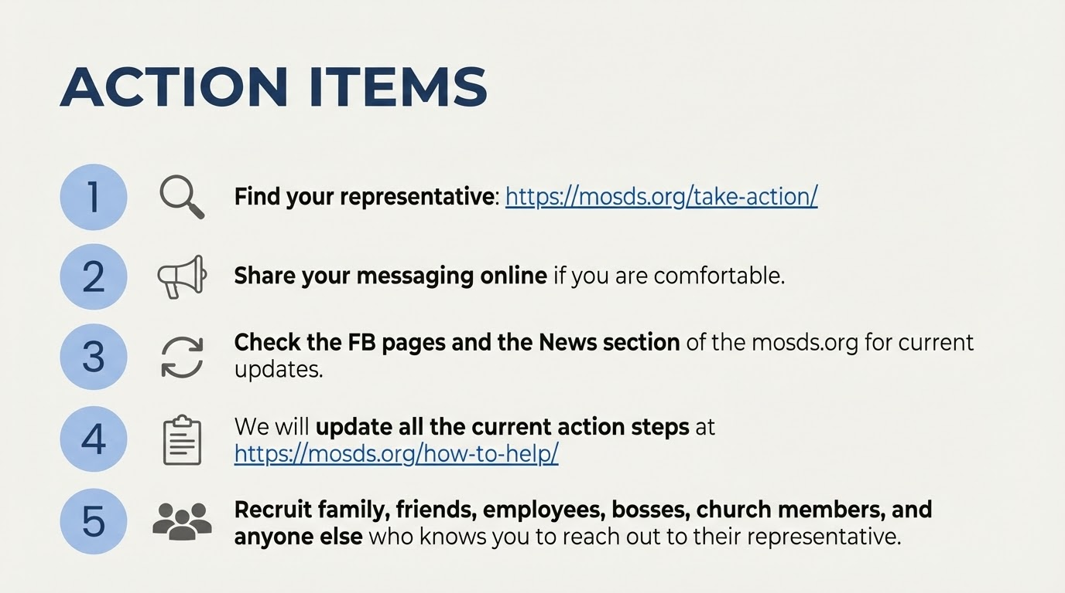
Notes:
SUPPORT SDS FAMILY GROUP - any amount.
With the $26 annual membership - you get access to Handshake and advanced sections of the website

