Slide 1
Self Directed Supports Program Updates
April 15th 2026
Katherine Cronin
Katherine.cronin@dmh.mo.gov
314-475-7616
Director of SDS

Slide 2
Fiscal Management Service Contract Status
The Fiscal Management Service (FMS) Contract award to Public Partnership LLC was protested. After review, the protest was upheld.
All FMS transition activities ended mid February.
The RFP has been posted on the MO Buys Website on 4-6-26 and closes on 4-30-26. We do not have an anticipated date for selection and award but will post that notice on our website and in DDD Weekley.
REF: State 0000000352SL Financial Management and Payroll Services
Bid Search

Slide 3
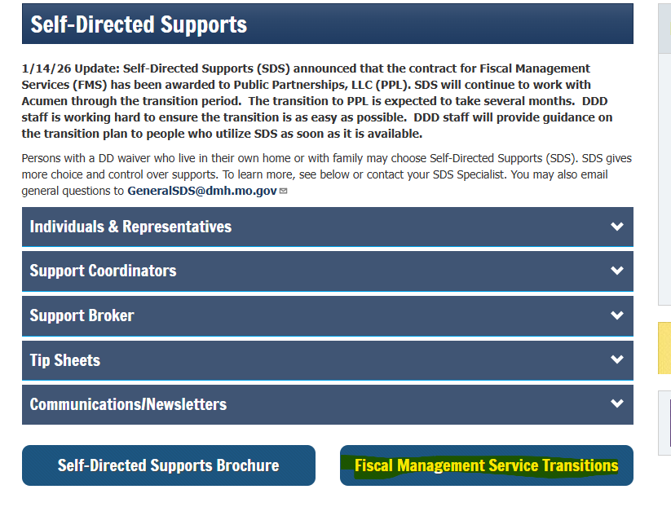

Slide 4
Where can I find information about the transition?
DDD Weekly: E-mail Blasts | dmh.mo.gov
Sign up for DDD Weekly: https://lp.constantcontactpages.com/sl/IZJqgUz
Facebook: Missouri Division of Developmental Disabilities | Jefferson City MO | Facebook
Instagram: MODIVDD (@missouri_ddd) • Instagram photos and videos

Slide 5
Where can I find my Self Directed Support Specialist ?
PCSP
Your Support Coordinator
Our General inbox generalsds@dmh.mo.gov

Slide 6
Authorizations
Currently Support Coordinators
can enter in Budgets until June 30th
This will change shortly as we extend Acumen’s contract.

Slide 7
Amendments to 9CSR 45-3.080
With regard to CSR language in Section 4, if adopted, a transition period will occur. Planning teams and Self-Directed Supports teams will work with families to transition paid staff out of roles that also hold legal responsibility over the Employer of Record.
Exceptions will not be made for any employee. From the time the amended CSR language is implemented, all new staff will need to meet the CSR requirements.

Slide 8
Section 4 Employer Rights and Responsibilities
Previous
Amended
(B) The employer may choose to hire eligible persons in accordance with the HCB waiver services requirements and with the following exceptions:
1. A spouse;
2. A parent or stepparent of an individual under age eighteen (18);
3. A legal guardian;
(B) The employer may choose to hire eligible persons in accordance with the HCB waiver services requirements and with the following exceptions:
1. A spouse;
2. A parent or stepparent of an individual under age eighteen (18);
3. Any person with legal responsibilities recognized by a Court and/or Social Security and the equivalent thereof including but not limited to Guardian, Conservator, Power of Attorney, Payee

