Slide 1

Recruiting, Hiring, Retaining, and Managing (PA/PCA/DSP) Staff
June 1, 2026
Cheryl Dennison and Victoria McMullen

Slide 2
Recruiting
  Don’t rule anyone out - training is what makes the difference
Don’t rule
  Recruit widely - Personal references, Facebook, Handshake, Care.com ( sample: Email)
Look Widely
  Have a clear job description ( sample: Job description)
Have
  Start with a positive description of the individual
Start
Include job tasks
Location(s)
Shifts needed and minimum number of hours per week
Paid training
Starting pay range
Advantages of position
Posting

Slide 3
Hiring
1
2
3
4
5
6
Have interviewees bring license, social security card, voided check, proof of high school graduation
Download the full copy of the application and fill out at end of interview if you know you want to hire
Have relias training link save and ready to text to applicant
Link: MO Abuse and Neglect
Number: 960785
Have a list of questions that you ask all applicants
Sample Questions
Notify applicant if you will be using one or two funding streams
Decide on a screening process and interview location

Slide 4
Teach with examples
Photo of correct positioning in wheelchair or stander
Video of physical therapy exercises or mealtime routine
Examples of documentation that reference individual’s goals and the level of assistance needed.
(describe if employee had to complete the task or it was individual who did it)
Goal: Maintain contact with friends and family
SUPPORT LEVEL: Verbal prompts for birthday cards; rehearsal and physical assistance for phone calls.
DOCUMENTATION: Today Ron colored, and name stamped a birthday card for his friend Jilli with verbal prompting. We reviewed his phone call script and I physically assisted him in calling his aunt Joann.

Slide 5






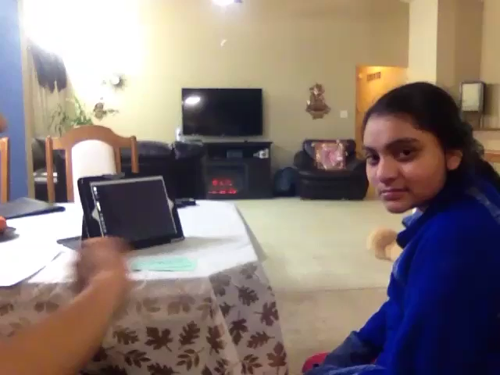
Training
(DSP Manual)
Start creating a support manual and checklist manual
Ask for funding for a community specialist
Consider using team collaboration to cross-train (DR must be present)
Create a training list
Consider using training videos
At the end of training assess employee’s, individual’s and DR’s comfort levels; provide more training if needed.

Slide 6






Supporting
After training, schedule a review ( SAMPLE: DSP Assessment)
Have staff self evaluate and have the staff set an improvement goal for themselves
Be receptive and supportive in training the staff
When there are behavior difficulties or personal hygiene emergencies, offer assistance if you are available
Offer the staff a short break to regroup whenever you feel it is appropriate
Use an app (GroupMe) to send messages to all employees

Slide 7





Scheduling
Use a shared calendar (google, ical, outlook)
Use an app (GroupMe) to have staff find replacements if they need to call off for a shift
Consider scheduling for larger block of time (by month or by semester)
Prepare for summer schedule ahead of time if using students
Be flexible - Does the shift have to start at 7:00 am?

Slide 8
Evaluating
Evaluate
Create
Provide
Remember
Provide
After hire and working alone with the individual, formally evaluate frequently during the first year; consider giving small raises frequently to maintain motivation
Create a standard list of things to evaluate
Always provide positive feedback first, set goals with the employee and follow up
Remember to recognize their progress when you see improvement
Provide raises as appropriate and as funding is available

Slide 9



Teaming
Make sure employees have each others’ contact information
Model group texting or app use for information sharing
Use team collaboration meetings for regular training and feedback with all the support staff

Slide 10




Retaining
Be positive and compliment support staff
Provide small incentives for staff.
Send support staff birthday and holiday cards
When college aged staff are moving on to full-time jobs ask for three things
Can you help find a replacement for yourself?
Would you be willing to continue working a few hours once or twice a month?
Would you be interested in supporting the individual with your presence for important events?

Slide 11

Questions?

