Slide 1
Creating an enviable life
Purpose. Belonging. Connection.
Presented by : Tamico Jones

Slide 2

An enviable life is more than a busy schedule

Slide 3
An enviable life is more than a full schedule
KNOWN
VALUED
The person is recognized for strengths, interests and contributions.
The person has real choices, authentic relationships and a meaningful role.
The goal is not simply to keep someone safe, busy or present—it is to help them build a life they genuinely want.
02
Notes:
Emphasize that each person defines success differently. An enviable life is person-centered, not a standardized schedule. This presentation explores practical ways to help people with developmental disabilities build lives that are meaningful, connected, and uniquely their own. We will look at how employment, volunteering, community involvement, relationships, and purposeful daily and weekly routines can create opportunities for belonging and personal growth.

Slide 4
Making Decisions That Support an Enviable Life

Slide 5

Purpose. Responsibility. Community. Routines. Relationships.
Purpose
Responsibility
Community
Routines
Being needed
Valued
Connected
Meaningful tasks
Making choices
Taking ownership
Build relationships
Participating
Contributing
Build:
Consistency
Confidence
Independence
Life Skills
Genuine Friendships
Trusted Connections
Choosing to be in life
-not paid staff
Relationships

Slide 6
Not Allowing Life’s Circumstances to Become an Excuse

Slide 7
An enviable life does not happen by accident. It is created when we stop allowing challenges, fear, inconvenience, or busy schedules to consistently stand between our loved one and the relationships, experiences, and opportunities they deserve.

Slide 8
It might mean:
Extra planning or travel
Trying a new social event
Supporting reasonable risk
Choosing the person's interests over convenience
The Goal:
Provide meaningful choices, encouragement and enough support for the person to experience friendship, purpose and belonging.

Slide 9
Adapt and Overcome

Slide 10
Acknowledge the barriers— but do not build a life around them.
Adjust plans
Ask for help
Find resources
Try a new approach
Continue Forward
Keep the GOAL ALIVE!!!!!!!
Notes:
because your loved one deserves more than a life limited by circumstances

Slide 11
Setting the standard and taking responsibility

Slide 12

Responsibility starts with what we can control
Teach People How to Treat You
Set clear expectations and boundaries
Speak up and communicate needs directly
Hold others accountable while working together
Follow through when change is needed
Reject disrespect and low expectations
Model dignity, respect, and self-advocacy
Know when to negotiate, escalate, or walk away

Slide 13
Maintaining Balance and Protecting Your Mental Health

Slide 14

Do not ignore your own needs – burnout is real!
Find Balance:
Knowing the difference between a true barrier and something that requires a different plan
Choosing the opportunities that matter most rather than trying to do everything
Building predictable weekly routines that include community involvement and downtime
Sharing responsibilities with family, friends, staff, providers, and natural supports
Asking for respite before reaching a crisis point
Setting healthy boundaries and allowing yourself to say no without guilt
Making time for sleep, healthcare, relationships, faith, hobbies, or counseling
Accepting that some weeks will be more successful than others
Celebrating progress without expecting perfection

Slide 15
Trust, release, Share responsibility

Slide 16

Trust others enough to share the responsibility
• Communicate expectations
• Train and support others
• Step back gradually
• Accept different—not unsafe—ways of doing
• Build more than one dependable support
Burnout can affect your health, relationships, decision-making, and the stability of your loved one’s support system.

Slide 17
Link arms and build community

Slide 18

Independence does not mean doing everything alone. Healthy lives are built through interdependence.
Community allows us to:
Share resources, information, contacts, and opportunities
Help with transportation, meals, childcare, or participation in community events
Exchange ideas and practical solutions when barriers arise
Offer emotional support without judgment
Celebrate accomplishments and encourage one another through difficult seasons
Create friendships for both people with disabilities and their caregivers
Advocate together when systems, policies, or funding create barriers
Combine our voices so decision-makers cannot easily overlook our needs
Take steps within YOUR control

Slide 19

Don’t rely on everyone else to do the work for you.
We are in this together.
One phone call.
One email.
One message.
They Matter.

Slide 20
Where do I start?

Slide 21

Family Navigation:
Family Navigation services provide families/individuals:
information on systems navigation
resources that meet their needs
advocacy training
support to complete or acquire required documentation
Family Navigators help individuals, and their families lead full lives that align with their personal goals.

Slide 22
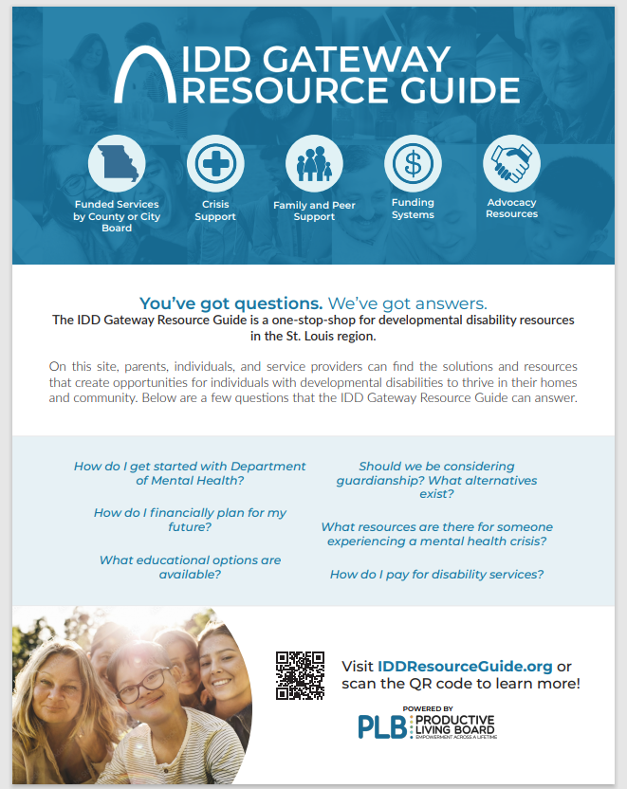
IDD Gateway resource guide website
Designed as a resource for providers, individuals and families to access information about services in one spot.

Slide 23
What does this look like in STL and MO?

Slide 24
The first “five”
Write down what is not working and where your family is need support.
Identify the three most urgent needs—such as respite, transportation, daytime support, employment, or volunteer experiences.
Contact your support coordinator or the St. Louis Regional Office and request a formal planning meeting.
Ask specifically: “What funded, non-waiver, county, and community resources are available for each of these needs?”
Set one achievable goal, assign responsibility, and establish a follow-up date.
Do not accept a vague statement that “nothing is available.”
You do not have to solve everything at once.

Slide 25
Enviable life in our community
What it could look like:
Working at a local business with job coaching and accommodations through providers such as the St. Louis Arc, Easterseals Midwest, UCP Heartland, MERS Goodwill, or RISE. Missouri’s employment directory identifies local providers offering career planning, benefits planning, job development, and supported employment. Missouri DD Employment Services Map
Volunteering regularly at a hospital, food pantry, animal shelter, library, faith community, community garden, or neighborhood organization. Mercy offers a supported volunteer program specifically for adults with developmental disabilities. Mercy Volunteer Program
Developing friendships through the J, St. Louis Arc leisure programs, local recreation centers, Special Olympics, community classes, sports, music, faith communities, or shared-interest groups. St. Louis Arc
Using familiar community spaces—libraries, parks, restaurants, museums, gyms, coffee shops, and stores—to practice communication, decision-making, money management, transportation, and social skills.
Joining self-advocacy groups such as People First and learning to speak up about personal preferences, rights, goals, and support needs. Also, Missouri’s Partners in Policymaking develops advocacy and leadership skills for people with disabilities and parents. Partners in Policymaking
Using daily and weekly routines to balance employment, volunteering, recreation, relationships, household responsibilities, rest, and personal interests.
Becoming known by name—not merely as a participant, client, or person receiving services.
A life not measure by the number of places, but rather a real sense of belonging.

Slide 26
Pivot!!!!!!

Slide 27


Slide 28
The original plan will not always work.
That does not mean the goal has to disappear—it means the approach may need to change.
Change the schedule, location, or level of support.
Try a different program, provider, activity, or transportation option.
Ask a Family Navigator or professional to help identify another route.
Break a large goal into smaller, achievable steps.
Listen to what your loved one is communicating and adjust accordingly.
Keep the goal, but remain flexible about how you reach it.
Pivoting is not quitting. It’s recognizing what isn’t working and moving in a new direction.

Slide 29
Keep the vision.
Adjust the plan.
Link arms.
Rest when needed. keep moving.
And when life gets stuck in the staircase – PIVOT!!!!

